Slide 1
SATAN’S ONSLAUGHT

Slide 2
SATAN’S ONSLAUGHT
“Therefore humble yourselves under the mighty hand of God,
that He may exalt you in due time, casting all your care upon Him, for He cares for you…
1 Peter 5:6-9

Slide 3
SATAN’S ONSLAUGHT
…Be sober, be vigilant; because your adversary the devil walks about like a roaring lion, seeking whom he may devour. Resist him, steadfast in the faith, knowing that the same sufferings are experienced by your brotherhood in the world.”
1 Peter 5:6-9

Slide 4
SATAN’S ONSLAUGHT
“My God sent His angel and
shut the lions mouths, so that they have not hurt me, because I was found innocent before Him; and also, O king, I have done no wrong before you.”
Daniel 6:22

Slide 5
SATAN’S ONSLAUGHT
“My God sent His angel and
shut the lions mouths, so that they have not hurt me, because I was found innocent before Him; and also, O king, I have done no wrong before you.”
Daniel 6:22

Slide 6
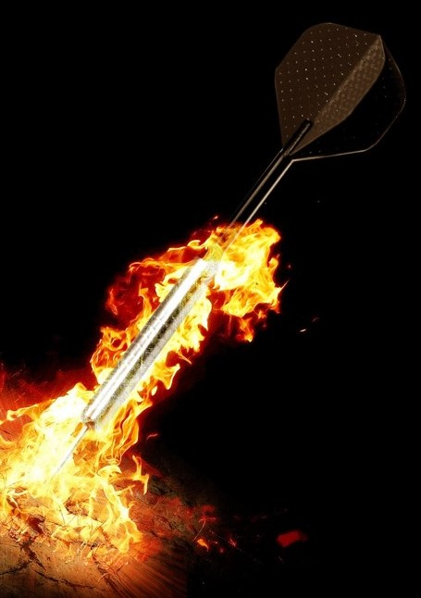
SATAN’S ONSLAUGHT
The Daily Battle

Slide 7
SATAN’S ONSLAUGHT
The Daily Battle
Who is targeted the most?
New Christians
Changing Christians
Mature Christians
Non-Christians?

Slide 8
SATAN’S ONSLAUGHT
The Daily Battle
There is no need
to go it alone!

Slide 9
SATAN’S ONSLAUGHT
The Daily Battle
“Two are better than one, Because they have a good reward for their labor. For if they fall, one will lift up his companion. But woe to him who is alone when he falls, For he has no one to help him up.”
Ecclesiastes 4:9-10

Slide 10
SATAN’S ONSLAUGHT
The Daily Battle
“Though one may be overpowered by another, two can withstand him.
And a threefold cord is not quickly broken.”
Ecclesiastes 4:12

Slide 11
SATAN’S ONSLAUGHT
How Satan Preys

Slide 12
SATAN’S ONSLAUGHT
How Satan Preys
Our Communication

Slide 13
SATAN’S ONSLAUGHT
How Satan Preys - Communication
“A soft answer turns away wrath,
But a harsh word stirs up anger.
The tongue of the wise uses knowledge rightly,
But the mouth of fools pours forth foolishness.
The eyes of the Lord are in every place, Keeping watch on the evil and the good.”
Proverbs 15:1-3

Slide 14
SATAN’S ONSLAUGHT
How Satan Preys - Communication
“An ungodly man digs up evil,
And it is on his lips like a burning fire.”
Proverbs 16:27

Slide 15
SATAN’S ONSLAUGHT
How Satan Preys - Communication
“Excellent speech is not becoming to a fool, Much less lying lips to a prince.”
Proverbs 17:7

Slide 16
SATAN’S ONSLAUGHT
How Satan Preys - Communication
“The words of a talebearer are like tasty trifles, And they go down into the inmost body.”
Proverbs 18:8

Slide 17
SATAN’S ONSLAUGHT
How Satan Preys
Our Habits

Slide 18
SATAN’S ONSLAUGHT
How Satan Preys
Lust of the Flesh, Eye, and Heart

Slide 19
SATAN’S ONSLAUGHT
How Satan Preys - Lust
“When you sit down to eat with a ruler,
Consider carefully what is before you;
and put a knife to your throat If you are a man given to appetite. Do not desire his delicacies, For they are deceptive food…
Proverbs 23:1-5

Slide 20
SATAN’S ONSLAUGHT
How Satan Preys - Lust
…Do not overwork to be rich; Because of your own understanding, cease!
Will you set your eyes on that which is not?
For riches certainly make themselves wings; They fly away like an eagle toward heaven.”
Proverbs 23:1-5

Slide 21
SATAN’S ONSLAUGHT
How Satan Preys - Lust
“Let your conduct be without covetousness; be content with such things as you have. For He Himself has said,
“I will never leave you nor forsake you.”
Hebrews 13:5

Slide 22
SATAN’S ONSLAUGHT
Putting it in God’s Hand

Slide 23
SATAN’S ONSLAUGHT
Putting it in God’s Hand
“What shall we say then? Shall we continue in sin that grace may abound? Certainly not! How shall we who died to sin live any longer in it?”
Romans 6:1-2

Slide 24
SATAN’S ONSLAUGHT
How Have You Been Faring in Your Battle With Satan?

