Slide 1
Losing
in
Order
to Win
Phil. 3: 1-11

Slide 2
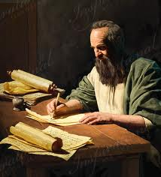
The apostle Paul…

Slide 3
The apostle Paul…
Confidence in the flesh: “I More So”
Stature: “Hebrew of the Hebrews”
Concerning the law: “Pharisee”
Concerning zeal: “Persecuting the church”
Concerning Righteousness: “Blameless”
Philippians 3: 1-11

Slide 4
Jesus’ Words…
“And he who does not take his cross and follow after Me is not worthy of Me.
He who finds his life will lose it, and he who loses his life for My sake will find it.”
Matthew 10:38-39

Slide 5
Jesus’ Words…
“So likewise, whoever of you does not forsake all that he has cannot be My disciple.”
Luke 14:33

Slide 6
Losing
in Order
to Win
Positions
Possessions
Persons
Pleasures

Slide 7
Losing in Order to Win
Positions…

Slide 8
Losing in Order to Win
Positions…
“though I also might have confidence in the
flesh. If anyone else thinks he may have confidence in the flesh, I more so: circumcised the eighth day, of the stock of Israel, of the tribe of Benjamin, a Hebrew of the Hebrews; concerning
the law, a Pharisee; concerning zeal, persecuting the church; concerning the righteousness which is in the law, blameless.”
Philippians 3:4-6

Slide 9
Losing in Order to Win
Positions…
“Yet indeed I also count all things loss for the
excellence of the knowledge of Christ Jesus my Lord, for whom I have suffered the loss of all things, and count them as rubbish, that I may gain Christ.”
Philippians 3:8

Slide 10
Losing in Order to Win
Positions…
“and be found in Him, not having my own
righteousness, which is from the law, but that which is through faith in Christ, the righteousness which is from God by faith;”
Philippians 3:9

Slide 11
Losing in Order to Win
Positions…
“that I may know Him and the power of His
resurrection, and the fellowship of His sufferings, being conformed to His death, if, by any means, I may attain to the resurrection from the dead.”
Philippians 3:10-11

Slide 12
Losing in Order to Win
Possessions…

Slide 13
Losing in Order to Win
Possessions…
“But when the young man heard that saying,
he went away sorrowful, for he had great possessions.”
Matthew 19:22

Slide 14
Losing in Order to Win
Possessions…
“But seek first the kingdom of God and His
righteousness, and all these things shall be added to you.”
Matthew 6:33

Slide 15
Losing in Order to Win
Possessions…
“not forsaking the assembling of ourselves
together, as is the manner of some, but exhorting one another,
and so much the more as you see the Day approaching.”
Hebrews 10:25

Slide 16
Losing in Order to Win
Persons…

Slide 17
Losing in Order to Win
Persons…
“He who loves father or mother more than Me is not worthy of Me. And he who loves son or daughter more than Me is not worthy of Me. And he who does not take his cross and follow after Me is not worthy of Me. He who finds his life will lose it, and he who loses his life for My sake will find it.”
Matthew 10:37-39

Slide 18
Losing in Order to Win
Persons…
“So Jesus answered and said, “Assuredly, I say to you, there is no one who has left house or brothers or sisters or father or mother or wife or children or lands,
for My sake and the gospel’s,…
Mark 10:29-30

Slide 19
Losing in Order to Win
Persons…
…who shall not receive a hundredfold now in this time—houses and brothers and sisters and mothers
and children and lands, with persecutions—
and in the age to come, eternal life.”
Matthew 10:37-38

Slide 20
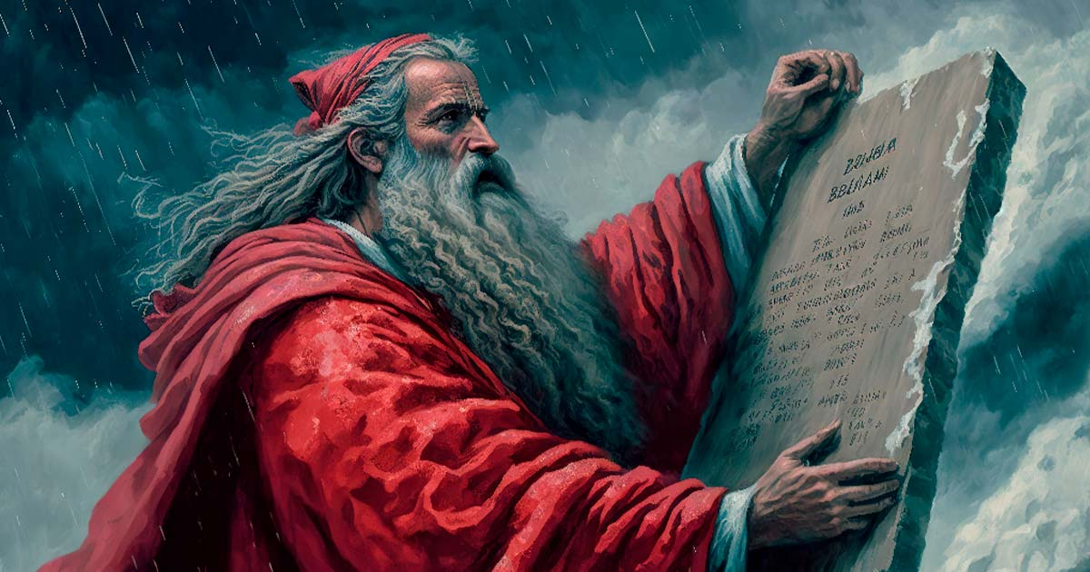
Losing in Order to Win
Pleasures…

Slide 21
Losing in Order to Win
Pleasures…
“choosing rather to suffer affliction with the people of God than to enjoy the passing pleasures of sin,”
Hebrews 11:25

Slide 22
Losing in Order to Win
Pleasures…
“Now the ones that fell among thorns are those who, when they have heard, go out and are choked with cares, riches, and pleasures of life, and bring no fruit to maturity.”
Luke 8:14

Slide 23
Losing in Order to Win
Pleasures…
“traitors, headstrong, haughty,
lovers of pleasure rather than lovers of God,”
2 Timothy 3:4

Slide 24
Losing in Order to Win
Pleasures…
“Rejoice in the Lord always. Again I will say, rejoice!”
Philippians 4:4

Slide 25
Losing
in Order
to Win
Positions
Possessions
Persons
Pleasures

Slide 26
Losing
in Order
to Win
Positions
Possessions
Persons
Pleasures
Must Be Our Mindset…
If the Lord needs anything we have, he has it.
If any of these things get in our way of serving Him, they are gone!

