Slide 1
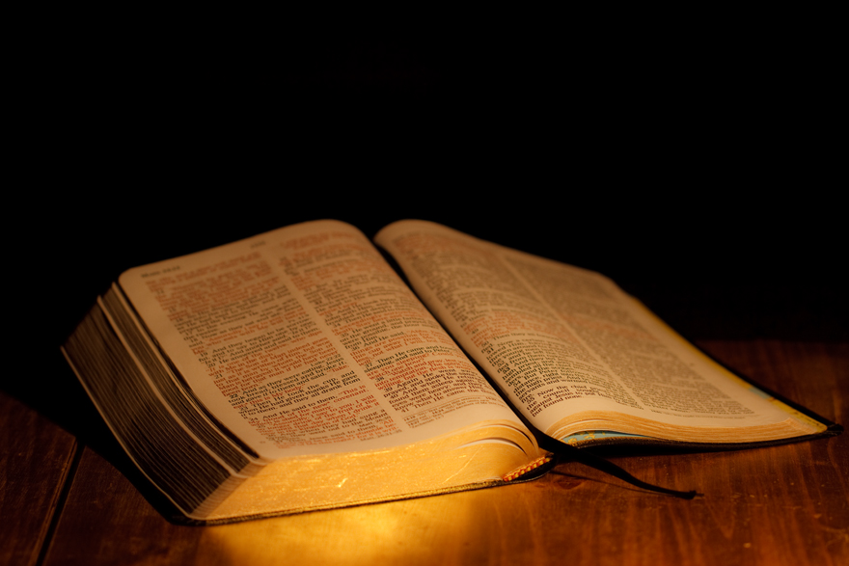
Active Protective Religion

Slide 2
The Gospel’s Twofold Power:
- Removes Sin

Slide 3
The Gospel’s Twofold Power:
- Removes Sin
“Then Peter said to them, “Repent, and let every one of you be baptized in the name of Jesus Christ for the remission of sins; and you shall receive the gift of the Holy Spirit.”
Acts 2:38

Slide 4
The Gospel’s Twofold Power:
- Removes Sin
“and that repentance and remission of sins should be preached in His name to all nations, beginning at Jerusalem.”
Luke 24:47

Slide 5
The Gospel’s Twofold Power:
- Removes Sin
- Prevents Sin

Slide 6
The Gospel’s Twofold Power:
- Removes Sin
- Prevents Sin
“My little children, these things I write to you, so that you may not sin. And if anyone sins, we have an Advocate with the Father, Jesus Christ the righteous.”
1 John 2:1

Slide 7
The Gospel’s Twofold Power:
- Removes Sin
- Prevents Sin
“Beware, brethren, lest there be in any of you an evil heart of unbelief in departing from the living God;”
Hebrews 3:12

Slide 8
The Gospel’s Twofold Power:
- Removes Sin
- Prevents Sin
“Therefore, brethren, be even more diligent to make your call and election sure, for if you do these things
you will never stumble;”
2 Peter 1:10

Slide 9
The Gospel’s Remedy for Sin
Does Not Justify Exposure:

Slide 10
The Gospel’s Remedy for Sin
Does Not Justify Exposure:
“What shall we say then?
Shall we continue in sin that grace may abound?”
Romans 6:1

Slide 11
Three Elements of Active Protective Religion:
- The Word of God
- The Worship of God
- The Work of God

Slide 12
Active Protective Religion – The Word of God

Slide 13
Active Protective Religion – The Word of God
Needed to meet God’s approval

Slide 14
Active Protective Religion – The Word of God
Needed to meet God’s approval
“Be diligent to present yourself approved to God,
a worker who does not need to be ashamed,
rightly dividing the word of truth?”
2 Timothy 2:15

Slide 15
Active Protective Religion – The Word of God
Needed to meet God’s approval
“But his delight is in the law of the Lord,
And in His law he meditates day and night.”
Psalm 1:2

Slide 16
Active Protective Religion – The Word of God
Needed to Save the Soul

Slide 17
Active Protective Religion – The Word of God
Needed to Save the Soul
“Therefore lay aside all filthiness and overflow of wickedness, and receive with meekness the implanted word, which is able to save your souls. But be doers of the word, and not hearers only, deceiving yourselves…
James 1:21-25

Slide 18
Active Protective Religion – The Word of God
Needed to Save the Soul
…or if anyone is a hearer of the word and not a doer,
he is like a man observing his natural face in a mirror;
for he observes himself, goes away, and immediately forgets what kind of man he was…
James 1:21-25

Slide 19
Active Protective Religion – The Word of God
Needed to Save the Soul
…But he who looks into the perfect law of liberty and continues in it, and is not a forgetful hearer but a doer
of the work, this one will be blessed in what he does.”
James 1:21-25

Slide 20
Active Protective Religion – The Word of God
Needed to Grow Spiritually

Slide 21
Active Protective Religion – The Word of God
Needed to Grow Spiritually
“newborn babes, desire the pure milk of the word,
that you may grow thereby,”
1 Peter 2:2

Slide 22
Active Protective Religion – The Worship of God

Slide 23
Active Protective Religion – The Worship of God
Regularly - Publicly

Slide 24
Active Protective Religion – The Worship of God
Regularly - Publicly
“Now on the first day of the week, when the disciples came together to break bread, Paul, ready to depart the next day, spoke to them and continued his message until midnight.”
Acts 20:7

Slide 25
Active Protective Religion – The Worship of God
Regularly - Publicly
“not forsaking the assembling of ourselves together, as is the manner of some, but exhorting one another, and so much the more as you see the Day approaching.”
Hebrews 10:25

Slide 26
Active Protective Religion – The Worship of God
Regularly - Publicly
“How is it then, brethren? Whenever you come together, each of you has a psalm, has a teaching, has a tongue,
has a revelation, has an interpretation.
Let all things be done for edification.”
1 Corinthians 14:26

Slide 27
Active Protective Religion – The Worship of God
Regularly - Privately

Slide 28
Active Protective Religion – The Worship of God
Regularly - Privately
“But you, when you pray, go into your room,
and when you have shut your door,
pray to your Father who is in the secret place;
and your Father who sees in secret will reward you openly.”
Matthew 6:6

Slide 29
Active Protective Religion – The Worship of God
Regularly - Privately
“But at midnight Paul and Silas were praying and singing hymns to God, and the prisoners were listening to them.”
Acts 16:25

Slide 30
Active Protective Religion – The Worship of God
Regularly - Dependently

Slide 31
Active Protective Religion – The Worship of God
Regularly - Dependently
“Nor is He worshiped with men’s hands,
as though He needed anything,
since He gives to all life, breath, and all things.”
Acts 17:25

Slide 32
Active Protective Religion – The Work of God

Slide 33
Active Protective Religion – The Work of God
Jesus Was a Worker

Slide 34
Active Protective Religion – The Work of God
Jesus Was a Worker
“I must work the works of Him who sent Me while it is day; the night is coming when no one can work.”
John 9:4

Slide 35
Active Protective Religion – The Work of God
Early Christians Were Workers
“Therefore those who were scattered
went everywhere preaching the word.”
Acts 8:4

Slide 36
Active Protective Religion – The Work of God
Word of God Produces Workers
“But he who looks into the perfect law of liberty and continues in it, and is not a forgetful hearer but a doer of the work, this one will be blessed in what he does.”
James 1:25

Slide 37
Active Protective Religion – The Work of God
Christians Need to Work
“Therefore, my beloved brethren, be steadfast, immovable, always abounding in the work of the Lord,
knowing that your labor is not in vain in the Lord.”
1 Corinthians 15:58

Slide 38
Active Protective Religion – The Work of God
Christians Need to Work
“And besides they learn to be idle, wandering about from house to house, and not only idle but also gossips and busybodies, saying things which they ought not.”
1 Timothy 5:13

Slide 39
Active Protective Religion – The Work of God
Christians Need to Work to Improve Spirituality
“Then Jesus said to those Jews who believed Him, “If you abide in My word, you are My disciples indeed. And you shall know the truth, and the truth shall make you free.”
John 8:31-32

Slide 40
Active Protective Religion – The Work of God
Christians Need to Work – Must be God’s Work
“But he who looks into the perfect law of liberty and continues in it, and is not a forgetful hearer but a doer of the work, this one will be blessed in what he does.”
James 1:25

Slide 41
Active Protective Religion – The Work of God
Christians Need to Work – Must be God’s Work
“All Scripture is given by inspiration of God, and is profitable for doctrine, for reproof, for correction, for instruction in righteousness, that the man of God may be complete, thoroughly equipped for every good work.”
2 Timothy 3:16-17

Slide 42
Active Protective Religion

Slide 43
Three Elements of Active Protective Religion:
- The Word of God
- The Worship of God
- The Work of God

