Slide 1
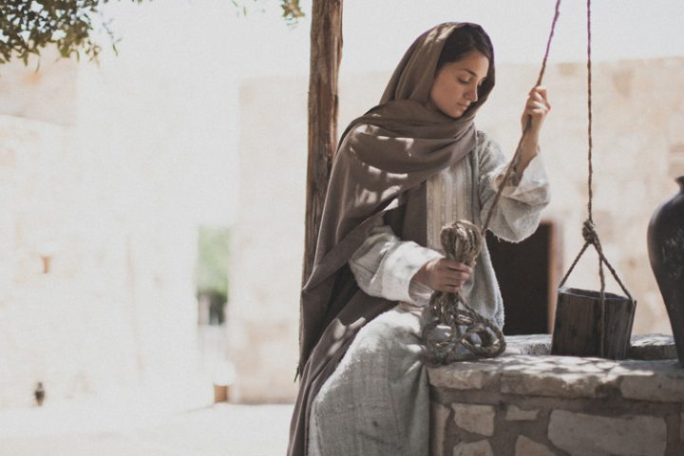
A Lesson of SHARING from Jacob’s Well

Slide 2
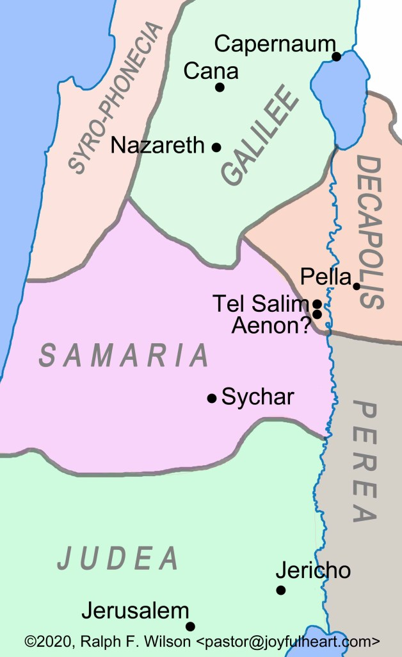
A Lesson of SHARING from Jacob’s Well
“He left Judea and departed again to Galilee.”
John 4:3
“So He came to a city of Samaria which is called Sychar, near the plot of ground that Jacob gave to his son Joseph.”
John 4:3

Slide 3
A Lesson of SHARING from Jacob’s Well
As Jesus and his disciples traveled north to Samaria they came to a city called Sychar. Jacob’s well was there.
Sychar was near Mt. Gerizim,
a peak some 2,850 feet high, about forty miles north of Jerusalem.

Slide 4
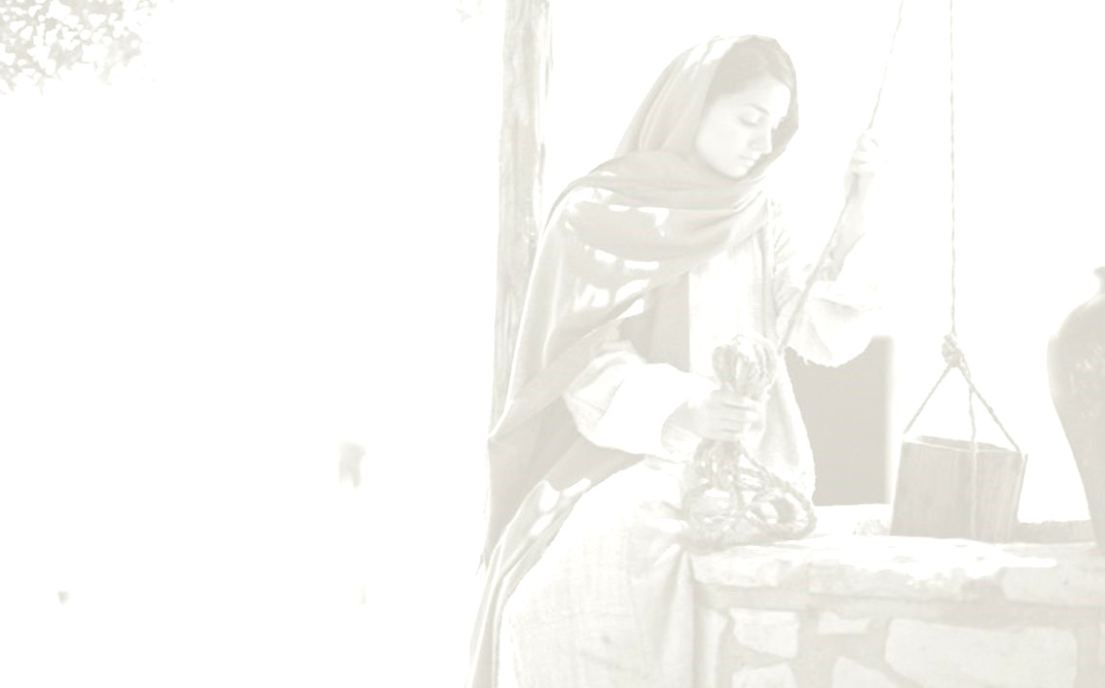
A Lesson of SHARING from Jacob’s Well
The Need That People Have
for the
Gospel

Slide 5
A Lesson of SHARING from Jacob’s Well
The Need That People Have for the Gospel
“Now, therefore, you are no longer strangers and foreigners, but fellow citizens with the saints and members of the household of God, having been built on the foundation of the apostles and prophets,
Jesus Christ Himself being the chief cornerstone,…
Ephesians 2:19-22

Slide 6
A Lesson of SHARING from Jacob’s Well
The Need That People Have for the Gospel
…in whom the whole building, being fitted together, grows into a holy temple in the Lord,
in whom you also are being built together for
a dwelling place of God in the Spirit.”
Ephesians 2:19-22

Slide 7
A Lesson of SHARING from Jacob’s Well
The Need That People Have for the Gospel
“in whom we have redemption through His blood, the forgiveness of sins.”
Colossians 1:14

Slide 8
A Lesson of SHARING from Jacob’s Well
The Need That People Have for the Gospel
“in whom are hidden all the treasures of
wisdom and knowledge.”
Colossians 2:3

Slide 9
A Lesson of SHARING from Jacob’s Well
The Need That People Have for the Gospel
“The thief does not come except to steal, and to kill, and to destroy. I have come that they may have life, and that they may have it more abundantly.”
John 10:10

Slide 10
A Lesson of SHARING from Jacob’s Well
The Need That People Have for the Gospel
“but whoever drinks of the water that I shall give him will never thirst. But the water that I shall give him will become in him a fountain of water
springing up into everlasting life.”
John 4:14

Slide 11
A Lesson of SHARING from Jacob’s Well
The Need to
Reach All People

Slide 12
A Lesson of SHARING from Jacob’s Well
The Need to Reach All People
“Then the woman of Samaria said to Him,
“How is it that You, being a Jew,
ask a drink from me, a Samaritan woman?”
For Jews have no dealings with Samaritans.”
John 4:9

Slide 13
A Lesson of SHARING from Jacob’s Well
The Need to Reach All People
“Then the Jews answered and said to Him,
“Do we not say rightly that You are a Samaritan
and have a demon?”
John 8:48

Slide 14
A Lesson of SHARING from Jacob’s Well
The Need to Reach All People
“Then Peter opened his mouth and said:
“In truth I perceive that God shows no partiality.”
Acts 10:34

Slide 15
A Lesson of SHARING from Jacob’s Well
The Need to Reach All People
“But in every nation whoever fears Him and
works righteousness is accepted by Him.”
Acts 10:35

Slide 16
A Lesson of SHARING from Jacob’s Well
The Need to Reach All People
“The woman answered and said, “I have no husband.”
Jesus said to her, “You have well said,
‘I have no husband,”
John 4:17

Slide 17
A Lesson of SHARING from Jacob’s Well
The Need to Reach All People
“for you have had five husbands, and the one whom you now have is not your husband;
in that you spoke truly.”
John 4:18

Slide 18
A Lesson of SHARING from Jacob’s Well
The Need to Reach All People
“Do you not know that the unrighteous will not inherit the kingdom of God? Do not be deceived. Neither fornicators, nor idolaters, nor adulterers, nor homosexuals, nor sodomites, nor thieves, nor covetous, nor drunkards, nor revilers, nor extortioners will inherit the kingdom of God…
1 Corinthians 6:9-11

Slide 19
A Lesson of SHARING from Jacob’s Well
The Need to Reach All People
…And such were some of you. But you were washed, but you were sanctified, but you were justified in the name of the Lord Jesus and by the Spirit of our God.”
1 Corinthians 6:9-11

Slide 20
A Lesson of SHARING from Jacob’s Well
The Need to Reach All People
“Our fathers worshiped on this mountain,
and you Jews say that in Jerusalem
is the place where one ought to worship.”
John 4:20

Slide 21
A Lesson of SHARING from Jacob’s Well
The Need to
Seize the Opportunity

Slide 22
A Lesson of SHARING from Jacob’s Well
The Need to Seize the Opportunity
“Now Jacob’s well was there. Jesus therefore,
being wearied from His journey, sat thus by the well.
It was about the sixth hour.”
John 4:6

Slide 23
A Lesson of SHARING from Jacob’s Well
The Need to Seize the Opportunity
“Jesus answered and said to her, “If you knew the gift of God, and who it is who says to you,
‘Give Me a drink,’ you would have asked Him,
and He would have given you living water.”
John 4:10

Slide 24
A Lesson of SHARING from Jacob’s Well
The Need to
Teach Just One Person

Slide 25
A Lesson of SHARING from Jacob’s Well
The Need to Teach Just One Person
“God is Spirit, and those who worship Him
must worship in spirit and truth.”
John 4:24

Slide 26
A Lesson of SHARING from Jacob’s Well
The Need to Teach Just One Person
“For what will it profit a man if he gains the whole world, and loses his own soul?”
Or what will a man give in exchange for his soul?
Mark 8:36-37

Slide 27
A Lesson of SHARING from Jacob’s Well
The Need to Teach Just One Person
“So he arose and went. And behold, a man of Ethiopia, a eunuch of great authority under Candace the queen of the Ethiopians, who had charge of all her treasury, and had come to Jerusalem to worship,”
Acts 8:27

Slide 28
A Lesson of SHARING from Jacob’s Well
The Need to Teach Just One Person
“The woman then left her waterpot,
went her way into the city, and said to the men, “Come, see a Man who told me all things that I ever did.
Could this be the Christ?”
Then they went out of the city and came to Him.”
John 4:28-30

Slide 29
A Lesson of SHARING from Jacob’s Well
The Need to Teach Just One Person
“And many of the Samaritans of that city believed in Him because of the word of the woman who testified, “He told me all that I ever did.” So when the Samaritans had come to Him, they urged Him to stay with them; and He stayed there two days. And many more believed because
of His own word.”
John 4:39-41

Slide 30
A Lesson of SHARING from Jacob’s Well
The church will not really grow
until more Christians
Learn to Imitate Jesus at Jacob’s Well

Slide 31
A Lesson of SHARING from Jacob’s Well
Four Basic Needs to Recognize…
The Need People Have for the Bible.
The Need to Reach ALL People.
The Need to Seize the Opportunity.
The Need to Teach Just One Person.

Slide 32
A Lesson of SHARING from Jacob’s Well

