Slide 1
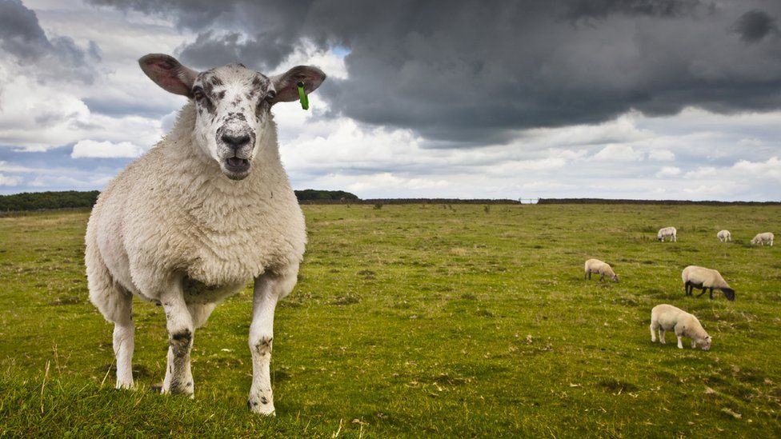
A King’s Disobedience

Slide 2
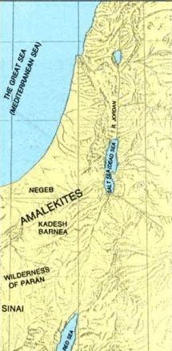
A King’s Disobedience
“Thus says the Lord of hosts: ‘I will punish Amalek for what he did to Israel, how he ambushed him on the way when he came up from Egypt. Now go and attack Amalek, and utterly destroy all that they have, and do not spare them. But kill both man and woman, infant and nursing child, ox and sheep, camel and donkey.”
1 Samuel 15:2-3

Slide 3
A King’s Disobedience
Saul was now God’s EXECUTIONER
of
VENGENCE
upon the nation of Amalek

Slide 4
A King’s Disobedience
“Then Samuel went to Saul, and Saul said to him, “Blessed are you of the Lord! I have performed the commandment of the Lord.”
1 Samuel 15:13

Slide 5
A King’s Disobedience
“Then Samuel went to Saul, and Saul said to him, “Blessed are you of the Lord! I have performed the commandment of the Lord.”
1 Samuel 15:13

Slide 6
A King’s Disobedience
“But Samuel said, “What then is this bleating of the sheep in my ears, and the lowing of the oxen which I hear?”
1 Samuel 15:14

Slide 7
The bleating and lowing had several meanings…

Slide 8
The bleating and lowing had several meanings…
It Meant That Saul Disobeyed God

Slide 9
The bleating and lowing had several meanings…
It Meant That Saul Disobeyed God
“So Samuel said, “When you were little in your own eyes, were you not head of the tribes of Israel? And did not the Lord anoint you king over Israel?”
1 Samuel 15:17

Slide 10
The bleating and lowing had several meanings…
It Meant That Saul Disobeyed God
“And Saul answered and said, “Am I not a Benjamite, of the smallest of the tribes of Israel, and my family the least of all the families of the tribe of Benjamin? Why then do you speak like this to me?”
1 Samuel 9:21

Slide 11
The bleating and lowing had several meanings…
It Meant That Saul Disobeyed God
“So when Samuel rose early in the morning to meet Saul, it was told Samuel, saying, “Saul went to Carmel, and indeed, he set up a monument for himself; and he has gone on around, passed by, and gone down to Gilgal.”
1 Samuel 15:12

Slide 12
The bleating and lowing had several meanings…
It Meant That Saul Disobeyed God
“So Samuel said: “Has the Lord as great delight in burnt offerings and sacrifices, As in obeying the voice of the Lord? Behold, to obey is better than sacrifice, And to heed than the fat of rams…
1 Samuel 15:22-23

Slide 13
The bleating and lowing had several meanings…
It Meant That Saul Disobeyed God
…For rebellion is as the sin of witchcraft,
And stubbornness is as iniquity and idolatry.
Because you have rejected the word of the Lord,
He also has rejected you from being king.”
1 Samuel 15:22-23

Slide 14
The bleating and lowing had several meanings…
It Meant That Saul Disobeyed God
“But Saul and the people spared Agag and the best of the sheep, the oxen, the fatlings, the lambs, and all that was good, and were unwilling to utterly destroy them. But everything despised and worthless, that they utterly destroyed.”
1 Samuel 15:9

Slide 15
The bleating and lowing had several meanings…
It Meant That Saul Disobeyed God
“And Saul said to Samuel, “But I have obeyed the voice of the Lord, and gone on the mission on which the Lord sent me, and brought back Agag king of Amalek; I have utterly destroyed the Amalekites.”
1 Samuel 15:20

Slide 16
The bleating and lowing had several meanings…
It Meant That Saul Disobeyed God
“but if you show partiality, you commit sin, and are convicted by the law as transgressors.”
James 2:9

Slide 17
The bleating and lowing had several meanings…
It Meant That Saul’s Disobedience Was Known

Slide 18
The bleating and lowing had several meanings…
It Meant That Saul’s Disobedience Was Known
“Then Samuel went to Saul, and Saul said to him, “Blessed are you of the Lord! I have performed the commandment of the Lord.”
1 Samuel 15:13

Slide 19
The bleating and lowing had several meanings…
It Meant That Saul’s Disobedience Was Known
“And Saul said to Samuel, “But I have obeyed the voice of the Lord, and gone on the mission on which the Lord sent me, and brought back Agag king of Amalek; I have utterly destroyed the Amalekites.”
1 Samuel 15:20

Slide 20
The bleating and lowing had several meanings…
It Meant That Saul’s Disobedience Was Known
Our Best Efforts Cannot Keep Our Secrets Forever

Slide 21
The bleating and lowing had several meanings…
It Meant That Saul’s Disobedience Was Known
“For the word of God is living and powerful, and sharper than any two-edged sword, piercing even to the division of soul and spirit, and of joints and marrow, and is a discerner of the thoughts and intents of the heart...
Hebrews 4:12-13

Slide 22
The bleating and lowing had several meanings…
It Meant That Saul’s Disobedience Was Known
…And there is no creature hidden from His sight, but all things are naked and open to the eyes of Him to whom we must give account.”
Hebrews 4:12-13

Slide 23
The bleating and lowing had several meanings…
It Meant That Saul’s Disobedience Was Known
“in the day when God will judge the secrets of men by Jesus Christ, according to my gospel.”
Romans 2:16

Slide 24
The bleating and lowing had several meanings…
It Meant Saul Must Deal With His Disobedience

Slide 25
The bleating and lowing had several meanings…
It Meant Saul Must Deal With His Disobedience
“And Saul said, “They have brought them from the Amalekites; for the people spared the best of the sheep and the oxen, to sacrifice to the Lord your God; and the rest we have utterly destroyed.”
1 Samuel 15:15

Slide 26
The bleating and lowing had several meanings…
It Meant Saul Must Deal With His Disobedience
“But the people took of the plunder, sheep and oxen, the best of the things which should have been utterly destroyed, to sacrifice to the Lord your God in Gilgal.”
1 Samuel 15:21

Slide 27
The bleating and lowing had several meanings…
It Meant Saul Must Deal With His Disobedience
“And Saul said, “They have brought them from the Amalekites; for the people spared the best of the sheep and the oxen, to sacrifice to the Lord your God; and the rest we have utterly destroyed.”
1 Samuel 15:15

Slide 28
The bleating and lowing had several meanings…
It Meant Saul Must Deal With His Disobedience
“And Saul said to Samuel, “But I have obeyed the voice of the Lord, and gone on the mission on which the Lord sent me, and brought back Agag king of Amalek; I have utterly destroyed the Amalekites.”
1 Samuel 15:20

Slide 29
The bleating and lowing had several meanings…
It Meant Saul Must Deal With His Disobedience
“But the people took of the plunder, sheep and oxen, the best of the things which should have been utterly destroyed, to sacrifice to the Lord your God in Gilgal.”
1 Samuel 15:21

Slide 30
The bleating and lowing had several meanings…
It Meant Saul Must Deal With His Disobedience
“Then Saul said to Samuel, “I have sinned, for I have transgressed the commandment of the Lord and your words, because I feared the people and obeyed their voice.”
1 Samuel 15:24

Slide 31
The bleating and lowing had several meanings…
It Meant Saul Must Deal With His Disobedience
“If we confess our sins, He is faithful and just to forgive us our sins and to cleanse us from all unrighteousness.”
1 John 1:9

Slide 32
The bleating and lowing had several meanings…
It Meant Saul Must Deal With His Disobedience
“But Samuel said to Saul, “I will not return with you, for you have rejected the word of the Lord, and the Lord has rejected you from being king over Israel.”
1 Samuel 15:26

Slide 33
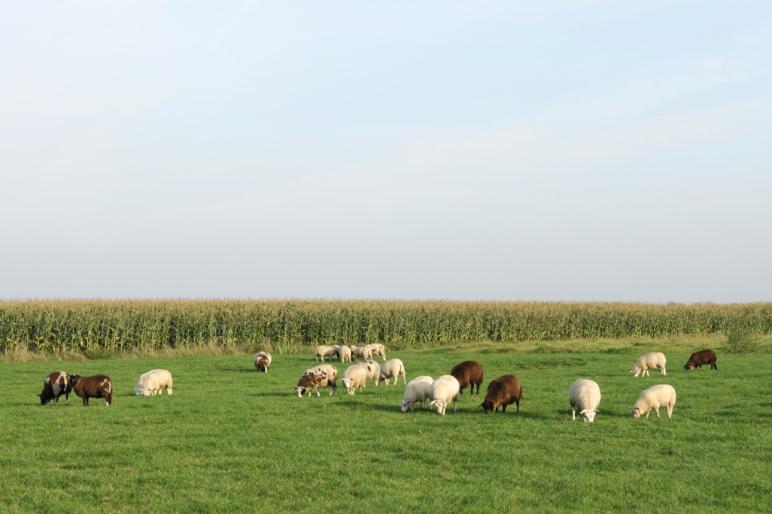
THINK YOU CAN KEEP A SIN SECRET?
A King’s Disobedience

Slide 34
THINK YOU CAN KEEP A SIN SECRET?
“But if you do not do so, then take note, you have sinned against the Lord; and be sure your sin will find you out.”
Numbers 32:23
A King’s Disobedience

Slide 35
THINK YOU CAN KEEP A SIN SECRET?
“lest, when I come again, my God will humble me among you, and I shall mourn for many who have sinned before and have not repented of the uncleanness, fornication, and lewdness which they have practiced.”
2 Corinthians 12:21
A King’s Disobedience

Slide 36
A King’s Disobedience

