Slide 1
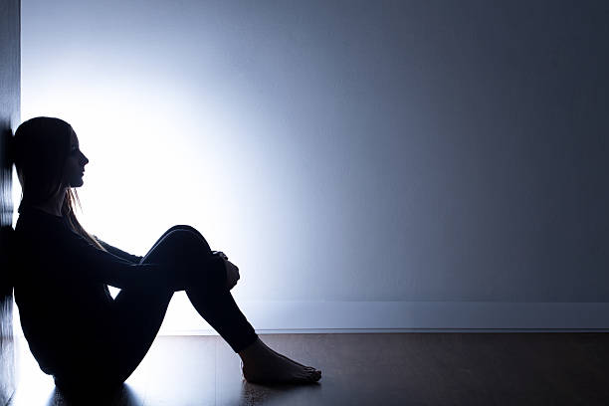
Why Does Life Appear to Be So Unfair?

Slide 2
Why Does Life Appear to Be So Unfair?
“He was in the world, and the world was made through Him, and the world did not know Him. He came to His own, and His own did not receive Him.”
John 1:10-11

Slide 3
Life
is not always
Fair

Slide 4
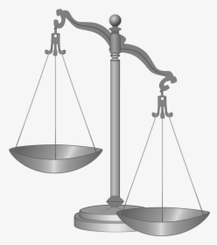
Why Does Life Appear to Be So Unfair?
We Are Living in a Sin Cursed World

Slide 5
Why Does Life Appear to Be So Unfair?
We Are Living in a Sin Cursed World
“Then to Adam He said, Because you have heeded the voice of your wife, and have eaten from the tree of which I commanded you, saying, ‘You shall not eat of it’: Cursed is the ground for your sake; In toil you shall eat of it All the days of your life…
Genesis 3:17-19

Slide 6
Why Does Life Appear to Be So Unfair?
We Are Living in a Sin Cursed World
…Both thorns and thistles it shall bring forth for you, And you shall eat the herb of the field. In the sweat of your face you shall eat bread Till you return to the ground, For out of it you were taken; For dust you are,
And to dust you shall return.”
Genesis 3:17-19

Slide 7
Why Does Life Appear to Be So Unfair?
We Are Living in a Sin Cursed World
“that you may be sons of your Father in heaven; for He makes His sun rise on the evil and on the good, and sends rain on the just and on the unjust.”
Matthew 5:45

Slide 8
Why Does Life Appear to Be So Unfair?
We Must Live With the Bad Choices of Others

Slide 9
Why Does Life Appear to Be So Unfair?
We Must Live With the Bad Choices of Others
“I call heaven and earth as witnesses today against you, that I have set before you life and death, blessing and cursing; therefore choose life, that both you and your descendants may live;”
Deuteronomy 30:19

Slide 10
Why Does Life Appear to Be So Unfair?
We Must Live With the Bad Choices of Others
“The soul who sins shall die. The son shall not bear the guilt of the father, nor the father bear the guilt of the son. The righteousness of the righteous shall be upon himself, and the wickedness of the wicked shall be upon himself.”
Ezekiel 18:20

Slide 11
Why Does Life Appear to Be So Unfair?
We Must Live With the Bad Choices of Others
“you shall not bow down to them nor serve them. For I, the Lord your God, am a jealous God, visiting the iniquity of the fathers upon the children to the third and fourth generations of those who hate Me,”
Exodus 20:5

Slide 12
Why Does Life Appear to Be So Unfair?
We Must Live With the Bad Choices of Others
“Remember the word that I said to you, ‘A servant is not greater than his master.’ If they persecuted Me, they will also persecute you. If they kept My word, they will keep yours also.”
John 15:20

Slide 13
Why Does Life Appear to Be So Unfair?
We Must Live With the Bad Choices of Others
“Yes, and all who desire to live godly in Christ Jesus will suffer persecution.”
2 Timothy 3:12

Slide 14
Nearly every choice
made
affects
someone else

Slide 15
Why Does Life Appear to Be So Unfair?
We Must Live With Our Own Past Bad Choices

Slide 16
Why Does Life Appear to Be So Unfair?
We Must Live With Our Own Past Bad Choices
“And He said to them, “Go into all the world and preach the gospel to every creature. He who believes and is baptized will be saved; but he who does not believe will be condemned.”
Mark 16:15-16

Slide 17
Why Does Life Appear to Be So Unfair?
We Must Live With Our Own Past Bad Choices
“But if we walk in the light as He is in the light, we have fellowship with one another, and the blood of Jesus Christ His Son cleanses us from all sin…
1 John 1:7-9

Slide 18
Why Does Life Appear to Be So Unfair?
We Must Live With Our Own Past Bad Choices
…If we say that we have no sin, we deceive ourselves, and the truth is not in us. If we confess our sins, He is faithful and just to forgive us our sins and to cleanse us from all unrighteousness.”
1 John 1:7-9

Slide 19
Why Does Life Appear to Be So Unfair?
We Must Recognize That Our Finite Minds Are Poor Judges of Fairness…

Slide 20
Why Does Life Appear to Be So Unfair?
We Must Recognize That Our Finite Minds Are Poor Judges of Fairness…
“Yet you say, ‘The way of the Lord is not fair.’ Hear now, O house of Israel, is it not My way which is fair, and your ways which are not fair.”
Ezekiel 18:25

Slide 21
Why Does Life Appear to Be So Unfair?
We Must Also Remember That All Injustice Will Not Be Rectified Until We Reach Heaven…

Slide 22
Why Does Life Appear to Be So Unfair?
We Must Also Remember That All Injustice Will Not Be Rectified Until We Reach Heaven…
“Nevertheless we, according to His promise, look for new heavens and a new earth in which righteousness dwells.”
2 Peter 3:13

