Slide 1
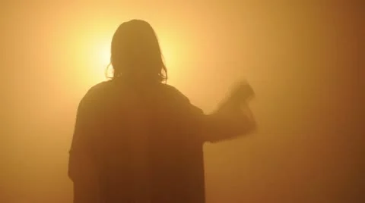
WHAT DEMONS “KNOW”
Luke 4: 40 - 41

Slide 2
We can know the Truth!

Slide 3
“For since the creation of the world His invisible attributes are clearly seen, being understood by the things that are made, even His eternal power and Godhead, so that they are without excuse, because, although they knew God, they did not glorify Him as God, nor were thankful, but became futile in their thoughts, and their foolish hearts were darkened.”
Romans 1:20-21

Slide 4
“For they being ignorant of God’s righteousness, and seeking to establish their own righteousness, have not submitted to the righteousness of God.”
Romans 10:3

Slide 5
“For the time will come when they will not endure sound doctrine, but according to their own desires, because they have itching ears, they will heap up for themselves teachers; and they will turn their ears away from the truth, and be turned aside to fables.”
2 Timothy 4:3-4

Slide 6
Many reject the very Truth that can save them!

Slide 7
Demons know that there is One True God

Slide 8
Demons know that there is One True God
“You believe that there is one God. You do well. Even the demons believe—and tremble!”
James 2:19

Slide 9
Demons know that there is One True God
“They profess to know God, but in works they deny Him, being abominable, disobedient, and disqualified for every good work.”
Titus 1:16

Slide 10
Demons know that there is One True God
“and to give you who are troubled rest with us when the Lord Jesus is revealed from heaven with His mighty angels, in flaming fire taking vengeance on those who do not know God, and on those who do not obey the gospel of our Lord Jesus Christ…
2 Thessalonians 1:7-9

Slide 11
Demons know that there is One True God
…These shall be punished with everlasting destruction from the presence of the Lord and from the glory of His power,”
2 Thessalonians 1:7-9

Slide 12
Demons know that there is One True God
“Knowing, therefore, the terror of the Lord, we persuade men; but we are well known to God, and I also trust are well known in your consciences.”
2 Corinthians 5:11

Slide 13
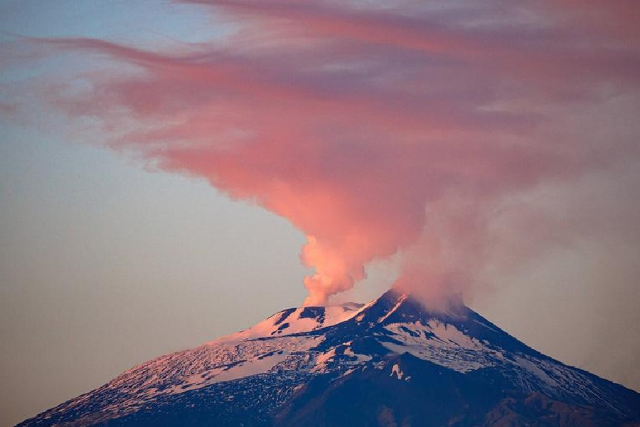
Demons know that Jesus is the Christ

Slide 14
Demons know that Jesus is the Christ
“And demons also came out of many, crying out and saying, “You are the Christ, the Son of God!”
And He, rebuking them, did not allow them to speak, for they knew that He was the Christ.”
Luke 4:41

Slide 15
Demons know that Jesus is the Christ
“Now in the synagogue there was a man who had a spirit of an unclean demon. And he cried out with a loud voice, saying, “Let us alone! What have we to do with You, Jesus of Nazareth? Did You come to destroy us? I know who You are—the Holy One of God!”
Luke 4:33-34

Slide 16
Demons know that Jesus is the Christ
“Nor is there salvation in any other, for there is no other name under heaven given among men by which we must be saved.”
Acts 4:12

Slide 17
Demons know that Jesus is the Christ
“Therefore I said to you that you will die in your sins; for if you do not believe that I am He, you will die in your sins.”
John 8:24

Slide 18
Demons know that Jesus is the Christ
“Many will say to Me in that day, ‘Lord, Lord, have we not prophesied in Your name, cast out demons in Your name, and done many wonders in Your name?’ And then I will declare to them, ‘I never knew you; depart from Me, you who practice lawlessness!”
Matthew 7:22-23

Slide 19
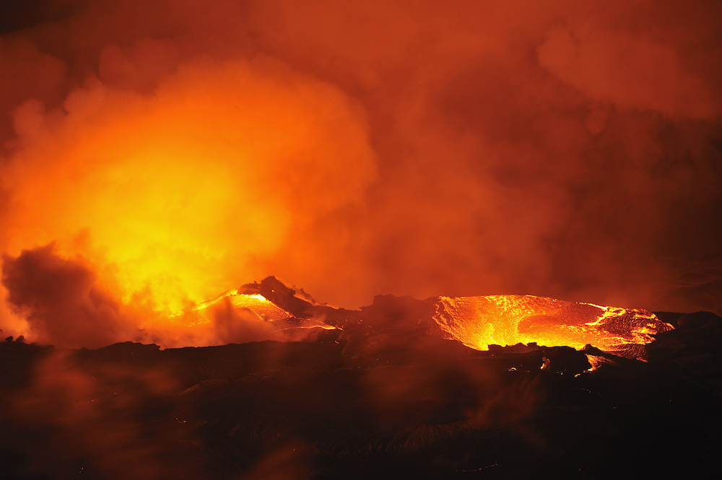
Demons know True Apostles

Slide 20
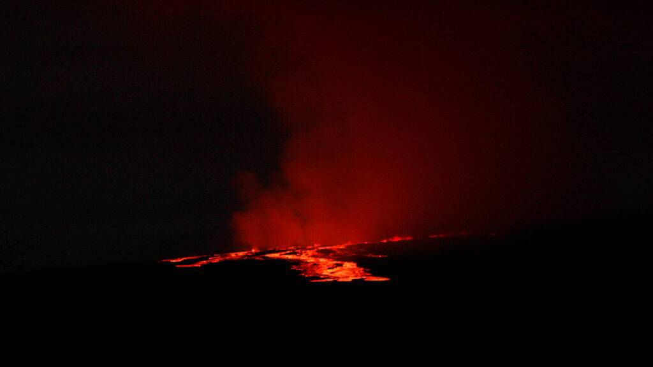
Demons know True Apostles
“And the evil spirit answered and said, “Jesus I know, and Paul I know; but who are you?”
Acts 19:15

Slide 21
Demons know True Apostles
“They profess to know God, but in works they deny Him, being abominable, disobedient, and disqualified for every good work.”
Titus 1:16

Slide 22
Demons know True Apostles
“I know your works, your labor, your patience, and that you cannot bear those who are evil. And you have tested those who say they are apostles and are not, and have found them liars;”
Revelation 2:2

Slide 23
Demons know True Apostles
“Truly the signs of an apostle were accomplished among you with all perseverance, in signs and wonders and mighty deeds.”
2 Corinthians 12:12

Slide 24
Demons know True Apostles
“But even if we, or an angel from heaven, preach any other gospel to you than what we have preached to you, let him be accursed.”
Galatians 1:8

Slide 25
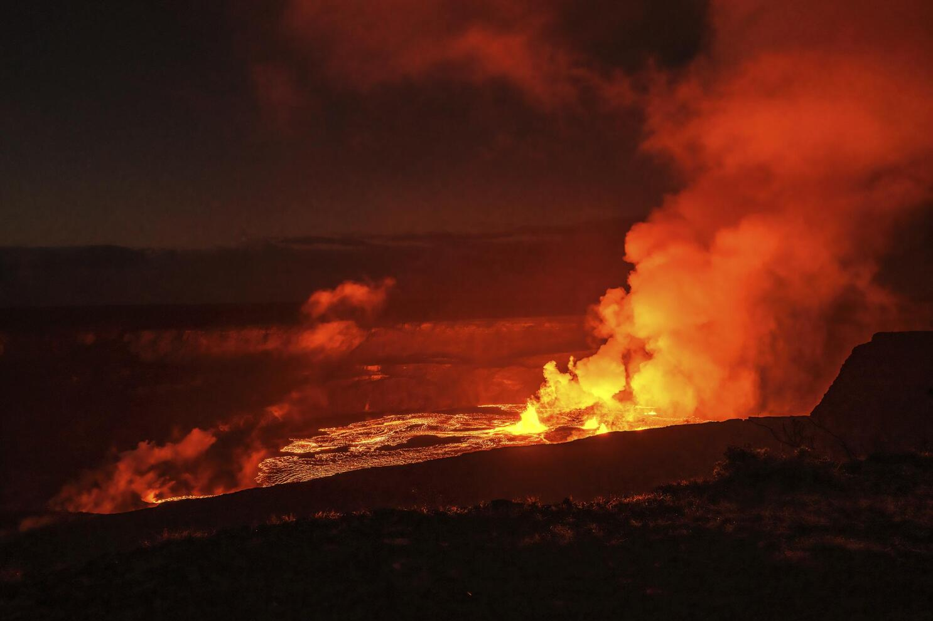
Demons know Their Destruction is Coming

Slide 26
Demons know Their Destruction is Coming
“But even if we, or an angel from heaven, preach any other gospel to you than what we have preached to you, let him be accursed.”
Galatians 1:8

Slide 27
Demons know Their Destruction is Coming
“Then He will also say to those on the left hand, ‘Depart from Me, you cursed, into the everlasting fire prepared for the devil and his angels:”
Matthew 25:41

Slide 28
“True” Christians Know what the Demons Know

Slide 29
“True” Christians Know what the Demons Know
“You therefore, beloved, since you know this beforehand, beware lest you also fall from your own steadfastness, being led away with the error of the wicked; but grow in the grace and knowledge of our Lord and Savior Jesus Christ. To Him be the glory both now and forever. Amen.”
2 Peter 3:17-18

