Slide 1
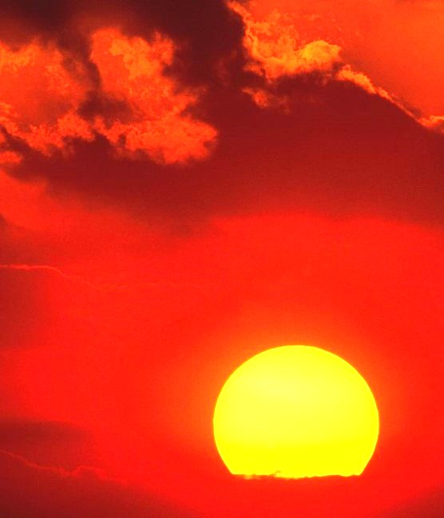
PAUL’S GREAT DILEMMA Philippians 1:21-24

Slide 2
PAUL’S GREAT DILEMMA
“so that it has become evident to the whole palace guard, and to all the rest, that my chains are in Christ;”
Philippians 1:13

Slide 3
PAUL’S GREAT DILEMMA
“and most of the brethren in the Lord, having become confident by my chains, are much more bold to speak the word without fear.”
Philippians 1:14

Slide 4
PAUL’S GREAT DILEMMA
“For to me, to live is Christ, and to die is gain. But if I live on in the flesh, this will mean fruit from my labor; yet what I shall choose I cannot tell.”
Philippians 1:21-22

Slide 5
PAUL’S GREAT DILEMMA
“For I am hard-pressed between the two, having a desire to depart and be with Christ, which is far better. Nevertheless to remain in the flesh is more needful for you.”
Philippians 1:23-24

Slide 6
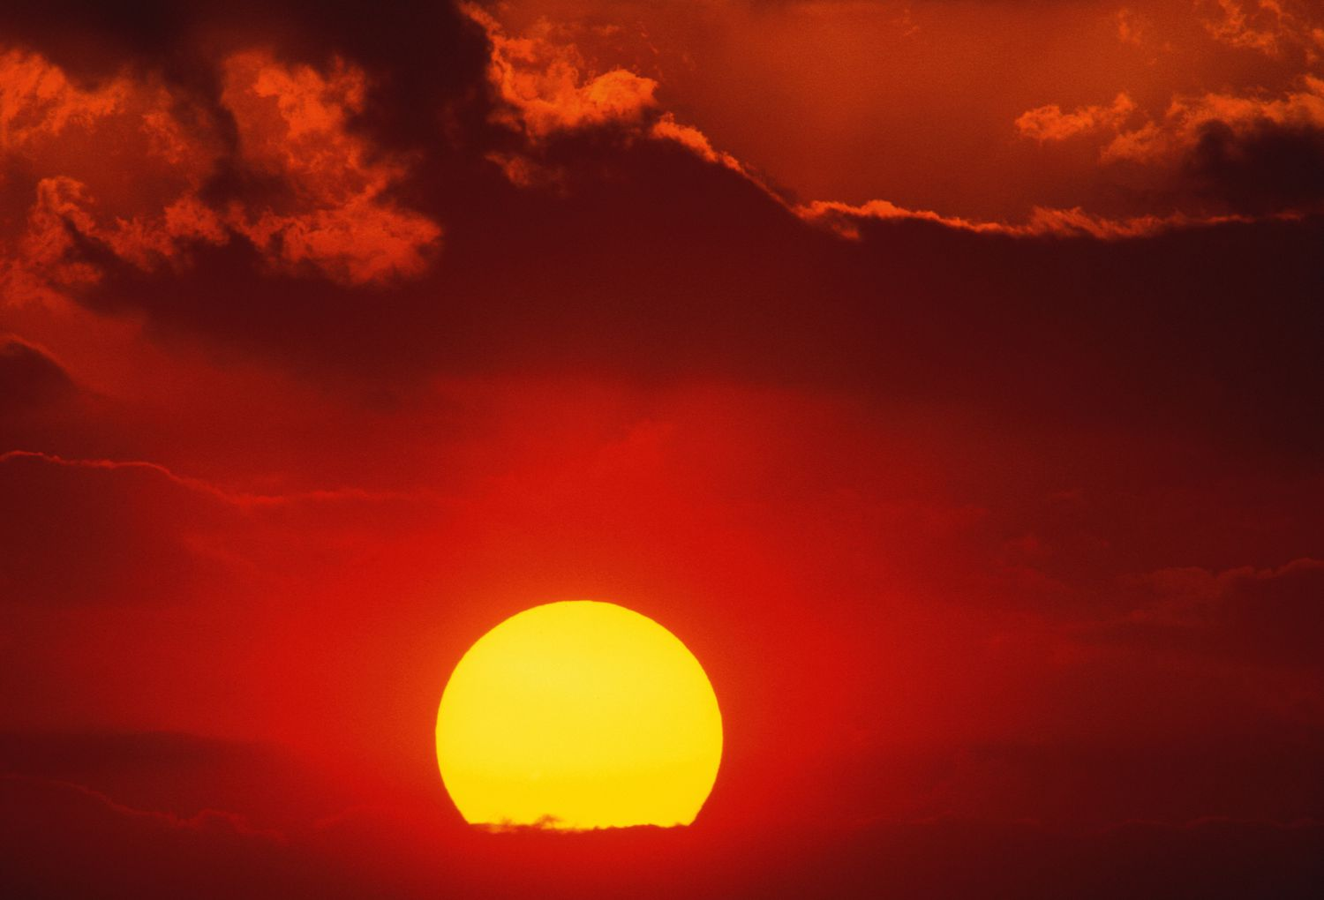
PAUL’S GREAT DILEMMA
IF HE CHOSE TO DEPART…

Slide 7
PAUL’S GREAT DILEMMA
IF HE CHOSE TO DEPART…
“Gain, Far Better”

Slide 8
PAUL’S GREAT DILEMMA
IF HE CHOSE TO DEPART…
“Therefore, King Agrippa, I was not disobedient to the heavenly vision,”
Acts 26:19

Slide 9
PAUL’S GREAT DILEMMA
IF HE CHOSE TO DEPART…
“though He was a Son, yet He learned obedience by the things which He suffered. And having been perfected, He became the author of eternal salvation to all who obey Him,”
Hebrews 5:8-9

Slide 10
PAUL’S GREAT DILEMMA
IF HE CHOSE TO DEPART…
“and to give you who are troubled rest with us when the Lord Jesus is revealed from heaven with His mighty angels, in flaming fire taking vengeance on those who do not know God, and on those who do not obey the gospel of our Lord Jesus Christ….
2 Thessalonians 1:7-9

Slide 11
PAUL’S GREAT DILEMMA
IF HE CHOSE TO DEPART…
These shall be punished with everlasting destruction from the presence of the Lord and from the glory of His power,”
2 Thessalonians 1:7-9

Slide 12
PAUL’S GREAT DILEMMA
IF HE CHOSE TO DEPART…
“I have fought the good fight, I have finished the race, I have kept the faith. Finally, there is laid up for me the crown of righteousness, which the Lord, the righteous Judge, will give to me on that Day, and not to me only but also to all who have loved His appearing.”
2 Timothy 4:7-8

Slide 13
PAUL’S GREAT DILEMMA
IF HE CHOSE TO DEPART…
“For if we sin willfully after we have received the knowledge of the truth, there no longer remains a sacrifice for sins, but a certain fearful expectation of judgment, and fiery indignation which will devour the adversaries”
Hebrews 10:26-27

Slide 14
PAUL’S GREAT DILEMMA
IF HE CHOSE TO DEPART…
“Of how much worse punishment, do you suppose, will he be thought worthy who has trampled the Son of God underfoot, counted the blood of the covenant by which he was sanctified a common thing, and insulted the Spirit of grace?”
Hebrews 10:29

Slide 15
PAUL’S GREAT DILEMMA
IF HE CHOSE TO DEPART…
“For I am hard-pressed between the two, having a desire to depart and be with Christ, which is far better.”
Philippians 1:23

Slide 16
PAUL’S GREAT DILEMMA
IF HE CHOSE TO DEPART…
“Then we who are alive and remain shall be caught up together with them in the clouds to meet the Lord in the air. And thus we shall always be with the Lord.”
2 Thessalonians 4:17

Slide 17
PAUL’S GREAT DILEMMA
IF HE CHOSE TO DEPART…
“But now he is dead; why should I fast? Can I bring him back again? I shall go to him, but he shall not return to me.”
2 Samuel 12:23

Slide 18
PAUL’S GREAT DILEMMA
IF HE CHOSE TO DEPART…
“But I discipline my body and bring it into subjection, lest, when I have preached to others, I myself should become disqualified.”
1 Corinthians 9:27

Slide 19
PAUL’S GREAT DILEMMA
IF HE CHOSE TO DEPART…
“And God will wipe away every tear from their eyes; there shall be no more death, nor sorrow, nor crying. There shall be no more pain, for the former things have passed away.”
Revelation 21:4

Slide 20
PAUL’S GREAT DILEMMA
IF HE CHOSE TO REMAIN…

Slide 21
PAUL’S GREAT DILEMMA
IF HE CHOSE TO REMAIN…
“To Live as Christ”

Slide 22
PAUL’S GREAT DILEMMA
IF HE CHOSE TO REMAIN…
“What then? Only that in every way, whether in pretense or in truth, Christ is preached; and in this I rejoice, yes, and will rejoice.”
Philippians 1:18

Slide 23
PAUL’S GREAT DILEMMA
IF HE CHOSE TO REMAIN…
“but the latter out of love, knowing that I am appointed for the defense of the gospel.”
Philippians 1:17

Slide 24
PAUL’S GREAT DILEMMA
IF HE CHOSE TO REMAIN…
“according to my earnest expectation and hope that in nothing I shall be ashamed, but with all boldness, as always, so now also Christ will be magnified in my body, whether by life or by death.”
Philippians 1:20

Slide 25
PAUL’S GREAT DILEMMA
IF HE CHOSE TO REMAIN…
“Nevertheless to remain in the flesh is more needful for you. And being confident of this, I know that I shall remain and continue with you all for your progress and joy of faith, that your rejoicing for me may be more abundant in Jesus Christ by my coming to you again.”
Philippians 1:24-26

Slide 26
How Would You Finish, “To Live Is…”

Slide 27
How Would You Finish, “To Live Is…”
MONEY?

Slide 28
How Would You Finish, “To Live Is…”
MONEY?
“Now godliness with contentment is great gain. For we brought nothing into this world, and it is certain we can carry nothing out. And having food and clothing, with these we shall be content…
1 Timothy 6:6-10

Slide 29
How Would You Finish, “To Live Is…”
MONEY?
…But those who desire to be rich fall into temptation and a snare, and into many foolish and harmful lusts which drown men in destruction and perdition. For the love of money is a root of all kinds of evil, for which some have strayed from the faith in their greediness, and pierced themselves through with many sorrows.”
1 Timothy 6:6-10

Slide 30
How Would You Finish, “To Live Is…”
PLEASURE?

Slide 31
How Would You Finish, “To Live Is…”
PLEASURE?
“traitors, headstrong, haughty, lovers of pleasure rather than lovers of God,”
2 Timothy 3:4

Slide 32
How Would You Finish, “To Live Is…”
POWER?

Slide 33
How Would You Finish, “To Live Is…”
POWER?
“So on a set day Herod, arrayed in royal apparel, sat on his throne and gave an oration to them. And the people kept shouting, “The voice of a god and not of a man!” Then immediately an angel of the Lord struck him, because he did not give glory to God. And he was eaten by worms and died.”
Acts 12:21-23

Slide 34
If you could choose life or death, which would you choose?

