Slide 1
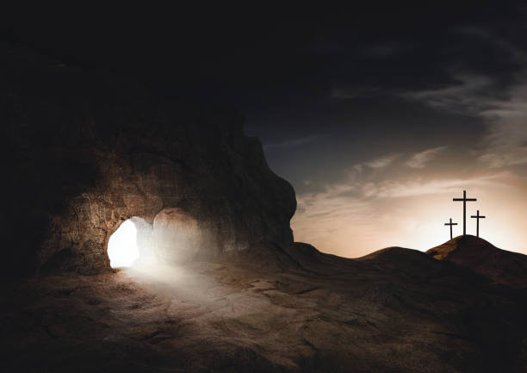
HE HAS RISEN!
John 2: 18-22

Slide 2
HE HAS RISEN!
Prophesies of the Resurrection…

Slide 3
HE HAS RISEN!
Prophesies of the Resurrection…
“Come, and let us return to the Lord;
For He has torn, but He will heal us;
He has stricken, but He will bind us up.
After two days He will revive us;
On the third day He will raise us up,
That we may live in His sight.”
Hosea 6:1-2

Slide 4
HE HAS RISEN!
Prophesies of the Resurrection…
“Then on the third day Abraham lifted his eyes and saw the place afar off.”
Genesis 22:4

Slide 5
HE HAS RISEN!
The Heart of the Matter…
- John 2: 13-22
- Matt. 26: 59-66

Slide 6
HE HAS RISEN!
The Heart of the Matter…
“But not even then did their testimony agree”
Mark 14:59

Slide 7
HE HAS RISEN!
Victory Over Death…
“And as it is appointed for men to die once, but after this the judgment, so Christ was offered once to bear the sins of many. To those who eagerly wait for Him He will appear a second time, apart from sin, for salvation.”
Hebrews 9:27-28

Slide 8
HE HAS RISEN!
Victory Over Death…
“All the nations will be gathered before Him, and He will separate them one from another, as a shepherd divides his sheep from the goats…
Matthew 25:32-34

Slide 9
HE HAS RISEN!
Victory Over Death…
“And He will set the sheep on His right hand, but the goats on the left. Then the King will say to those on His right hand, ‘Come, you blessed of My Father, inherit the kingdom prepared for you from the foundation of the world”
Matthew 25:32-34

Slide 10
HE HAS RISEN!
The Lord’s Resurrection…
- Matthew 28: 1-17
- Mark 16: 4-14
- Luke 24: 1-48
- John 20: 19-31

Slide 11
HE HAS RISEN!
Please Consider Seriously and Honestly Where You Will Be After This Life!

