Slide 1
BUILDING FOR THE LORD
Nehemiah 4:6

Slide 2
BUILDING FOR THE LORD
“But do you want to know, O foolish man, that faith without works is dead?”
James 2:20

Slide 3
BUILDING FOR THE LORD
“But do you want to know, O foolish man, that faith without works is dead?”
James 2:20

Slide 4
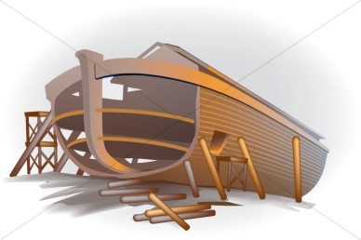
BUILDING FOR THE LORD
Noah and the Ark
Genesis 6:13-22

Slide 5
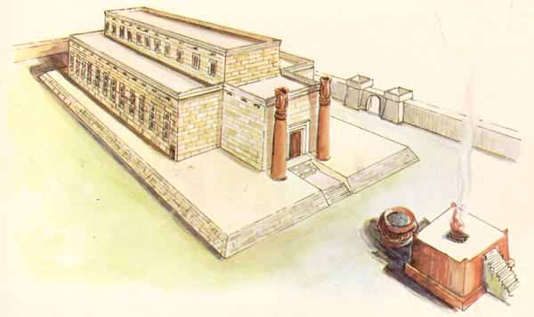
BUILDING FOR THE LORD
God’s Temple
2 Samuel 7

Slide 6
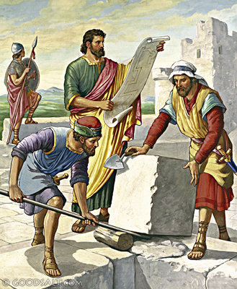
BUILDING FOR THE LORD
The Walls of
Jerusalem
Nehemiah 4

Slide 7
BUILDING FOR THE LORD
The Lord’s Church
Book of Acts

Slide 8
BUILDING FOR THE LORD
Each Congregation of the Lord’s Church

Slide 9
BUILDING FOR THE LORD
Each Congregation of the Lord’s Church
“For whatever things were written before were written for our learning, that we through the patience and comfort of the Scriptures might have hope.”
Romans 15:4

Slide 10
BUILDING FOR THE LORD
Each Congregation of the Lord’s Church
“All Scripture is given by inspiration of God, and is profitable for doctrine, for reproof, for correction, for instruction in righteousness, that the man of God may be complete, thoroughly equipped for every good work.”
Romans 15:4

Slide 11
BUILDING FOR THE LORD
Commitment
Focus
Motivation
Energy
Make it a Priority

