Slide 1
What Will You Do With Easter?

Slide 2
Possible Answers
Discuss
Discuss all the reasons why you shouldn’t celebrate it (Pagan origin etc)
Ignore
Ignore it (Not discuss it at all)
Accept
Accept the false teachings
Teach
Teach the truth about the resurrection

Slide 3
Does not Celebrating Easter as the Resurrection Time of Christ Make it Any Less Important to Christians?

Slide 4
If Christ is not Risen Then He is a Liar
Matthew 12:40 New King James Version (NKJV)
⁴⁰ For as Jonah was three days and three nights in the belly of the great fish, so will the Son of Man be three days and three nights in the heart of the earth.
Matthew 16:21 New King James Version (NKJV)
²¹ From that time Jesus began to show to His disciples that He must go to Jerusalem, and suffer many things from the elders and chief priests and scribes, and be killed, and be raised the third day.

Slide 5
If Christ is not Risen There is no Gospel
1 Corinthians 15:3-5 New King James Version (NKJV)
³ For I delivered to you first of all that which I also received: that Christ died for our sins according to the Scriptures, ⁴ and that He was buried, and that He rose again the third day according to the Scriptures,

Slide 6
If Christ is not Risen There is no Gospel
1 Corinthians 15:3-5 New King James Version (NKJV)
³ For I delivered to you first of all that which I also received: that Christ died for our sins according to the Scriptures, ⁴ and that He was buried, and that He rose again the third day according to the Scriptures,

Slide 7
If Christ is not Risen Our Preaching and Your Faith is Empty
1 Corinthians 15:14 New King James Version (NKJV)
¹⁴ And if Christ is not risen, then our preaching is empty and your faith is also empty.

Slide 8
If Christ is not Risen Our Faith is futile
1 Corinthians 15:17 New King James Version (NKJV)
¹⁷ And if Christ is not risen, your faith is futile; you are still in your sins!

Slide 9
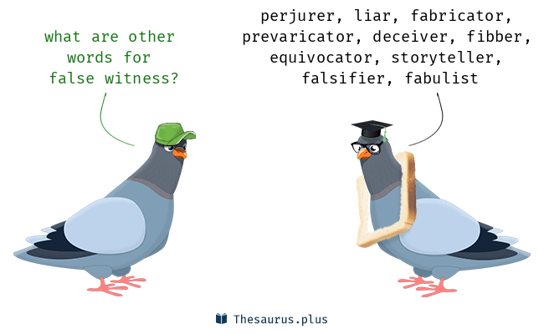
If Christ is not Risen We are Spreading a lie
1 Corinthians 15:15 New King James Version (NKJV)
¹⁵ Yes, and we are found false witnesses of God, because we have testified of God that He raised up Christ, whom He did not raise up—if in fact the dead do not rise.

Slide 10
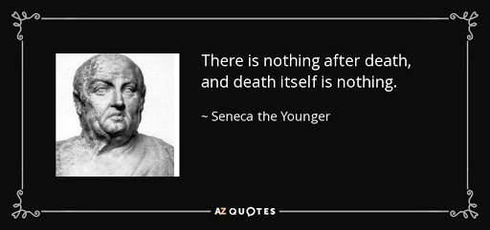
If Christ is not Risen We have no hope for the future
1 Corinthians 15:18 New King James Version (NKJV)
¹⁸ Then also those who have fallen asleep in Christ have perished.

Slide 11
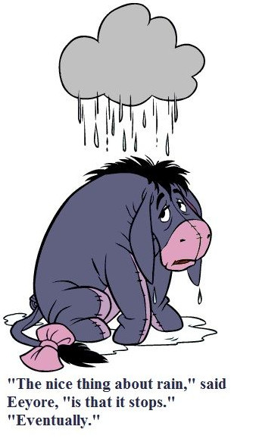
If Christ is not Risen We are most pitiable
1 Corinthians 15:19 New King James Version (NKJV)
¹⁹ If in this life only we have hope in Christ, we are of all men the most pitiable.

Slide 12
The Good News is Christ did rise from the grave
15:1-8

