Slide 1
Restoration of the soul
Understanding Church Discipline

Slide 2
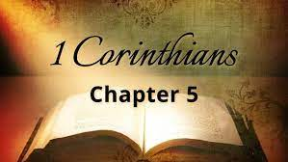
Background
⁵ deliver such a one to Satan for the destruction of the flesh, that his spirit may be saved in the day of the Lord Jesus.

Slide 3
Restoration Defined
To bring back to its former state; to bring back from a state of ruin, decay, disease, or the like; to repair; to renew; to recover.

Slide 4
Restoration Defined
Restoring an excluded member to full fellowship, forgiveness, affection, and comfort, after they have cleared themselves from their sin by Godly repentance

Slide 5
Restoration Defined
It is most fully described in II Corinthians 2:6-8, where Paul instructs the church at Corinth to restore the excluded fornicator from I Corinthians 5:1-13

Slide 6
Restoration Defined
Contrary to the way they had been treating him (shunning and admonishing), they were now to receive him again and console and encourage him with affection and forgiveness

Slide 7
Restoration Defined
It is not something we vote on as God has clearly declared to us what Godly repentance is and we are able to clearly see it in the action of the one seeking to be restored

Slide 8
Restoration Defined
It is the goal of any spiritual discipline that has taken place and when it occurs there should be great rejoicing
(Lk 15:7, 10)

Slide 9
When does restoration occur
2 Cor 2:6-7 ⁶ This punishment which was inflicted by the majority is sufficient for such a man, ⁷ so that, on the contrary, you ought rather to forgive and comfort him, lest perhaps such a one be swallowed up with too much sorrow.

Slide 10
When does restoration occur
2 Cor 7:10-11 ¹⁰ For godly sorrow produces repentance leading to salvation, not to be regretted; but the sorrow of the world produces death. ¹¹ For observe this very thing, that you sorrowed in a godly manner: What diligence it produced in you, what clearing of yourselves, what indignation, what fear, what vehement desire, what zeal, what vindication! In all things you proved yourselves to be clear in this matter.

Slide 11
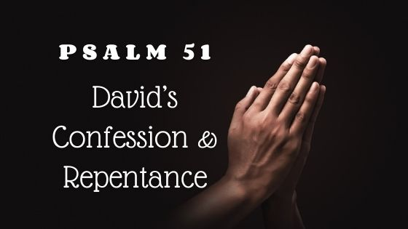
Examples of true repentance

Slide 12
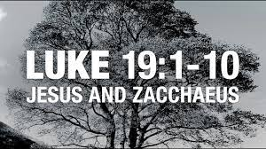
Examples of true repentance

Slide 13
Examples of true repentance

Slide 14
Let us live and remember the command
Gal 6:1 6 Brethren, if a man is overtaken in any trespass, you who are spiritual restore such a one in a spirit of gentleness, considering yourself lest you also be tempted.

