Slide 1
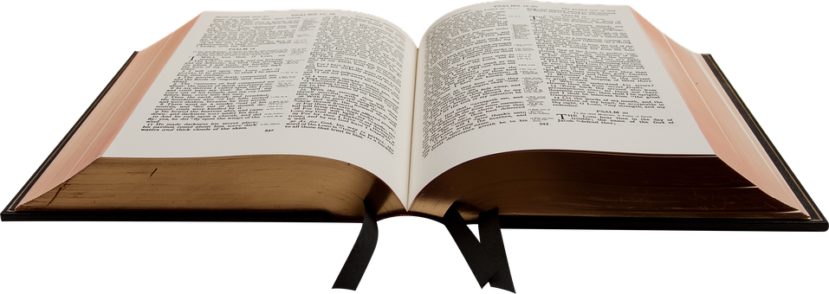
Realities of Life
Eccl 9:1-10

Slide 2
Reality #1: God is in Control
9 For I considered all this in my heart, so that I could declare it all: that the righteous and the wise and their works are in the hand of God. People know neither love nor hatred by anything they see before them.

Slide 3
Reality #1: God is in Control
Being in the hand of God is no guarantee of economic prosperity, physical health, freedom from pain, or popularity
We don’t know what tomorrow will bring
We do know beyond a shadow of a doubt: A loving God is in control, and nothing takes place outside His control

Slide 4
Realtity #2: A Common Destiny
² All things come alike to all: One event happens to the righteous and the wicked; To the good, the clean, and the unclean; To him who sacrifices and him who does not sacrifice. As is the good, so is the sinner; He who takes an oath as he who fears an oath.
³ This is an evil in all that is done under the sun: that one thing happens to all. Truly the hearts of the sons of men are full of evil; madness is in their hearts while they live, and after that they go to the dead.

Slide 5
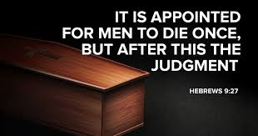
Realty #2: A Common Destiny

Slide 6
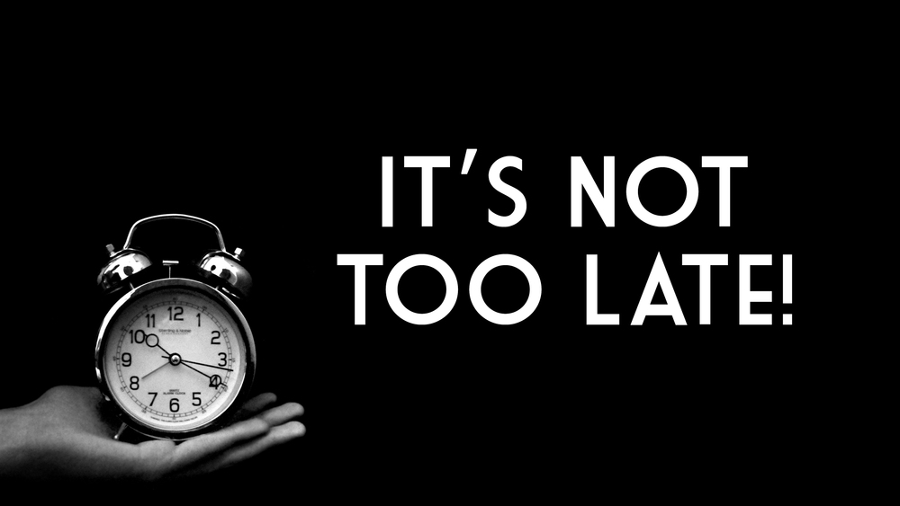
Reality #3: While There is Life, There is Hope
⁴ But for him who is joined to all the living there is hope, for a living dog is better than a dead lion.

Slide 7
Reality #3: While There is Life, There is Hope
The basic idea of a living dog is better than a dead lion is that “as long as there is life, there is hope.” Solomon used these two animals as symbols for two types of people—the lowly and the mighty. From an ancient-world point of view, a living dog held no authority or status but at least had the distinct advantage of life. A deceased lion represented someone who may have once been formidable and influential but was now helpless and hopeless in death. In Solomon’s reasoning, it was better to be alive and powerless (yet still with hope) than dead, even if once mighty and respected.
Notes:
Gotquestions.org

Slide 8
Reality #3: While There is Life, There is Hope
A living dog is better than a dead lion because, for the lion, hope is dead. His once regal standing is worthless in death. But the living dog still has hope. The living human can still come to know Jesus Christ as Lord and Savior and experience the hope of eternal life with God.
As Christians, we are “born again to a living hope through the resurrection of Jesus Christ from the dead, to an inheritance that is imperishable, undefiled, and unfading, kept in heaven for you, who by God’s power are being guarded through faith for a salvation ready to be revealed in the last time” (1 Peter 1:3–5, ESV). The believer’s hope is “an anchor for the soul, firm and sure,” never to be destroyed by death (Hebrews 6:13–20).
Notes:
Gotquestions.org

Slide 9
Reality #3: While There is Life, There is Hope
⁵ For the living know that they will die; But the dead know nothing, And they have no more reward, For the memory of them is forgotten.
⁶ Also their love, their hatred, and their envy have now perished; Nevermore will they have a share In anything done under the sun.

Slide 10
Reality #3: While There is Life, There is Hope
Once death comes, it’s too late
If you want to spend eternity in Heaven
and not Hell, you must plan and prepare
before you die
Notes:
Gotquestions.org

Slide 11
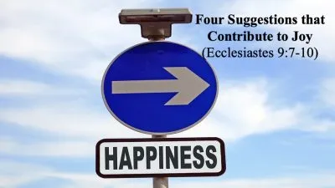
Reality #4: Life is Short so Cherish its Joys (vs 7)
Enjoy life while you can
There is nothing wrong with enjoying the fruits of our labor or what this life has to offer
Enjoy and appreciate the life God has given you

Slide 12
Reality #4: Life is Short so Cherish its Joys (vs 8)
Live a life of purity
Know that God will hold you accountable for how you live
Make everyday a day of celebration
Money is made to be spent not hoarded

Slide 13
Reality #4: Life is Short so Cherish its Joys (vs 9)
Enjoy your spouse
Prov 18:22 and 19:14 speak of a wife as a gift from God
I believe we can apply the idea to enjoying all our family

Slide 14
Reality #4: Life is Short so Cherish its Joys (vs 10)
Life is short, do not do things half-heartedly
We must maximize our time while working to the best of our ability for the Lord
We should enjoy the work we do

