Slide 1
We Thank Thee, Lord
Song # 10

Slide 2
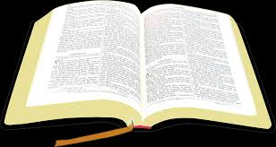
For All the Blessing of the Year…
Psalm 65:9-13

Slide 3
For All the Blessing of the Year…
Psalm 40:5 ⁵ Many, O Lord my God, are Your wonderful works Which You have done; And Your thoughts toward us Cannot be recounted to You in order; If I would declare and speak of them, They are more than can be numbered.

Slide 4
For All the Blessing of the Year…
Jam 1:17 ¹⁷ Every good gift and every perfect gift is from above, and comes down from the Father of lights, with whom there is no variation or shadow of turning.

Slide 5
For All the Friends We Hold So Dear…
Ecl 4:9-12 Two are better than one, Because they have a good reward for their labor.
¹⁰ For if they fall, one will lift up his companion. But woe to him who is alone when he falls, For he has no one to help him up.
¹¹ Again, if two lie down together, they will keep warm; But how can one be warm alone?
¹² Though one may be overpowered by another, two can withstand him. And a threefold cord is not quickly broken.

Slide 6
For All the Friends We Hold So Dear…
Prov 17:17 ¹⁷ A friend loves at all times, And a brother is born for adversity.
Prov 27:6 ⁶ Faithful are the wounds of a friend, But the kisses of an enemy are deceitful.
Prov 27:9 ⁹ Ointment and perfume delight the heart, And the sweetness of a man’s friend gives delight by hearty counsel.
Notes:
Consider also the friendship of Jonathan and David ((1 Samuel 18:1–4; 20:14–17 ; 2 Samuel 1:19–27

Slide 7
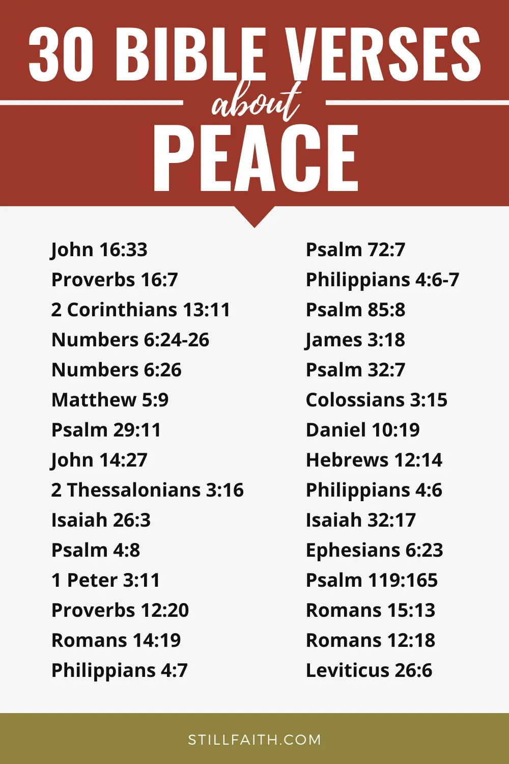
For Peace on Earth Both Far and Near…
Is 9:6-7 ⁶ For unto us a Child is born, Unto us a Son is given; And the government will be upon His shoulder. And His name will be called Wonderful, Counselor, Mighty God, Everlasting Father, Prince of Peace.
⁷ Of the increase of His government and peace There will be no end, Upon the throne of David and over His kingdom, To order it and establish it with judgment and justice From that time forward, even forever. The zeal of the Lord of hosts will perform this.

Slide 8
For Peace on Earth Both Far and Near…
Ps 4:8 ⁸ I will both lie down in peace, and sleep; For You alone, O Lord, make me dwell in safety.
Ps 119:165 ¹⁶⁵ Great peace have those who love Your law, And nothing causes them to stumble.
Is 26:3 ³ You will keep him in perfect peace, Whose mind is stayed on You, Because he trusts in You.
Notes:
Phil 4:6-7 “Do not be anxious about anything, but in everything by prayer and supplication with thanksgiving let your requests be made known to God. And the peace of God, which surpasses all understanding, will guard your hearts and your minds in Christ Jesus. “

Slide 9
For Life and Health, Those Common Things, Which Every day and Hour Brings…
Ps 119:113-114 ¹³ For You formed my inward parts; You covered me in my mother’s womb.
¹⁴ I will praise You, for I am fearfully and wonderfully made; Marvelous are Your works, And that my soul knows very well.
Acts 17:28 ²⁸ for in Him we live and move and have our being, as also some of your own poets have said, ‘For we are also His offspring.’

Slide 10
For Life and Health, Those Common Things, Which Every day and Hour Brings…
Ps 103 :1-5 103 Bless the Lord, O my soul; And all that is within me, bless His holy name!
² Bless the Lord, O my soul, And forget not all His benefits:
³ Who forgives all your iniquities, Who heals all your diseases,
⁴ Who redeems your life from destruction, Who crowns you with lovingkindness and tender mercies,
⁵ Who satisfies your mouth with good things, So that your youth is renewed like the eagle’s.

Slide 11
For Life and Health, Those Common Things, Which Every day and Hour Brings…
Jam 5:14-15 ¹⁴ Is anyone among you sick? Let him call for the elders of the church, and let them pray over him, anointing him with oil in the name of the Lord.
¹⁵ And the prayer of faith will save the sick, and the Lord will raise him up. And if he has committed sins, he will be forgiven.

Slide 12
For Home Where our Affection Clings…
Gen 2:24 ²⁴ Therefore a man shall leave his father and mother and be joined to his wife, and they shall become one flesh.
Notes:
There is a difference between a house and a home. A house is a very physical thing, made up of such things as timber, bricks, mortar, carpet, and furniture. On the other hand, a home consists of people - especially families.
tn Heb “and they become one flesh.” The retention of the word “flesh” (בָּשָׂר, basar) in the translation often leads to an incomplete interpretation. The Hebrew word refers to more than just a sexual union. The man and woman bring into being a new family unit (הָיָה plus preposition ל [hayah plus lamed] means “become”). The phrase “one flesh” occurs only here and must be interpreted in light of v. 23. There the man declares that the woman is bone of his bone and flesh of his flesh. To be one’s “bone and flesh” is to be related by blood to someone
The expression “one flesh” seems to indicate that they become, as it were, “kin,” at least legally (a new family unit is created) or metaphorically.

Slide 13
For Home Where our Affection Clings…
Ps 127:3-5 ³ Behold, children are a heritage from the Lord, The fruit of the womb is a reward.
⁴ Like arrows in the hand of a warrior, So are the children of one’s youth.
⁵ Happy is the man who has his quiver full of them; They shall not be ashamed, But shall speak with their enemies in the gate.

Slide 14
Conclusion
We thank Thee, Lord

