Slide 1
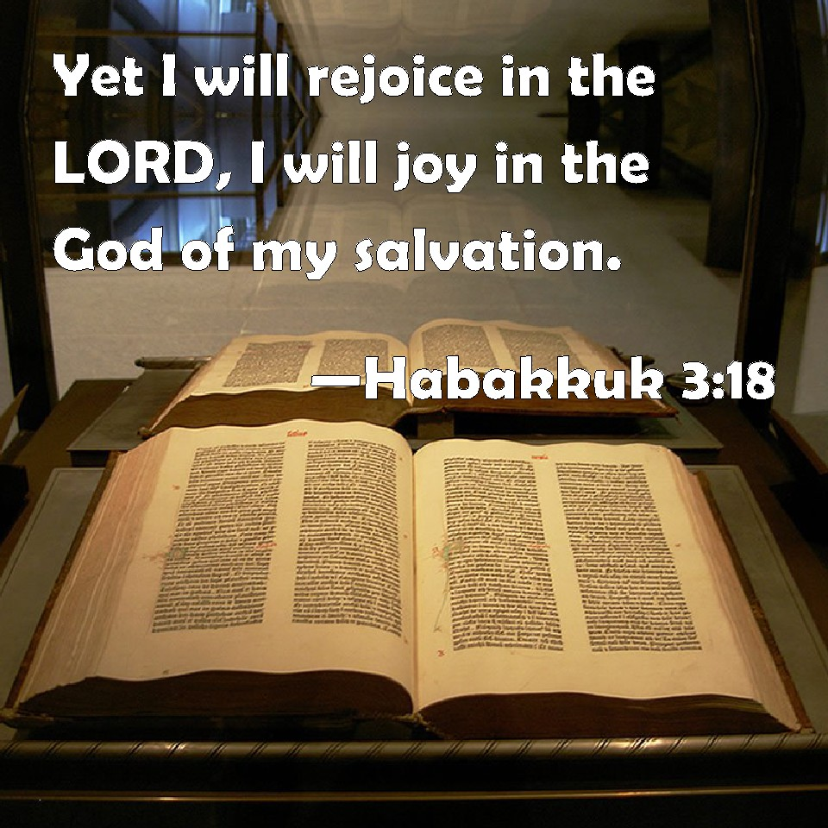
Habakkuk: A Prophet who Vowed to be Thankful in all Things

Slide 2
Introduction
Habakkuk was written against a backdrop of apostasy, judgment, and unbelievable hardship
This book was written during a time when Jehoiakim the king of Judah led the people into idolatry and away from the Lord.
Because of their sin, God is preparing to judge the nation.
The prophet Habakkuk is having trouble understanding why God would use a heathen nation like Babylon to punish His people.
Habakkuk can't understand why God doesn't just purge their sins and draw them back to Himself and to righteousness.

Slide 3
Introduction
Habakkuk is a lot like Job.
He argues his case, but in the end, he realizes God is not to be worshiped because of the temporal, material and physical blessings of life; God is to be worshipped for who He is.
Habakkuk ends his words with a song of thanksgiving to God for who he is and for the unchanging benefits which belong to those who know him.
Habakkuk had every reason to worry, but he chose to be thankful instead.

Slide 4
Be thankful that even though God’s provisions may change, He does not
Habakkuk envisions losing things vital to their economy
The fig tree may not blossom
No fruit on the vines
Olive trees not producing
Fields yielding no food
Sheep and cattle are lost

Slide 5
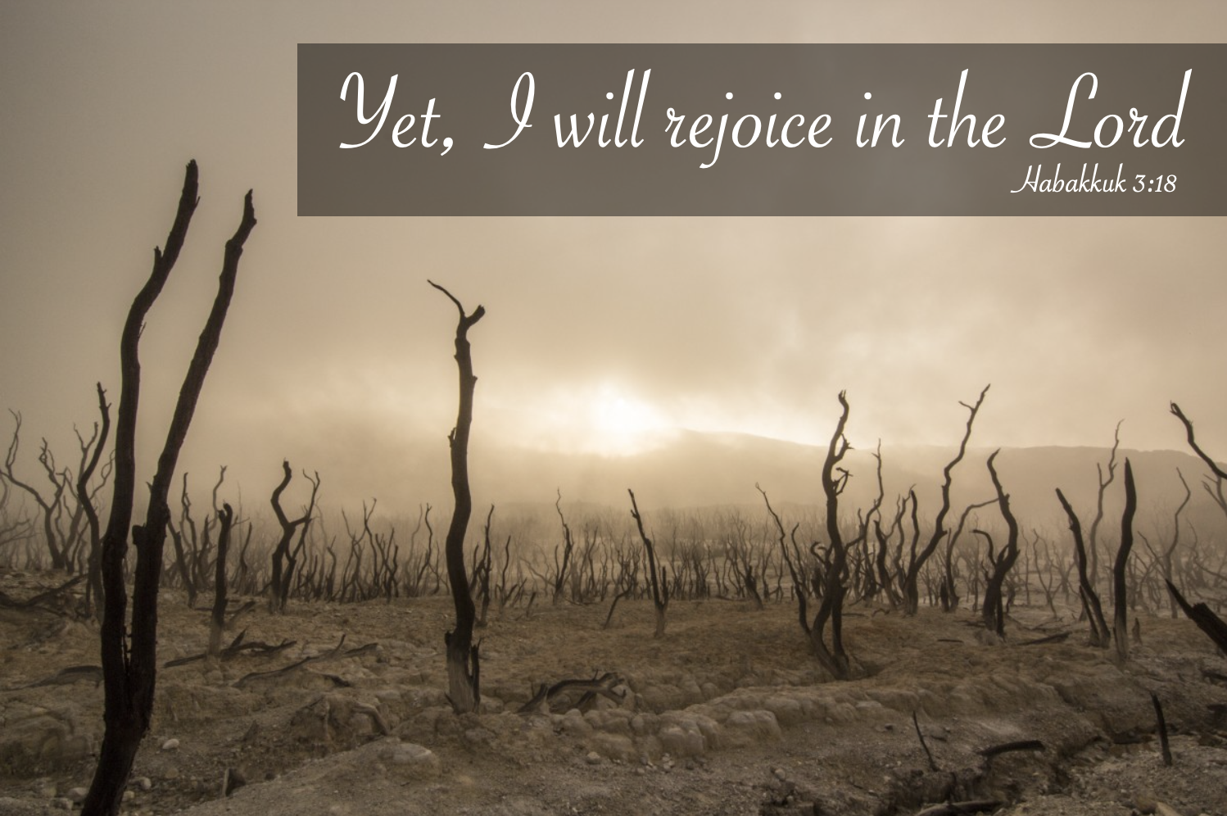
Be thankful that even though God’s provisions may change, He does not
Habakkuk envisions losing things vital to their economy
The fig tree may not blossom
No fruit on the vines
Olive trees not producing
Fields yielding no food
Sheep and cattle are lost

Slide 6
Be thankful that even though economic conditions may change, God does not
Egypt had seven poor years
Job lost all his wealth
The great depression/stock market crash 1929
Loss of health

Slide 7
Be thankful that even though economic conditions may change, God does not
Notes:
⁶ “For I am the Lord, I do not change; Therefore you are not consumed, O sons of Jacob.
3:6 tn Heb “do not change.” This refers to God’s ongoing commitment to his covenant promises to Israel. (NET notes)
Heb 13:8 “⁸ Jesus Christ is the same yesterday, today, and forever.”

Slide 9
When suffering be thankful for His salvation
Life’s suffering is never further than, “Just around the corner”
Job 14:1 “14 “Man who is born of woman Is of few days and full of trouble.”
Jn 16:33 “³³ These things I have spoken to you, that in Me you may have peace. In the world you will have tribulation; but be of good cheer, I have overcome the world.”

Slide 10
When suffering be thankful for His salvation
We don’t know when this short life will end
Ja 4:14 “¹⁴ whereas you do not know what will happen tomorrow. For what is your life? It is even a vapor that appears for a little time and then vanishes away.”
Lk 12:40 “⁴⁰ Therefore you also be ready, for the Son of Man is coming at an hour you do not expect.”

Slide 11
When suffering be thankful for His salvation
Salvation grants us eternal life
1 Jn 5:11-13 “¹¹ And this is the testimony: that God has given us eternal life, and this life is in His Son. ¹² He who has the Son has life; he who does not have the Son of God does not have life. ¹³ These things I have written to you who believe in the name of the Son of God, that you may know that you have eternal life, and that you may continue to believe in the name of the Son of God.

Slide 12
When suffering be thankful for His salvation
Heaven is in our eternal future
Jn 14:1-3 “14 “Let not your heart be troubled; you believe in God, believe also in Me. ² In My Father’s house are many mansions; if it were not so, I would have told you. I go to prepare a place for you. ³ And if I go and prepare a place for you, I will come again and receive you to Myself; that where I am, there you may be also.

Slide 13
When suffering be thankful for His salvation
The best is yet to come
Jn 14:1-3 “14 “Let not your heart be troubled; you believe in God, believe also in Me. ² In My Father’s house are many mansions; if it were not so, I would have told you. I go to prepare a place for you. ³ And if I go and prepare a place for you, I will come again and receive you to Myself; that where I am, there you may be also.

Slide 14
We can be thankful the Lord is our strength to give us triumph over trials
The Lord is my strength
Ps 27:1 “27 The Lord is my light and my salvation; Whom shall I fear? The Lord is the strength of my life; Of whom shall I be afraid?”
Is 40:31 “³¹ But those who wait on the Lord Shall renew their strength; They shall mount up with wings like eagles, They shall run and not be weary, They shall walk and not faint.”

Slide 15
We can be thankful the Lord is our strength to give us triumph over trials
The Lord is my strength
Hinds feet refer to the feet of a doe
This carries the idea of grace, agility, and swiftness
High places refer to the mountain tops where the deer roam
“Difficult times are coming, but Habakkuk is confident the Lord will sustain him. Habakkuk will be able to survive, just as the deer negotiates the difficult rugged terrain of the high places without injury.
Notes:
(Net notes)

Slide 16
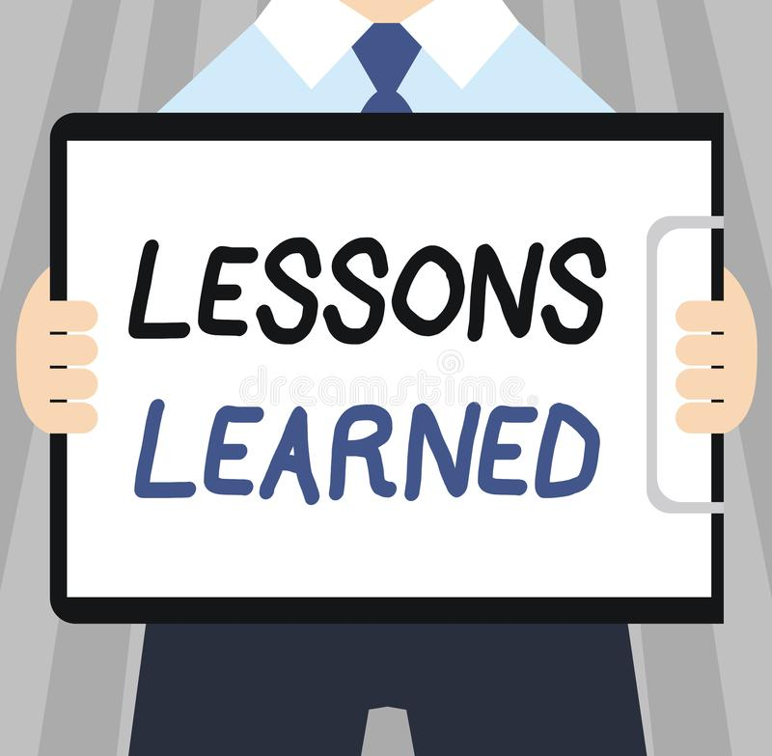
Habakkuk learned he had nothing to fear from life Habakkuk learned he had every reason to be thankful to the Lord for all He has done and all He will do

