Slide 1
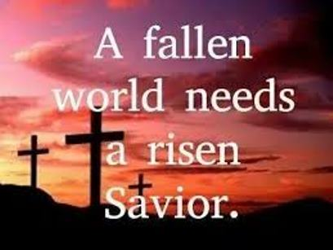
1 Cor 15:1-23

Slide 2
The Resurrection has been Proven (vs 1-8)
1 Cor 15:3-4 (The scriptures)
Predicted in the OT
(Ps 16:10 referenced by Peter Acts 2:24-32)
Correlation of Jonah in the great fish (Jonah 1:17 referenced Mt 12:39-40)
Promised by Christ
Mt 17:22-23; 29:17-19
Lk 9:22; 18:31-33; 24:46
Performed by Christ
Mt 28:1-6
Mk 16:1-8

Slide 3
The Resurrection has Been Proven (vs 1-8)
The Women who saw him
Mt 28:10
Mary Magdalene
Mk 16:9
Two Men on the road to Emmaus
Mk 16:12
The disciples
Mk 16:14
Over 500
1 Cor 15:6-8

Slide 4
The Resurrection Has Been Protested by Many (vs 12-19)
There were people in Corinth who refused to believe in the resurrection
They could not understand how a man could die and then rise again from the dead at a later date
This is same Protest of His resurrection exists in our time today
We must remember the problem of the thinking of the “natural man” (1 Co 2:14)
Notes:
1 Cor 2:14 “¹⁴ But the natural man does not receive the things of the Spirit of God, for they are foolishness to him; nor can he know them, because they are spiritually discerned.

Slide 5
Consequences of the Protest… If They are Right…
Jesus is still in the tomb (vs 13)
Our preaching and faith are empty (vs 14)
All who proclaim His resurrection are false teachers (vs 15)
We are still lost in our sins (vs 17)
There is no hope for any who have passed before us (vs 18)
We of all men are the most pitiful… no hope for the future (vs 19)

Slide 7
The Resurrection is a Precious Event that did Occur (20-23)
Paul affirms Christ is risen from the dead (vs 20)

Slide 8
Because Jesus lives, all the Negatives from Verses 12-19 Become Positives
Because He lives His tomb is empty (Mt 28:1-6)
Because He lives we preach powerful truth (Heb 4:12)
Because He lives our testimony is truth (Jn 17:17)
Because He lives our sins have been removed (Heb 10:10-12)
Because He lives the saints who have passed on have hope (1 Thes 4:13-14)
Because He lives we have hope in the world to come (Rev 21:1-4)
Because He lives we have Joy inexpressible (1 Pet 1:6-8)

Slide 9
His Resurrection is Precious because of its Victory (vs 22-23)
He is the “Firstfruits from the dead”
This means He is the first to rise from the dead with many to follow after
Because He lives forever, He will share in His life forever if we are in Him (Jn 10:27-28)
Jesus has given us victory over our greatest enemy (Jn 5:24)
This includes both the saints who are currently living as well as those who have passed on before (1 Thes 4:13-18)

