Slide 1
The Whole World is Guilty
Romans 3:10–3:20

Slide 2
Rom 3:10-18 a Sequence of 6 OT Passages Proving all are Under Sin
Rom 3:10-12 quotes from Ps 14:1-3
Rom 3:13 quotes from Ps 5:9, 140:3
Rom 3:14 quotes from Ps 10:7
Rom 3:15-17 quotes from Is 59:7-8
Rom 3:18 quotes from Ps 36:1

Slide 3
The Universality of Sin (Rom 3:10-12)
Universally evil
Spiritually Ignorant
Defiantly Rebellious
Naturally Wayward
Spiritually Useless
Morally Corrupt
“None righteous, no, not one;”
“None who understands”
“None who seeks after God”
“They have all turned aside”
“They have become unprofitable”
“None who does good, no not one”

Slide 4
The Speech of Sin (Rom 3:13-14)
Spiritually Dead
Deceitful
Deadly
Hostile Defamation
“Their throat is an open tomb”
“With their tongues they have practiced deceit”
“The poison of asps is under their lips”
“Mouth is full of cursing and bitterness”
Notes:
carries two ideas. First, in Jewish thinking, graves are tainted by death, and are therefore corrupt. Anything taken from a grave would be ceremonially unclean. The phrase could also mean that the effect of their words is death and decay

Slide 5
The Results of Sin (Rom 3:15-17)
Harmful
Destruction and Misery
Chaos and violence
“Feet are swift to shed blood”
“Destruction are in their ways”
“The way of peace they have not known”

Slide 6
The Root Cause of Sin (Rom 3:18)
Arrogance and no respect for God
“No fear of God before their eyes”

Slide 7
Conclusion: All Mankind is Lost in Sin (Rom 3:19-20)
The purpose of the law is to make people aware of their sin, their failure to measure up to God’s righteousness.
God’s revelation is like a mirror that reflects our true condition. If our face is dirty the mirror will show it. It will drive us to soap and water, the solution to a dirty face. We cannot use the mirror to cleanse our face but we only use it for the purpose of revealing the state of our face. The solution is soap and water, not the mirror. The purpose of knowing God’s standards is to find the solution to our sins…
Notes:
Versebyversecommentary.com

Slide 8
Conclusion: All Mankind is Lost in Sin (Rom 3:19-20)
“²⁰ Therefore by the deeds of the law no flesh will be justified in His sight, for by the law is the knowledge of sin.”

Slide 9
Notes:
Make not of vs 32 that not only those who practice but also those who approve are them are worthy of death

Slide 10
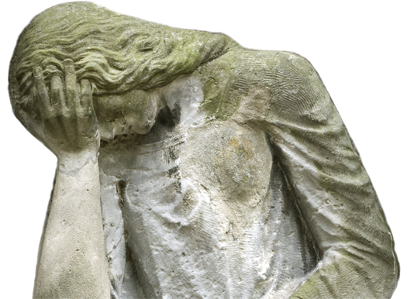
God is Right to Judge and Save
God’s Righteousness
God’s anger is neither irrational nor capricious.
Rather, human rebellion and willful rejection of the light God has given to both Gentiles and Jews are good reasons for his anger.

Slide 11
God is Right to Judge and Save
God’s Righteousness
God’s wrath is not revealed in what God does, but in what he does not do. God allows humanity, Gentiles and Jews alike, to suffer the disastrous consequences of their own evil.

Slide 12
God is Right to Judge and Save
God’s Righteousness
Paul’s ultimate goal is to show that:
“There is no difference between Jew and Gentile, for all have sinned and fall short of the glory of God, and all are justified freely by his grace through the redemption that came by Christ Jesus.” —Romans 3:22–24

Slide 13
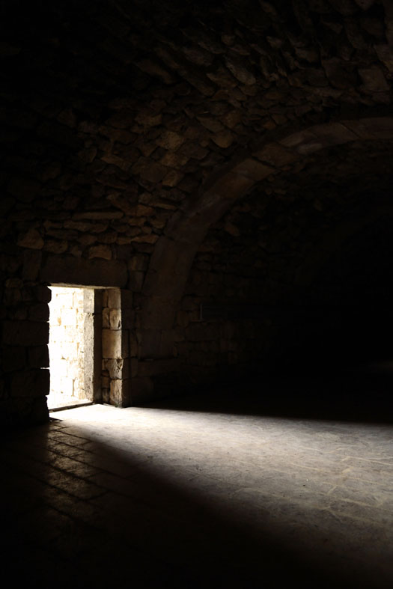
God is Right to Judge and Save
God’s Righteousness
Paul wants to present the power of the gospel to his readers.
Just as we can better understand the light when we contrast it with the darkness, so also the ugliness of human sin makes us long for God’s gracious help.
Menu

Slide 14
The Power of the Gospel
Romans 3:21–8:39
Menu

Slide 15
The Power of the Gospel
The apostle Paul has shown that:
God is right in being angry.
Human sin is destructive and offends God.
As Paul explains God’s solution to the horror of human sin, he focuses on a different side of God’s righteousness.

Slide 16
The Power of the Gospel
God’s Righteousness is revealed in his plan of salvation.
In 3:21–8:39, the apostle Paul explains what the power of the gospel achieves.
Forgiveness (3:21–4:25)
Peace (5:1–21)
Freedom from the power of sin (6:1–23)
Freedom from the condemnation of the law (6:1–23)
New life in the Spirit (8:1–39)

Slide 17
The Power of the Gospel
Forgiveness
Forgiveness of sin through the ministry of Jesus is a revelation of God’s righteousness and of the power of the gospel.
All the images the apostle used before—commercial, religious, and legal—point to this essential benefit.
Forgiveness (3:21–4:25)
Peace (5:1–21)
Freedom from the power of sin (6:1–23)
Freedom from the condemnation of the law (6:1–23)
New life in the Spirit (8:1–39)

Slide 18
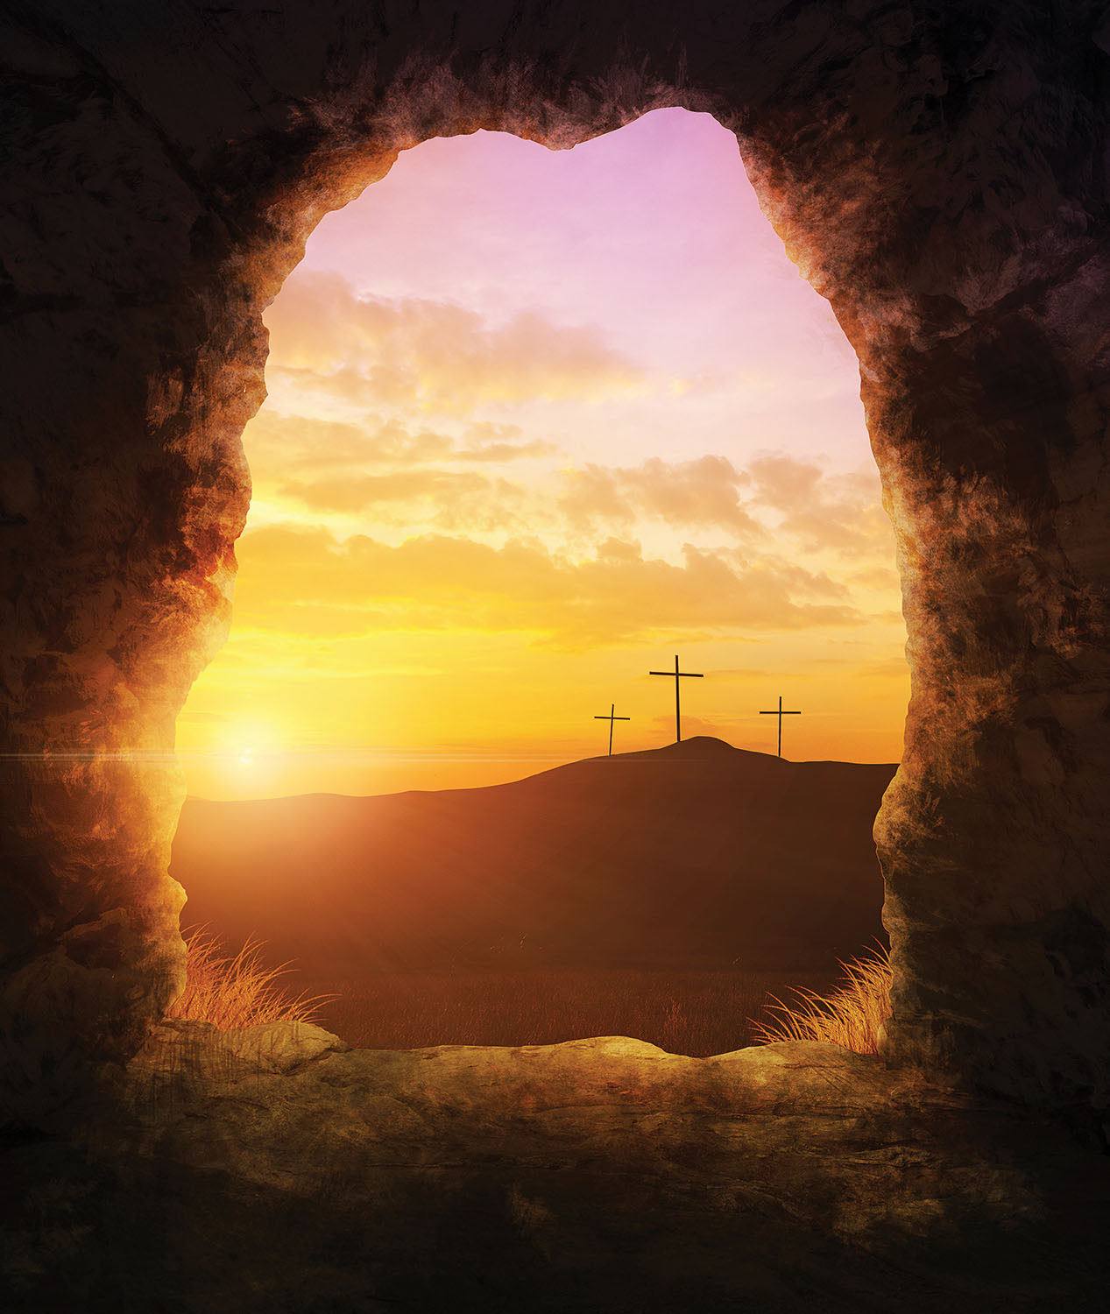
The Power of the Gospel
Forgiveness
The benefits of the gospel are not something people earn or deserve.
Rather, they come from God’s grace, as a gift, and are appropriated by faith.

Slide 19
The Power of the Gospel
Forgiveness
Sin:
Offends God’s holiness and justice,
breaks any possibility of a relationship with humanity,
and brings death and destruction.
The first step in God’s amazing grace is to forgive people who do not deserve forgiveness.

Slide 20
The Power of the Gospel
Peace
Because of God’s gracious forgiveness, humanity can start a new relationship with God.
The enmity that sin causes between God and humans is now overcome.
Forgiveness (3:21–4:25)
Peace (5:1–21)
Freedom from the power of sin (6:1–23)
Freedom from the condemnation of the law (6:1–23)
New life in the Spirit (8:1–39)

Slide 21
The Power of the Gospel
“But God demonstrates his own love for us in this: While we were still sinners, Christ died for us.” —Romans 5:8

Slide 22
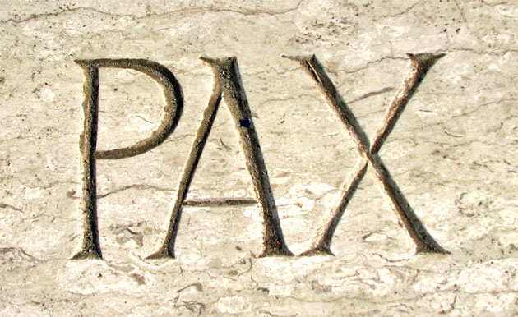
The Power of the Gospel
Peace
The Roman audience understood the concept well because of the Pax Romana—the peace within the Roman Empire that allowed for consistent commerce, growth of cities, and peaceful travel.
Pax, Latin for “Peace”

Slide 23
The Power of the Gospel
Peace
The peace that Christ brings:
Is just the beginning of a new life.
Includes perseverance, character, and hope.
Brings a new freedom that believers must learn to experience.

Slide 24
The Power of the Gospel
Peace
There is nothing people can do to earn or merit or influence God’s decision to save us.
Salvation is an undeserved gift from God.
God’s offer of salvation to all people is free!

Slide 25
The Power of the Gospel
Peace
However, this teaching raises the problem of “cheap grace”—antinomianism.
Paul gives an answer to that problem in Romans, chapters 6 and 7.
Cheap grace and legalism are two sides of the same coin:
Both represent the inability to understand or accept the wondrous grace of God.
Legalism: The teaching that we must obey the Law to be saved.

Slide 26
The Power of the Gospel
Freedom from the Power of Sin
Believers are free from the power of sin.
This does not mean that Christians do not sin at all.
Rather, because of Christ’s death, sin no longer controls us; we can choose not to sin.
Forgiveness (3:21–4:25)
Peace (5:1–21)
Freedom from the power of sin (6:1–23)
Freedom from the condemnation of the law (6:1–23)
New life in the Spirit (8:1–39)

Slide 27
The Power of the Gospel
Freedom from the Power of Sin
Returning to his image of slavery, Paul affirms that we are no longer slaves to sin.
We “have become slaves to righteousness” (6:18).
We are free to do what is right in a world where wickedness and injustice abounds.

Slide 28
The Power of the Gospel
Rom. 6: | Dead to Sin | Alive in Christ
13 | Instruments of unrighteousness to sin | Instruments of righteousness to God
14–15 | Not under the law | Under grace
16 | Sin unto death | Obedience unto righteousness
18 | Free from sin | Enslaved to righteousness
19 | Slave to impurity unto wickedness | Slave to righteousness unto holiness
20 | Slaves to sin | Slaves to God
21–22 | End is death | End is eternal life
22 | Free from sin | Slaves to God
23 | Wages of sin is death | Gift of God is eternal life
(Adapted from James D. G. Dunn, WBC Vol. 38A, Romans 1–8 )

Slide 29
The Power of the Gospel
Freedom from the condemnation of the law
The law condemns us because of our sin.
The law cannot remove the stain of sin nor transform our hearts so we can become free from the slavery to sin.
But God has delivered us “through Jesus Christ our Lord!” (7:25).
Forgiveness (3:21–4:25)
Peace (5:1–21)
Freedom from the power of sin (6:1–23)
Freedom from the condemnation of the law (6:1–23)
New life in the Spirit (8:1–39)

Slide 30
The Power of the Gospel
New Life in the Spirit
“The law of the Spirit who gives life has set you free from the law of sin and death” (8:2).
In Romans 8, Paul neatly brings the arguments from the previous chapters to a closing—and a glorious closing it is!
Forgiveness (3:21–4:25)
Peace (5:1–21)
Freedom from the power of sin (6:1–23)
Freedom from the condemnation of the law (6:1–23)
New life in the Spirit (8:1–39)

Slide 31
The Power of the Gospel
New Life in the Spirit
God’s solution to the greatest human problem is found in Christ’s death and resurrection.
“We were therefore buried with him through baptism into death in order that, just as Christ was raised from the dead through the glory of the Father, we too may live a new life.”—Romans 6:4

Slide 32
The Power of the Gospel
New Life in the Spirit
How do we see the benefits of Christ’s death and resurrection in the life of believers? The answer is found in chapter 8.
“For those who are led by the Spirit of God are the children of God” (8:14).
God gives us new life in the spirit!

Slide 33
The Power of the Gospel
New Life in the Spirit
This salvation that the Spirit makes active in the believers has consequences beyond the individual. It has cosmic consequences!
The entire universe groans for God’s deliverance, just as believers groan for God’s deliverance and the Spirit groans as he intercedes for us (8:22, 23, 26).

Slide 34
The Power of the Gospel
New Life in the Spirit
Even in this context of suffering in life, Paul offers encouragement and comfort by reminding us that we, as believers, are safe in God’s loving hands.

Slide 35
The Power of the Gospel
New Life in the Spirit
Because of what Christ did on the cross and the presence of the Spirit in our lives, we can proclaim along with the Paul:
“In all these things [trouble, hardship, persecution, famine, nakedness, danger, sword (8:35)] we are more than conquerors through him who loved us” (8:37).
Menu

Slide 36
God’s Righteous Plan for Israel and Gentiles
Romans 9:1–11:36
Menu

Slide 37
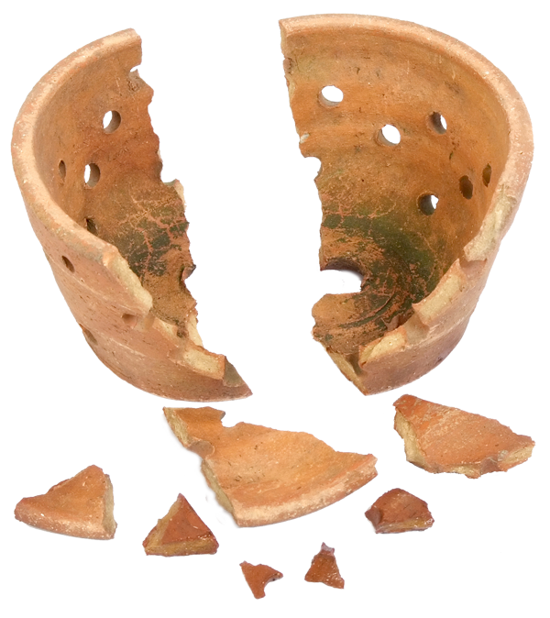
God’s Righteous Plan
Divisions
Paul now deals with a vital and practical problem in the church:
Divisions between the Roman Gentiles and Jewish Christians.
Divisions within the body oppose the very gospel that Paul describes.

Slide 38
God’s Righteous Plan
Paul refutes questions about Israel’s place in God’s plans:
Did God’s plans fail?
Is God still faithful to his promises to Israel?
Are Gentile Christians above the Jews now?
If God’s faithfulness to Israel changed, could his faithfulness to believers, as expressed in 8:31–39, also change?
Are we truly safe in his hands?

Slide 39
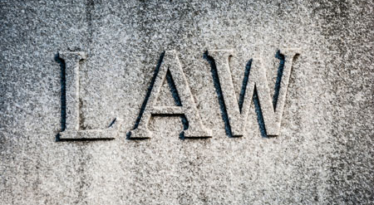
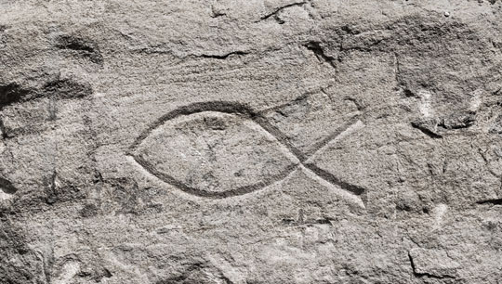
God’s Righteous Plan
For most of his ministry, Paul dealt with the problem of Jewish Christians wanting Gentiles to follow Jewish laws.
In his letter to the Romans, Paul deals with the opposite problem: Gentile Christians who seem to regard Jews as inferior.

Slide 40
God’s Righteous Plan
Paul’s appeal to believers is a personal one, as an apostle of the Lord and as a Jew.
In the previous section, Paul used examples from the life of Abraham and Adam to connect more directly with the Gentile experience.
In chapters 9–11, Paul argues using many Old Testament quotations and allusions.

Slide 41
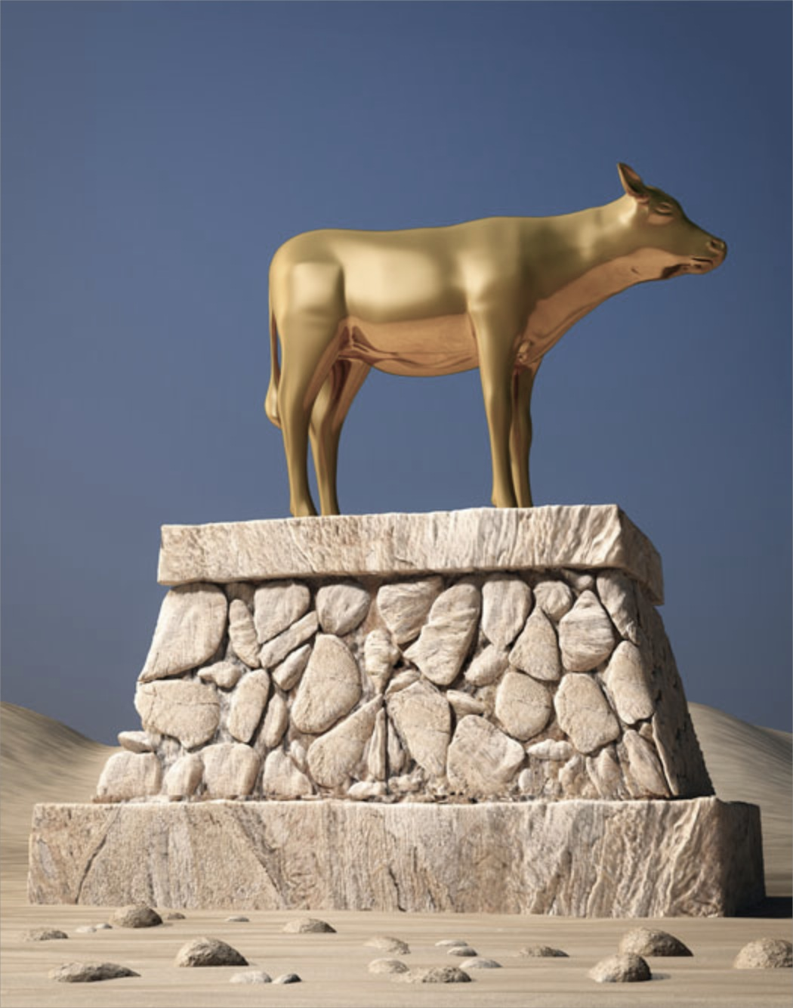
God’s Righteous Plan
Paul begins with alluding to Moses’ own appeal on behalf of God’s people in the aftermath of the golden calf catastrophe (Ex. 32:32):
“For I could wish that I myself were cursed and cut off from Christ for the sake of my people, those of my own race” (Rom. 9:3).

Slide 42
God’s Righteous Plan
He presents a three-part salvation plan:
God rejects Israel for the sake of the Gentiles (11:11–12).
The Gentiles will be saved “until the full number of the Gentiles has come in” (11:25).
Then “all Israel will be saved” (11:26).

Slide 43
God’s Righteous Plan
Paul’s conclusions
Rejection of Israel is temporary and has a vital purpose.
“But if their transgression means riches for the world, and their loss means riches for the Gentiles, how much greater riches will their full inclusion bring!” (11:12).

Slide 44
God’s Righteous Plan
Paul’s conclusions
Gentiles should not feel superior to the Jews.
Salvation is not by works, so no one can boast about it.
Gentiles’ attitude toward Jews should be one of humility and hope.

Slide 45
God’s Righteous Plan
The beautiful doxology at the end of the section suggests this attitude of humility (11:33–36).
“Oh, the depth of the riches of the wisdom and knowledge of God! How unsearchable his judgments, and his paths beyond tracing out!”—Romans 11:33
Menu

Slide 46
The Power of the Gospel in the Life of Believers
Romans 12:1–15:13
Menu

Slide 47
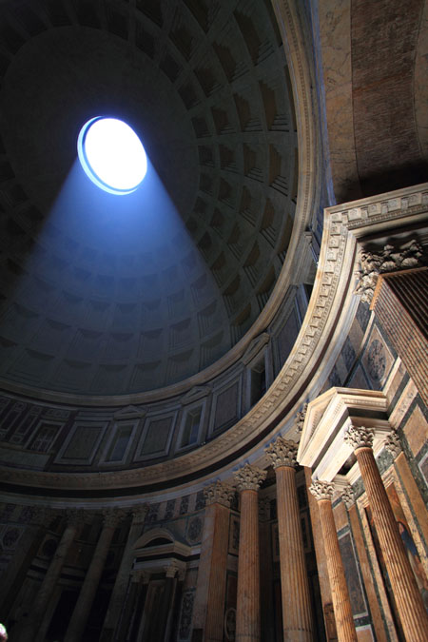
The Gospel in the Life of Believers
So far, the apostle Paul has covered much doctrinal ground in this most impressive letter. He has explained:
The basis for his gospel.
The role of Israel in the history of salvation.

Slide 48
The Gospel in the Life of Believers
He now turns to the consequences of all he has taught.
The power of the gospel has concrete and decisive effects in the lives of believers.

Slide 49
The Gospel in the Life of Believers
Romans 12:1–15:13
The basis for Christian living apart from the Mosaic law (12:1–2)
The body of Christ as the social expression of God’s people (12:3–8)
Love as the fundamental moral rule in human relationships (12:9–21)
Christians and the powers that be (13:1–7)
Love of neighbor as the fulfillment of the law in human relationships (13:8–10)
Christ as the pattern of Christian living (13:11–14)
The basis for social interaction apart from the Mosaic law (14:1–15:13)

Slide 50
The Gospel in the Life of Believers
Transformative
The power of the gospel is creative and transformative; the consequences are equally radical.
In light of all he has written, Paul now appeals to his readers to become living sacrifices.
“Therefore, I urge you, brothers and sisters, in view of God’s mercy, to offer your bodies as a living sacrifice, holy and pleasing to God—this is your true and proper worship.”—Romans 12:1

Slide 51
The Gospel in the Life of Believers
Law of Love
The concept captures what he has hinted at before:
If we are not bound to the law, which requires daily sacrifices,
we are now bound to the law of love, which requires that we offer our whole selves to God.
“Let no debt remain outstanding, except the continuing debt to love one another, for whoever loves others has fulfilled the law” (13:8).
Our entire lives should be an act of worship to God!

Slide 52
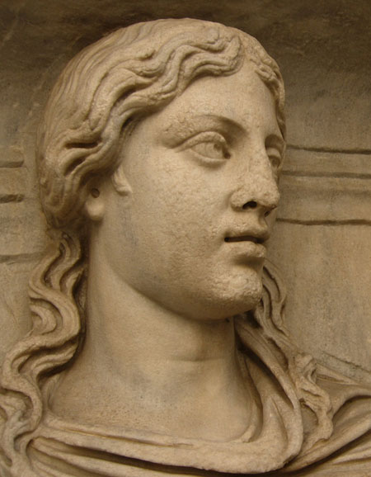
The Gospel in the Life of Believers
Renewed
Paul uses another radical concept: Our minds must be transformed and renewed.
If we were once slaves of sin, we are now slaves of righteousness.
We need a radical change in worldview!

Slide 53
The Gospel in the Life of Believers
New Creation
This transformation begins with being made into a new creation, with the surrender of our bodies and our minds.
Transformation is possible, and it can occur in this life. This is good news indeed!

Slide 54
The Gospel in the Life of Believers
This table shows the connections between this section and the beginning of the letter. It reveals the way God is solving the problem of human sin and its effects.
1:24 | Degrading of their bodies | 12:1 | Offer your bodies
1:25 | Worshiped created things | 12:1 | Proper worship
1:28 | A depraved mind | 12:2 | Renewing of your mind
2:18 | Know his will and approve | 12:2 | Test and approve what God’s will is
(Adapted from James D. G. Dunn, WBC Vol. 38A, Romans 1–8 )

Slide 55
The Gospel in the Life of Believers
Paul provides several examples of how a renewed mind deals with difficult ethical and moral issues.
He does not give us a comprehensive list. Rather, he expects his readers to understand his examples and apply his insights to all areas of life.
He expects us to exercise our moral muscles to develop renewed discernment. We can do that because now “we can test and approve what God’s will is” (12:2).

Slide 56
The Gospel in the Life of Believers
“Love must be sincere. Hate what is evil; cling to what is good. Be devoted to one another in love. Honor one another above yourselves. Never be lacking in zeal, but keep your spiritual fervor, serving the Lord. Be joyful in hope, patient in affliction, faithful in prayer. Share with the Lord’s people who are in need. Practice hospitality.”—Romans 12:9–13
Menu

Slide 57
Conclusion
Romans 15:14–16:27
Menu

Slide 58
Conclusion
Paul begins the conclusion of his letter with encouragement for the Roman Christians:
“I myself am convinced, my brothers and sisters, that you yourselves are full of goodness, filled with knowledge and competent to instruct one another. Yet I have written you quite boldly on some points to remind you of them again, because of the grace God gave me to be a minister of Christ Jesus to the Gentiles.”—Romans 15:14–16

Slide 59
Conclusion
After sending extended greetings to many people in Rome, he offers a final exhortation:
“I urge you, brothers and sisters, to watch out for those who cause divisions and put obstacles in your way that are contrary to the teaching you have learned.” —Romans 16:17
Menu

Slide 60
Application Questions
for reflection and discussion
Menu

Slide 61
Application Questions
Romans 1:16–17
What is the power of the gospel?
How does it accomplish God’s purposes in the lives of people?
How have you seen that power at work in your own life?

Slide 62
Application Questions
Romans 1:21–32
What are the dangers of valuing God’s creation more than the Creator himself?
In what ways have you struggled with this?

Slide 63
Application Questions
Romans 3:20
How should our inability to “be declared righteous in God’s sight by the works of the law” affect our attitudes toward God?
How about our attitudes toward others?

Slide 64
Application Questions
Romans 10:1–4; 11:1, 25–26
How should Paul’s arguments regarding the Jews give us reassurance about our own salvation?

Slide 65
Application Questions
Romans 10:9–15
What is our role in spreading the gospel, and why?
What are some different ways we can fulfill that?

Slide 66
Application Questions
Romans 12:1–2
Practically speaking, what does it mean to be “a living sacrifice” (12:1)?
How does it enable us to know God’s “good and pleasing and perfect” will—and actually do it?

Slide 67
Application Questions
Romans 12:3–8
How does a sacrificial attitude help us relate better to those who are built differently from us?

Slide 68
Application Questions
Romans 15:14
What is your reaction to Paul’s statement that your “brothers and sisters … are full of goodness”?
How would (or does) believing Paul’s statement change the way you approach and work together with your “brothers and sisters”?
Menu

Slide 69
Romans PowerPoint®
All rights reserved. No part of this publication may be reproduced, stored in a retrieval system or transmitted in any form or by any means—for example, electronic, photocopy, recording—without prior written permission of the publisher.
Image Credits: Some images used under license from Shutterstock.com
Author: Benjamin Galan, MTS, ThM
Tables adapted from James D. G. Dunn, WBC Vol. 38A, Romans 1–8
Trademarks: Any trademarked symbols included in this teaching presentation belong to the organizations identified. Rose Publishing is a Christian organization and not affiliated with any of the organizations with trademarked symbols. The symbols and photos used in this presentation fall under the U.S.A. Copyright Law, Title 17, Section 107.
All Scripture quotations, unless otherwise indicated, are taken from the Holy Bible, New International Version®, NIV®. Copyright ©1973, 1978, 1984, 2011 by Biblica, Inc.™ Used by permission of Zondervan. All rights reserved worldwide. www.zondervan.com The “NIV” and “New International Version” are trademarks registered in the United States Patent and Trademark Office by Biblica, Inc.™
© 2015 Bristol Works, Inc.
Rose Publishing, Inc.
4733 Torrance Blvd., #259 Torrance, California 90505 U.S.A. All rights reserved. Email: info@rose-publishing.com
www.rose-publishing.com

Slide 70
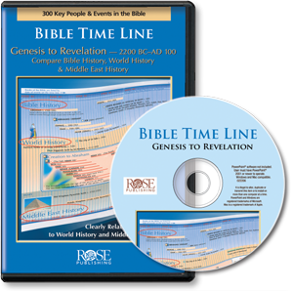
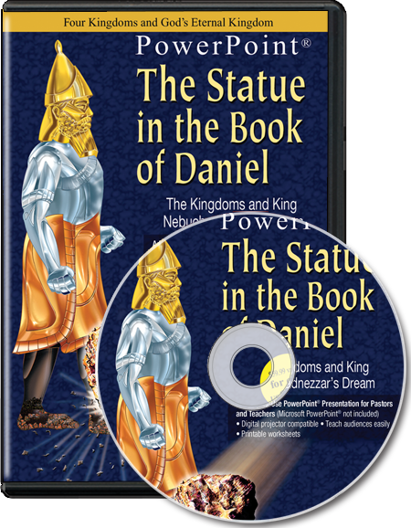
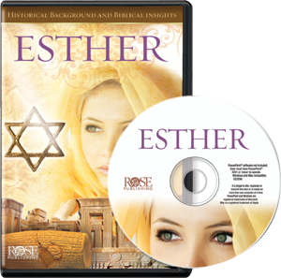
More than 60 PowerPoint® Presentations from Rose Publishing
www.rose-publishing.com

