Slide 2
Background
to the letter to the Romans

Slide 3
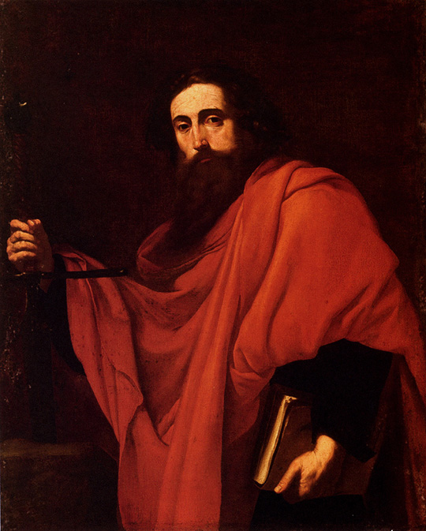
Background to Romans
Who wrote Romans?
The apostle Paul wrote the letter (epistle) to the Romans. (Rom 1:1-2)
He was a one-time enemy of Christianity whom God transformed into the greatest missionary of all time!
The Apostle Paul
Notes:
Rom 1:1-2

Slide 4
Background to Romans
Paul came from a well-respected Jewish family in Asia Minor (Turkey today) where his father was an official.
Paul’s Jewish name was Saul.
He was sent to Jerusalem to study under the great teacher Gamaliel. (Acts 22:1-3)
The Apostle Paul
Notes:
Acts 22:1-3 “22 “Brethren and fathers, hear my defense before you now.” ² And when they heard that he spoke to them in the Hebrew language, they kept all the more silent.
Then he said: ³ “I am indeed a Jew, born in Tarsus of Cilicia, but brought up in this city at the feet of Gamaliel, taught according to the strictness of our fathers’ law, and was zealous toward God as you all are today.

Slide 5
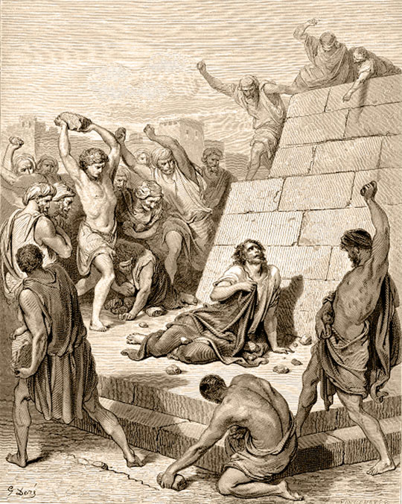
Background to Romans
Paul belonged to a group of people who thought the followers of Christ were dangerous.
He hated Christians and participated in the first execution of a Christian leader—Stephen. (Acts 7:54-60)
The Stoning of Stephen
Notes:
Acts 7:54-60 “⁵⁴ When they heard these things they were ^{[a]}cut to the heart, and they gnashed at him with their teeth. ⁵⁵ But he, being full of the Holy Spirit, gazed into heaven and saw the glory of God, and Jesus standing at the right hand of God, ⁵⁶ and said, “Look! I see the heavens opened and the Son of Man standing at the right hand of God!”
⁵⁷ Then they cried out with a loud voice, stopped their ears, and ran at him with one accord; ⁵⁸ and they cast him out of the city and stoned him. And the witnesses laid down their clothes at the feet of a young man named Saul. ⁵⁹ And they stoned Stephen as he was calling on God and saying, “Lord Jesus, receive my spirit.” ⁶⁰ Then he knelt down and cried out with a loud voice, “Lord, do not charge them with this sin.” And when he had said this, he fell asleep.

Slide 6
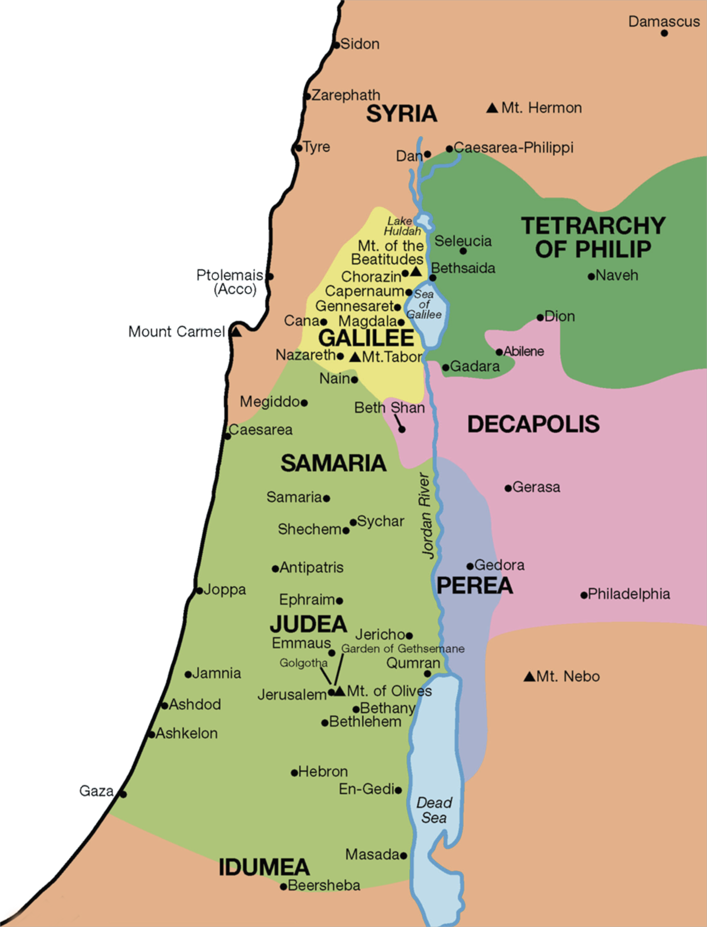
Background to Romans
Paul asked the chief priest in Jerusalem to give him authorization to arrest any follower of Jesus in Damascus (about 100 miles/ 160 km away). (Acts 9:1-2)
Notes:
Acts 9:1-2 “9 Then Saul, still breathing threats and murder against the disciples of the Lord, went to the high priest ² and asked letters from him to the synagogues of Damascus, so that if he found any who were of the Way, whether men or women, he might bring them bound to Jerusalem.

Slide 7
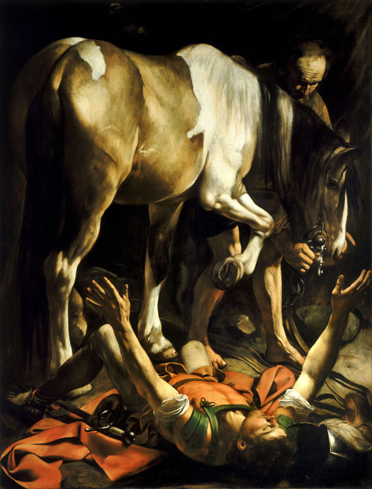
Background to Romans
On his way to Damascus, a light from heaven blinded him.
He fell to the ground and a voice said, “Saul, Saul, why do you persecute me?”
Paul answered, “Who are you?”
The voice said, “I am Jesus, the one you are persecuting. Get up! Go into the city, and you will be told what to do.”
Paul, blinded on the Road to Damascus

Slide 8
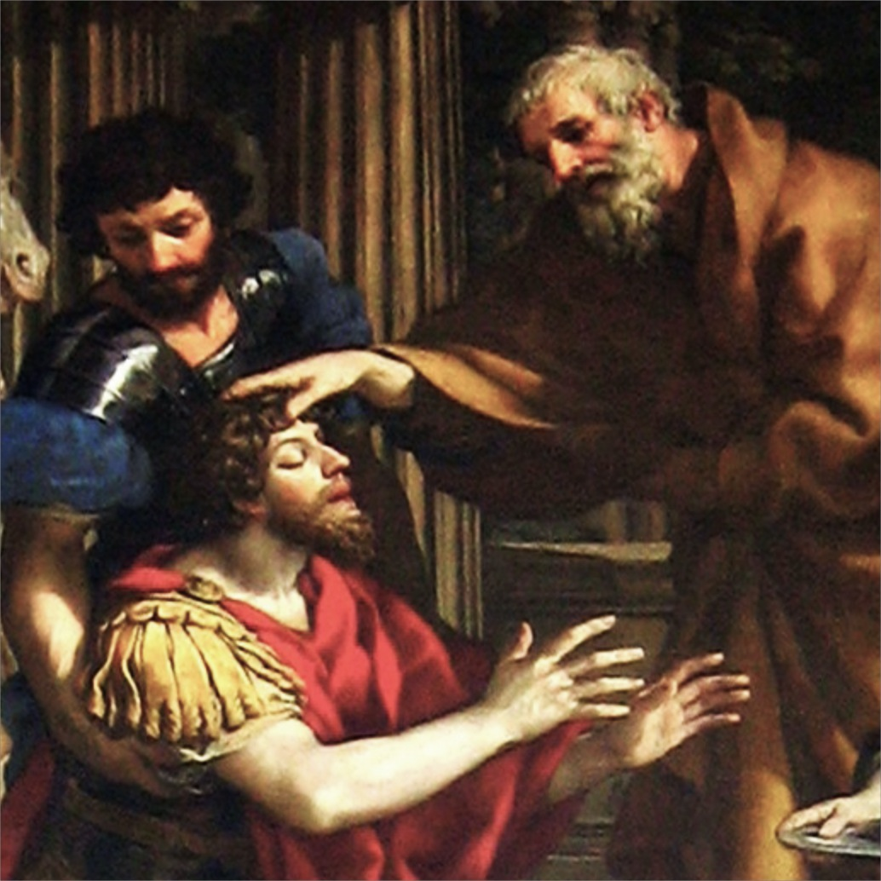
Background to Romans
He went to a house and waited for a Christian man named Ananias to come restore his sight.
“Ananias went to the house and entered it. Placing his hands on Saul, he said, ‘Brother Saul, the Lord—Jesus, who appeared to you on the road as you were coming here—has sent me so that you may see again and be filled with the Holy Spirit.’”—Acts 9:17
Paul and Ananias

Slide 9
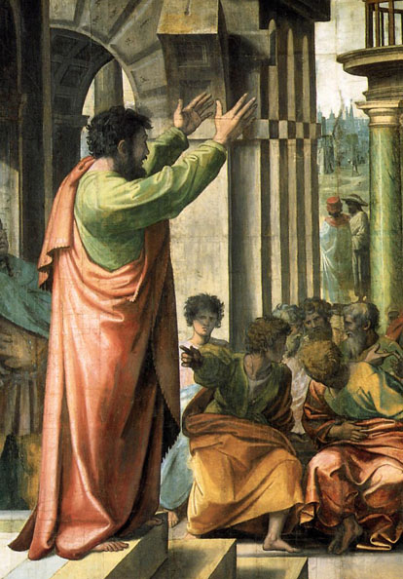
Background to Romans
Paul became one of God’s powerful tools to spread the good news of Jesus.
While traveling throughout the Roman Empire, the apostle Paul preached and ministered to many Gentile (non-Jewish) Christians.
Paul Preaching at Athens

Slide 10
Background to Romans
During the very early years of Christianity, Jesus’ disciples preached only to Jews, so most converts at that time were Jewish.
But as Jews scattered throughout the Roman Empire, they told their neighbors about Jesus. Many of these Gentiles then became followers of Jesus too.

Slide 11
Background to Romans
“Now those who had been scattered by the persecution that broke out when Stephen was killed traveled as far as Phoenicia, Cyprus and Antioch, spreading the word only among Jews. Some of them, however, men from Cyprus and Cyrene, went to Antioch and began to speak to Greeks also, telling them the good news about the Lord Jesus. The Lord’s hand was with them, and a great number of people believed and turned to the Lord.”—Acts 11:19–21

Slide 12
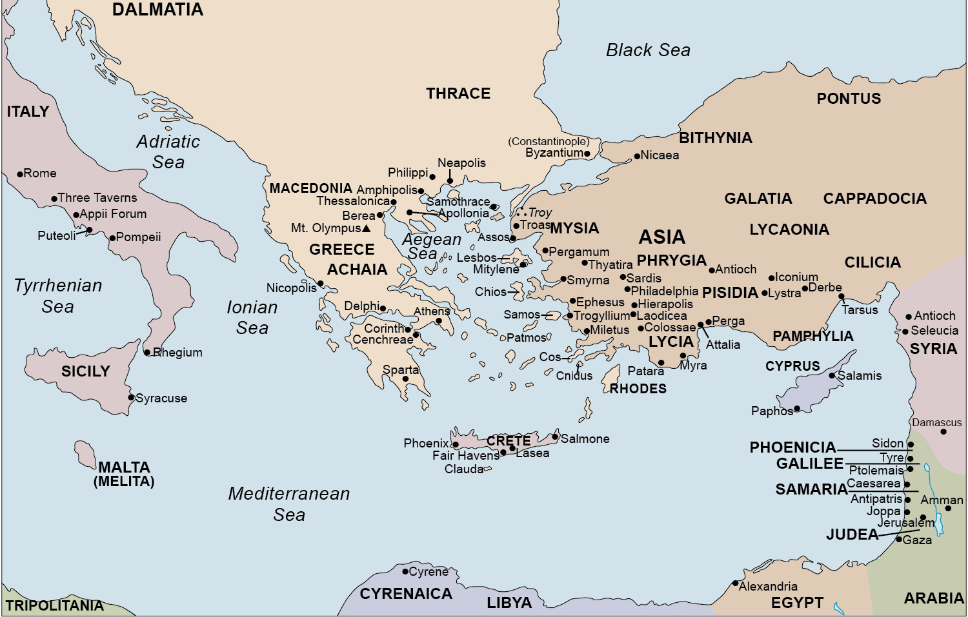
The World of the First Christians

Slide 13
Background to Romans
When was the letter written?
Paul wrote the the letter at the height of the Roman Empire, about AD 57, while on his 3rd journey during the rule of Nero. (Acts 20:1-3)
He wrote it just after his Corinthian letters and just before he headed to Jerusalem with the relief fund gathered for the believers there. (Rom. 15:25–27; Acts 20:16, 24:17)
Notes:
Acts 20:1-3 “20 After the uproar had ceased, Paul called the disciples to himself, embraced them, and departed to go to Macedonia. ² Now when he had gone over that region and encouraged them with many words, he came to Greece ³ and stayed three months. And when the Jews plotted against him as he was about to sail to Syria, he decided to return through Macedonia.
Rom 15:25-27 “²⁵ But now I am going to Jerusalem to ^{[a]}minister to the saints. ²⁶ For it pleased those from Macedonia and Achaia to make a certain contribution for the poor among the saints who are in Jerusalem. ²⁷ It pleased them indeed, and they are their debtors. For if the Gentiles have been partakers of their spiritual things, their duty is also to minister to them in material things.

Slide 14
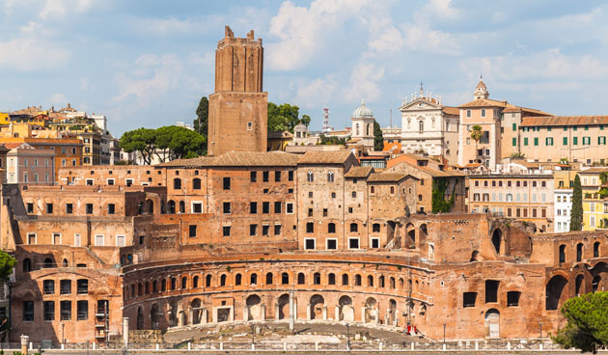
Background to Romans
To whom was the letter written?
Paul wrote this letter to the church in Rome.
In the first century, Rome was the center of nearly all that happened in the Mediterranean world.
The church at Rome during this time was a mix of both Jewish and Gentile believers.
Emperor Trajan’s Market in Rome
Notes:
“Since Rome was the capital city of the empire, the existence and strength of the church there would have special influence for God

Slide 15
Background to Romans
To whom was the letter written?
The church was composed of Gentiles (1:13; 11:13) and Jews (7:1; 2:17-29).
This would lead to questions about the Old Testament law and about how to treat one another in light of ancient animosities
Emperor Trajan’s Market in Rome
Notes:
Rom 1:13 “¹³ Now I do not want you to be unaware, brethren, that I often planned to come to you (but was hindered until now), that I might have some fruit among you also, just as among the other Gentiles.
Rom 11:3 “¹³ For I speak to you Gentiles; inasmuch as I am an apostle to the Gentiles, I magnify my ministry,”
Acts 2:17 “^{17 [a]}Indeed you are called a Jew, and rest^{[b]} on the law, and make your boast in God,”
Rom 7:1 “7 Or do you not know, brethren (for I speak to those who know the law), that the law ^{[a]}has dominion over a man as long as he lives? “

Slide 16
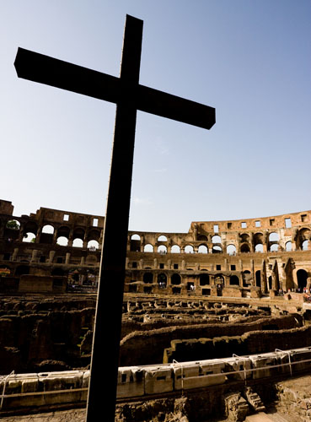
Background to Romans
Though there is no mention of who first brought the gospel to Rome, Christianity had spread quickly into Rome, probably through travelers engaged in business, political, and religious activities.
Cross at the Colosseum, Rome

Slide 17
Background to Romans
Many Christian believers were already there before Paul made his first journey to Rome around AD 57.
By the time of the great persecution under Emperor Nero (AD 64), the historian Tacitus could say a “great multitude” of Christians lived in Rome.
Cross at the Colosseum, Rome

Slide 18
Paul’s Journey to Rome, AD 57–62

Slide 19
Theme and Purpose
in the letter to the Romans

Slide 20
Theme
“Rom 1:16-17 “¹⁶ For I am not ashamed of the gospel of Christ, for it is the power of God to salvation for everyone who believes, for the Jew first and also for the Greek. ¹⁷ For in it the righteousness of God is revealed from faith to faith; as it is written, “The just shall live by faith.”
In these two verses Paul states his confidence in the gospel and the reasons for it
The bulk of his epistle is devoted to explaining why and how the gospel of Christ is God’s power to save those who believe

Slide 21
Purpose
Paul expresses in this epistle that he had for some time planned to preach the gospel at Rome (Rom 1:13-15) and from there go on to Spain (Rom 15:22-24)
Rom 15:30-33 “³⁰ Now I beg you, brethren, through the Lord Jesus Christ, and through the love of the Spirit, that you strive together with me in prayers to God for me, ³¹ that I may be delivered from those in Judea who ^{d}o not believe, and that my service for Jerusalem may be acceptable to the saints, ³² that I may come to you with joy by the will of God, and may be refreshed together with you. ³³ Now the God of peace be with you all. Amen.”
Notes:
Rom 1:13-15 “¹³ Now I do not want you to be unaware, brethren, that I often planned to come to you (but was hindered until now), that I might have some fruit among you also, just as among the other Gentiles. ¹⁴ I am a debtor both to Greeks and to barbarians, both to wise and to unwise. ¹⁵ So, as much as is in me, I am ready to preach the gospel to you who are in Rome also.
Rom 15:22-24 “²² For this reason I also have been much hindered from coming to you. ²³ But now no longer having a place in these parts, and having a great desire these many years to come to you, ²⁴ whenever I journey to Spain, ^{[a]}I shall come to you. For I hope to see you on my journey, and to be helped on my way there by you, if first I may enjoy your company for a while.

