Slide 1
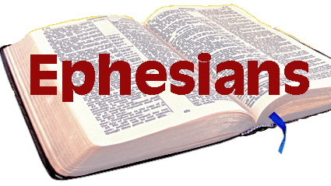
Walk Worthy of the calling: Walk as a Soldier
Eph 6:10-13

Slide 2
Stand Strong in the Lord (10)
“¹⁰ Finally, my brethren, be strong in the Lord and in the power of His might.”
Notes:
In light of all that God has done for you.
· In light of the glorious standing you have as a child of God.
· In light of His great plan of the ages that God has made you part of.
· In light of the plan for Christian maturity and growth He gives to you.
· In light of the conduct God calls every believer to live.
· In light of the filling of the Spirit and our walk in the Spirit.
· In light of all this, there is a battle to fight in the Christian life.

Slide 3
Stand Strong in the Lord (10)
“¹⁰ Finally, my brethren, be strong in the Lord and in the power of His might.”
Notes:
You are not to rely on your own strength and power
Self-empowerment will not work against our enemy (the devil)

Slide 4
Stand Strong in the Lord (10)
“¹⁰ Finally, my brethren, be strong in the Lord and in the power of His might.”
Notes:
"Might" is the intrinsic energy someone posses personally to do or achieve things. "Power" is the capability of doing something, either by his own or someone else's "might“
Might is inherent power or force. A muscular man’s big muscles display his might, even if he doesn’t use them. It is the reserve of strength.
ii. Power is the exercise of might. When the muscular man uses his might to bend an iron bar, he uses his power. It means that the reserve of strength is actually in operation.
God has vast reservoirs of might that can be realized as power in our Christian life. But His might does not work in me as I sit passively. His might works in me as I rely on it, and step out to do the work. I can rely on it and do no work. I can do work without relying on it. But both of these fall short. I must rely on His might and then do the work.
We must accept what God is telling us. We will fail if we rely on our own power. God is not a supplement to our strength; he is our strength in total!

Slide 5
What you Must do (11)
“¹¹ Put on the whole armor of God, that you may be able to stand against the wiles of the devil”
Notes:
Paul says that relying on the power of God means putting on the armor of God. This is how we are strong in the Lord. We have God’s armor that we depend on when we are attacked

Slide 6
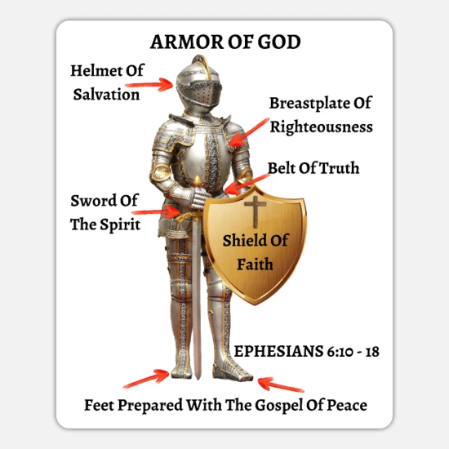
What you Must do (11)
“¹¹ Put on the whole armor of God, that you may be able to stand against the wiles of the devil”
Notes:
Armor does not have much value if you only have a helmet on but do not have a shield and breastplate. We need to be fully covered by the armor of God so that nothing is exposed in this spiritual battle. Therefore we must recognize we need something. We are unprotected without the armor of God.

Slide 7
What you Must do (11)
“¹¹ Put on the whole armor of God, that you may be able to stand against the wiles of the devil”
Notes:
God is giving us the armor we need to stand when Satan attacks. Notice that this is God’s focus: “That you may be able to stand against the schemes of the devil” (6:11). “That you may be able to withstand in the evil day, and having done all, to stand firm” (6:13). “Stand therefore” (6:14). Four times God says “stand” or “withstand.” The armor of God is the strength God is giving us. We cannot stand without the armor.

Slide 8
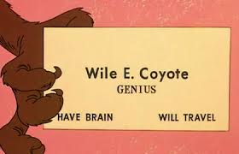
What you Must do (11)
“¹¹ Put on the whole armor of God, that you may be able to stand against the wiles of the devil”
Notes:
Wiles: Clever tricks used by someone to get what they want
a trick or stratagem intended to ensnare or deceive
Guile, ruses, ploys, schemes, subterfuges, deception

Slide 9
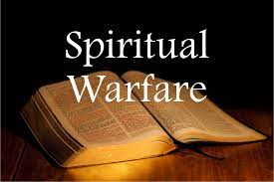
The Type of Battle (12)
“¹² For we do not wrestle against flesh and blood, but against principalities, against powers, against the rulers of the darkness of this age, against spiritual hosts of wickedness in the heavenly places.”
Notes:
The fact that our real battle is not against flesh and blood is forgotten by many Christians, who put all their efforts in that direction. Paul’s idea here is much the same as in 2 Corinthians 10:3-4: For though we walk in the flesh, we do not war according to the flesh. For the weapons of our warfare are not carnal but mighty in God for pulling down strongholds.

Slide 10
The Type of Battle (12)
“¹² For we do not wrestle against flesh and blood, but against principalities, against powers, against the rulers of the darkness of this age, against spiritual hosts of wickedness in the heavenly places.”
Notes:
Paul used a variety of terms to refer to our spiritual enemies. We should regard them as being on many different levels and of many different ranks, yet they all have one goal: to knock the Christian down from their place of standing.

Slide 11
The Preparation for Battle (13)
“¹³ Therefore take up the whole armor of God, that you may be able to withstand in the evil day, and having done all, to stand.
Notes:
. Take up the armor! That is what you are supposed to do! Now Paul wants to convince you that you need this armor. Paul wants to make sure that you understand how much you need to be actively getting this armor on your body

Slide 12
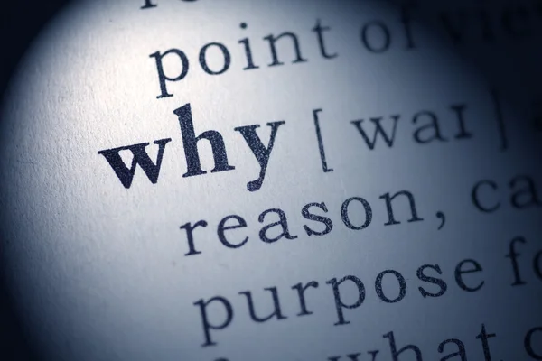
The Preparation for Battle (13)
“¹³ Therefore take up the whole armor of God, that you may be able to withstand in the evil day, and having done all, to stand.
Notes:
. Without the strength of God and the protection of spiritual armor, it is impossible to stand against the attacks of spiritual enemies.
this tells us that we need to be prepared before the attack comes. You cannot put the armor on after you have been shot. It is too late then. And we cannot start concerning ourselves with the armor of God after the trial and after the difficulty. We must put this armor on now because the days are evil and we are in a struggle. So we need this armor on so that we are ready for the attack. We need to spend our time each day preparing our armor, readying ourselves for the evil day.

Slide 13
The Preparation for Battle (13)
“¹³ Therefore take up the whole armor of God, that you may be able to withstand in the evil day, and having done all, to stand.
Notes:
We are not supposed to be sitting around waiting to get attacked by the devil. We are to be giving our all. This stand requires our all. All of our effort is necessary so that we have the armor properly on our bodies for the day of the attack of the devil.

Slide 14
One Final Thought (13)
“¹³ Therefore take up the whole armor of God, that you may be able to withstand in the evil day, and having done all, to stand.
Notes:
With the complete armor of God on you, you will be able to withstand the evil day…We do not have to wonder if this armor is going to work. We know the armor works because it is given to us by God.

