Slide 1
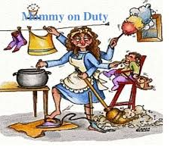
Mother’s We Need You

Slide 3
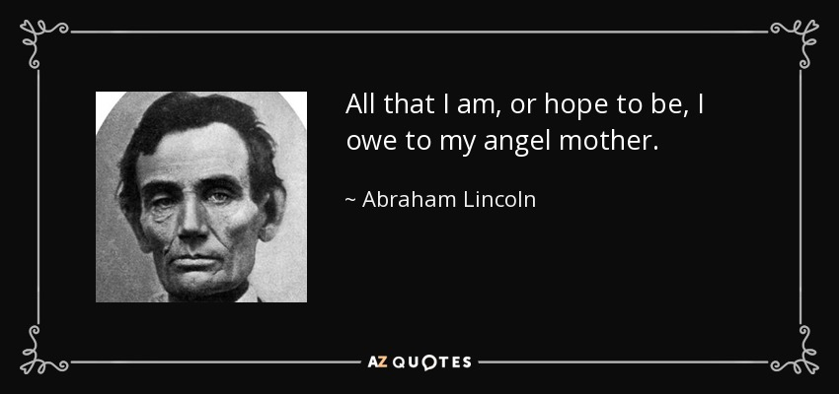
Mom, we need you
Notes:
It has been stated: Life didn’t’t come with an instruction manual—it came with something far better. It came with a Mother.

Slide 4
Mom, we need you
The word “mother” is used 245 times in the Bible
Strong’s Concordance tells us that the word literally means “the bond of the family”
In other words, a mother is the glue that holds a family together.

Slide 5
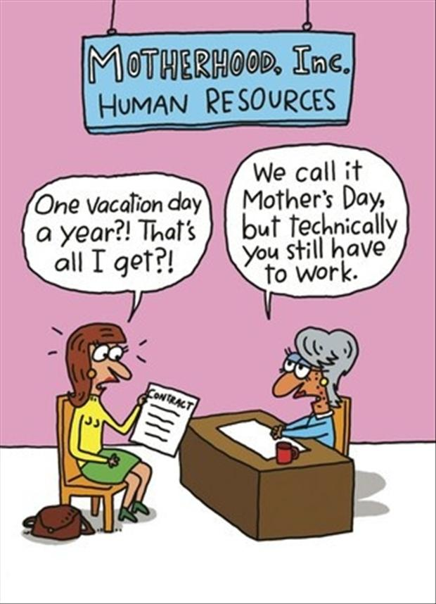
Mom, we need you: your true worth
Mothers work as many as 90 hours a week
She’s on call 24/7

Slide 6
Mom, we need you: your true worth
The national average weekly salary for a full-time nanny is $705. That’s $36,660 per year

Slide 7
Mom, we need you: your true worth
Regular cleaning service costs anywhere between $50-$100 per visit, depending on how big your space is. You’re looking at $100 per week at the bare minimum to stay presentable.
$5,200 per year

Slide 8
Mom, we need you: your true worth
Errands and Groceries: Personal shoppers on average run around $65 an hour. Average the amount of time spent at the grocery stores or department stores per week is 4 hours and you’re looking at around $260,
$13,520 per year

Slide 9
Mom, we need you: your true worth
Cooking: A personal chef can start from $400
$12,480 per year

Slide 10
Mom, we need you: your true worth
$15 an hour for the average rate of a financial assistant
Average 5 hours a week on financial services
$3900 per year

Slide 11
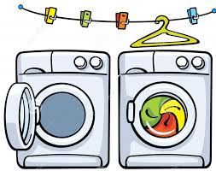
Mom, we need you: your true worth
Laundry: add at least a fee of $25 a week for the bare minimum washer/dryer personal service
$3,900 per year

Slide 12
Mom, we need you: your true worth
Average taxi fare is around $24 for 10 miles
At least 6 trips a week
$7,488 per year

Slide 13
Mom, we need you: your true worth
Grand total annual salary $80,548
There’s no sick leave with childcare
There’s no paid time off
There’s no 401(k)

Slide 14
Mom, we need you: Examples
2 And a man of the house of Levi went an. d took as wife a daughter of Levi.
² So the woman conceived and bore a son. And when she saw that he was a beautiful child, she hid him three months.
³ But when she could no longer hide him, she took an ark of bulrushes for him, daubed it with asphalt and pitch, put the child in it, and laid it in the reeds by the river’s bank

Slide 15
Mom, we need you: Examples
²⁶ Then the woman whose son was living spoke to the king, for she yearned with compassion for her son; and she said, “O my lord, give her the living child, and by no means kill him!” But the other said, “Let him be neither mine nor yours, but divide him.”
²⁷ So the king answered and said, “Give the first woman the living child, and by no means kill him; she is his mother.”

Slide 16
Mom, we need you: Examples
Paul is not saying a successful woman in a business owner or executive
He does not recommend that women become socialites
Paul is not explaining how to be a good employee
Paul is not explaining how to be loved by the world
Notes:
³ the older women likewise, that they be reverent in behavior, not slanderers, not given to much wine, teachers of good things— ⁴ that they admonish the young women to love their husbands, to love their children, ⁵ to be discreet, chaste, homemakers, good, obedient to their own husbands, that the word of God may not be blasphemed.

Slide 17
Mom, we need you: Examples
Paul is telling us what makes for a godly wife and mother so that the “Word of God not is blasphemed or reproached.”
Notes:
³ the older women likewise, that they be reverent in behavior, not slanderers, not given to much wine, teachers of good things— ⁴ that they admonish the young women to love their husbands, to love their children, ⁵ to be discreet, chaste, homemakers, good, obedient to their own husbands, that the word of God may not be blasphemed.

Slide 18
Mom, we need you for who you are and what you do
Trustworthy (11)
Strong in her convictions (17)
Soft and merciful caring for less fortunate (19,20)

Slide 19
Mom, we need you for who you are and what you do
Optimistic (21)
Strong and dignified (22, 25)
Industrious (13-16, 24, 27)

Slide 20
conclusion

