Slide 1
Walk Worthy of the calling in marriage
Eph 5:22-33

Slide 2
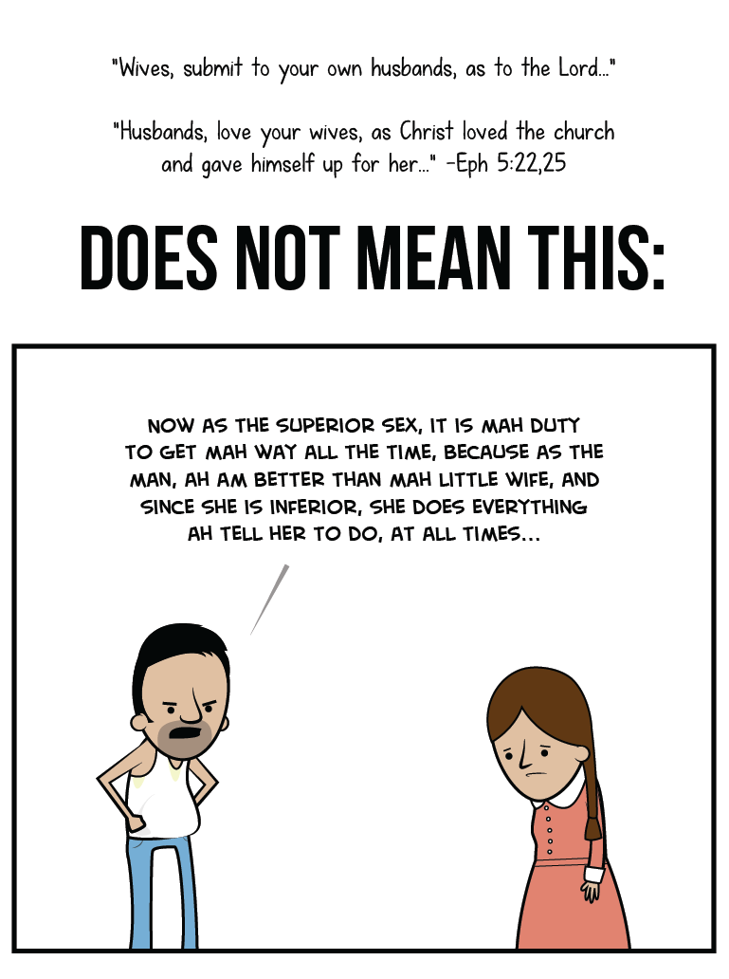
A Message to the Wives (5:22-24)
“²² Wives, submit to your own husbands, as to the Lord.
²³ For the husband is head of the wife, as also Christ is head of the church; and He is the Savior of the body.
²⁴ Therefore, just as the church is subject to Christ, so let the wives be to their own husbands in everything.
Notes:
the action or fact of accepting or yielding to a superior force or to the will or authority of another person." Submitting means putting others before yourself; it means not always doing what you want to do
to yield to the authority, control, or choice of another.
Please consider that submission and yielding does not mean she is inferior. Was Christ inferior for yielding to the will of the Father? Not at all! Yielding shows strength and godly meekness. Submission should be praised not denigrated.

Slide 3
A Message to the Wives (5:22-24)
“²² Wives, submit to your own husbands, as to the Lord.
²³ For the husband is head of the wife, as also Christ is head of the church; and He is the Savior of the body.
²⁴ Therefore, just as the church is subject to Christ, so let the wives be to their own husbands in everything.

Slide 4
A Message to the Wives (5:22-24)
“²² Wives, submit to your own husbands, as to the Lord.
²³ For the husband is head of the wife, as also Christ is head of the church; and He is the Savior of the body.
²⁴ Therefore, just as the church is subject to Christ, so let the wives be to their own husbands in everything.
Notes:
. As to the Lord does not define the extent of a wife’s submission or the limit of a wife’s submission. It defines the motive of a wife’s submission.
i. “It means: ‘Wives, submit yourselves unto your own husbands because it is a part of your duty to the Lord, because it is an expression of your submission to the Lord

Slide 5
A Message to the Wives (5:22-24)
“²² Wives, submit to your own husbands, as to the Lord.
²³ For the husband is head of the wife, as also Christ is head of the church; and He is the Savior of the body.
²⁴ Therefore, just as the church is subject to Christ, so let the wives be to their own husbands in everything.
Notes:
Headship: The quality of being in a position of leadership or guidance.
It means to have the appropriate responsibility to lead and the matching accountability. It is right and appropriate to submit to someone who is our head.

Slide 6
A Message to the Wives (5:22-24)
“²² Wives, submit to your own husbands, as to the Lord.
²³ For the husband is head of the wife, as also Christ is head of the church; and He is the Savior of the body.
²⁴ Therefore, just as the church is subject to Christ, so let the wives be to their own husbands in everything.
Notes:
This point is simple and clear. We have a model for the marriage relationship: the relationship between Jesus and the church. In that relationship, the headship of Jesus Christ is unquestioned. So also is the husband the head of the “team” that is the one-flesh relationship of husband and wife.

Slide 7
A Message to the Wives (5:22-24)
“²² Wives, submit to your own husbands, as to the Lord.
²³ For the husband is head of the wife, as also Christ is head of the church; and He is the Savior of the body.
²⁴ Therefore, just as the church is subject to Christ, so let the wives be to their own husbands in everything.
Notes:
Nothing is excluded in this picture of yielding. In all areas of your lives together, wives are to submit to their husbands. It does not matter if you do not like how he leads. It does not matter if you are unhappy with his decisions. Please read these words again: “Wives should submit in everything.” There are no exceptions. We cannot be full of excuses by we do not want to yield to his leadership. “But he doesn’t love me right.” “But he does not do this or that.” He is in sin for that but his actions do not nullify your responsibility to submit to him

Slide 8
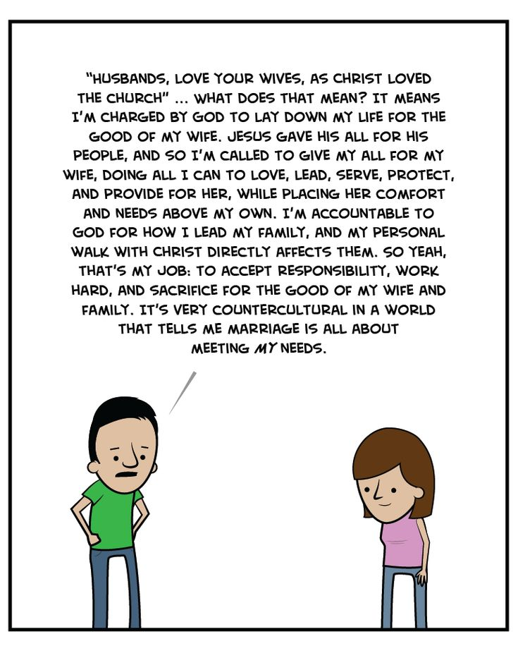
A Message to the Husbands (5:25-32)
“ ²⁵ Husbands, love your wives, just as Christ also loved the church and gave Himself for her,
²⁶ that He might sanctify and cleanse her with the washing of water by the word,
²⁷ that He might present her to Himself a glorious church, not having spot or wrinkle or any such thing, but that she should be holy and without blemish

Slide 9
A Message to the Husbands (5:25-32)
“ ²⁸ So husbands ought to love their own wives as their own bodies; he who loves his wife loves himself.
²⁹ For no one ever hated his own flesh, but nourishes and cherishes it, just as the Lord does the church.
³⁰ For we are members of His body, of His flesh and of His bones.
Notes:
Paul demands that husbands love their wives "as their own bodies." This includes personal care, time, and provision. A man would not leave his body "unattended" or without care for a great length of time. He should likewise not treat his wife in this manner.

Slide 10
A Message to the Husbands (5:25-32)
“ ²⁸ So husbands ought to love their own wives as their own bodies; he who loves his wife loves himself.
²⁹ For no one ever hated his own flesh, but nourishes and cherishes it, just as the Lord does the church.
³⁰ For we are members of His body, of His flesh and of His bones.
Notes:
Any man in his right mind is going to take care of his own flesh, even if it is just in the sense of feeding and clothing and caring for his own body. He knows that if he doesn’t, he is going to suffer for it. In the same way, once we know the Biblical fact of this unity, if we are in our right minds we will nourish and cherish our wives because she is part of us.

Slide 11
A Message to the Husbands (5:25-32)
“ ²⁸ So husbands ought to love their own wives as their own bodies; he who loves his wife loves himself.
²⁹ For no one ever hated his own flesh, but nourishes and cherishes it, just as the Lord does the church.
³⁰ For we are members of His body, of His flesh and of His bones.

Slide 12
A Message to the Husbands (5:25-32)
“ ³¹ “For this reason a man shall leave his father and mother and be joined to his wife, and the two shall become one flesh.
³² This is a great mystery, but I speak concerning Christ and the church.
Notes:
Paul quotes Genesis 2:24 in verse 31. She is your body. The two of you are now one flesh. You do not lead her in a hateful way or harsh way. You cherish her like your own body because the two of you are one now. Husbands must see the marriage relationship in this way. She is your very body and must be treated with care and love.

Slide 13
A Message to the Husbands (5:25-32)
“ ³¹ “For this reason a man shall leave his father and mother and be joined to his wife, and the two shall become one flesh.
³² This is a great mystery, but I speak concerning Christ and the church.
Notes:
A truly Christian marriage will mirror the relationship between Christ and the church. Paul sets before us an example for us to look to in our marriages. Look to the relationship of Christ and the church. Everything in this section of text used this image for both wives and husbands so we would know how to act properly and walk worthy of our calling in our marriages

Slide 14
A Message to the Husbands (5:25-32)
“ ³³ Nevertheless let each one of you in particular so love his own wife as himself, and let the wife see that she respects her husband.
Notes:
Men, love your wives. It does not matter if she deserves it or not. We do not deserve the love of Christ yet Christ loved us anyway. Husbands will not hurt their wives with their words or decisions

Slide 15
A Message to the Husbands (5:25-32)
“ ³³ Nevertheless let each one of you in particular so love his own wife as himself, and let the wife see that she respects her husband.
Notes:
Wives, respect your husbands. It does not matter if he deserves it or not. We do not deserve the love of Christ and yet Christ submitted his will to the Father for us
When husbands love their wives like Christ and when wives submit to their husbands like Christ, the marriage will be a joyful blessing given to us by God.

