Slide 1
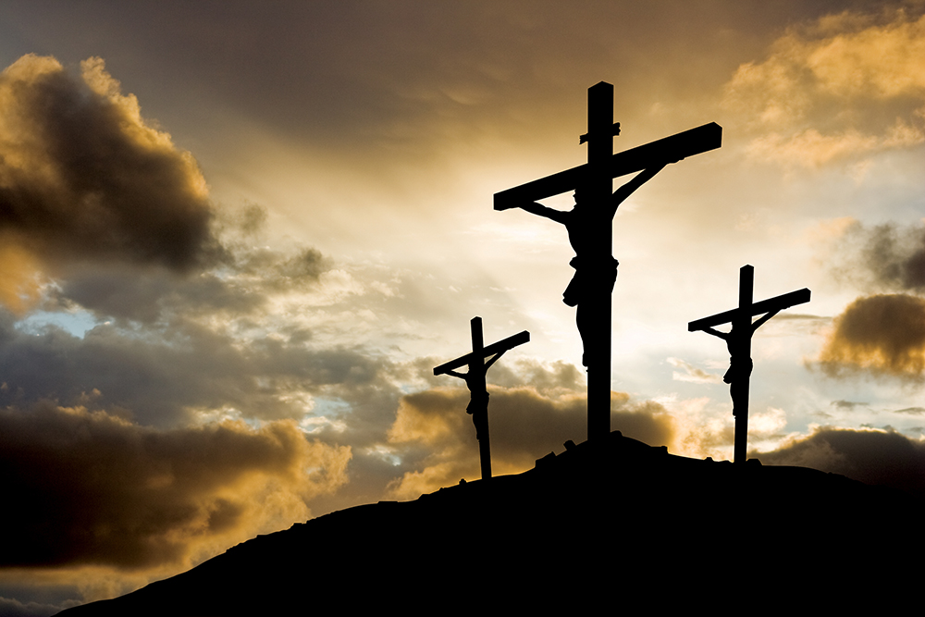
The Two Thieves: A Closer Look
Lk 23:32-43
Notes:
Bible reading Jn 19:18

Slide 2
Hard-hearted thief
Guilty of a crime… vs 34
Being held accountable for his actions… vs 41
Guilty of sin… Rom 3:23
Being held accountable for his sin Rom 6:23

Slide 3
Hard-hearted thief
Blasphemy… vs 39
Doubt/disbelief… vs 39
Refused to accept responsibility for his actions

Slide 4
Hard-hearted thief
This man is no different than most of the world today
He is called a thief but could have easily been called a drunk, murderer, drug addict, liar, or any other type of sinner
He spent his last moments denying Jesus as savior, blaspheming and mocking his name

Slide 5
Honest thief
Guilty of a crime… vs 34
Being held accountable for his actions… vs 41
Guilty of sin… Rom 3:23
Being held accountable for his sin Rom 6:23

Slide 6
honest thief
Rebuked the other… vs 40
Feared God… vs 40
Admitted his sin… vs 41
Recognized Jesus as lord… vs 41-42

Slide 7
honest thief
The first step toward removal of sin is recognizing you have it
We must become convinced Jesus is who He claims to be and profess that belief
We must take action based on our belief… knowledge of who Jesus is without taking action will not save

Slide 8
conclusion
If you see yourself in the hard-hearted thief…
Nothing you have outside of Jesus is worth dying for (Mk 8:35-36)
Today is your wake-up call 2 Cor 6:2)
Notes:
Mk 8:35-36 “³⁵ For whoever desires to save his life will lose it, but whoever loses his life for My sake and the gospel’s will save it. ³⁶ For what will it profit a man if he gains the whole world, and loses his own soul?
² For He says:
“In an acceptable time I have heard you, And in the day of salvation I have helped you.”
Behold, now is the accepted time; behold, now is the day of salvation.

