Slide 1
Walk as the New Man
Eph 4:21-32

Slide 2
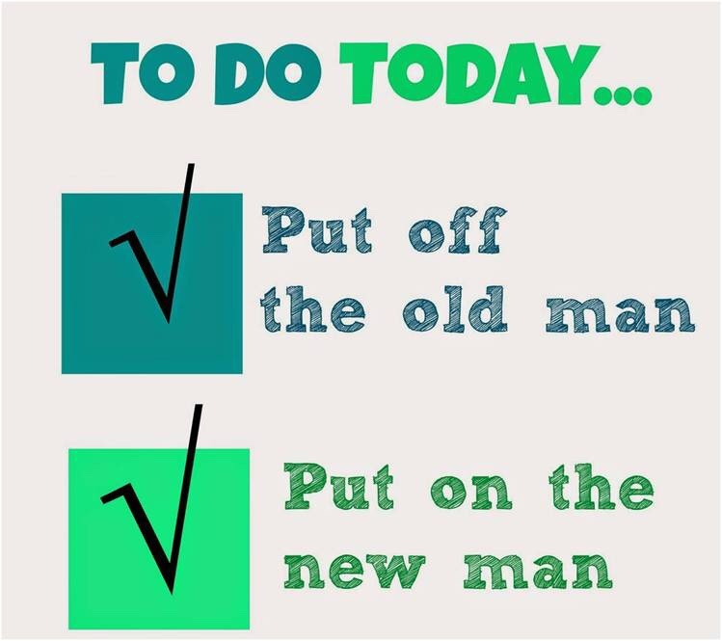
Walk in Purity (4:22-24)
“²² that you put off, concerning your former conduct, the old man which grows corrupt according to the deceitful lusts, ²³ and be renewed in the spirit of your mind, ²⁴ and that you put on the new man which was created according to God, in true righteousness and holiness.
Notes:
Put off means to divest yourself of something, to take it off. When you go into your bedroom at night to get ready for bed you put off your clothes, you divest yourself of them, and lay them aside. If you have a soiled garment, you put it off and put on something new.
We must reject those basic assumptions which have caused our trouble, putting them off, rejecting them, divesting ourselves of them, just as you would put off your dirty clothes.

Slide 3
Walk in Purity (4:22-24)
“²² that you put off, concerning your former conduct, the old man which grows corrupt according to the deceitful lusts, ²³ and be renewed in the spirit of your mind, ²⁴ and that you put on the new man which was created according to God, in true righteousness and holiness.
Notes:
The old man is simply how you lived prior to becoming a child of God… we are not to be associated with or continue in the sinful practices we once engaged in

Slide 4
Walk in Purity (4:22-24)
“²² that you put off, concerning your former conduct, the old man which grows corrupt according to the deceitful lusts, ²³ and be renewed in the spirit of your mind, ²⁴ and that you put on the new man which was created according to God, in true righteousness and holiness.
Notes:
Paul is saying that the whole character which represented the former self was not only corrupt but was continually growing more and more corrupt (present tense). The old man is decaying day by day, like a decomposing corpse.

Slide 5
Walk in Purity (4:22-24)
“²² that you put off, concerning your former conduct, the old man which grows corrupt according to the deceitful lusts, ²³ and be renewed in the spirit of your mind, ²⁴ and that you put on the new man which was created according to God, in true righteousness and holiness.
Notes:
Deceit (539) (apate from apatao [word study] = cheat, delude, deceive, beguile) describes that which gives a false impression, whether by appearance, statement or influence
Lust: overwhelming desire or craving… a neutral term denoting the presence of strong desires or impulses, longings or passionate craving (whether good or evil is determined by context) directed toward an object.
Lust has as its focus pleasing oneself, and it often leads to unwholesome actions to fulfill one’s desires with no regard to the consequences… Lust is about possession and greed. The Christian faith is about selflessness and is marked by holy living

Slide 6
Walk in Purity (4:22-24)
“²² that you put off, concerning your former conduct, the old man which grows corrupt according to the deceitful lusts, ²³ and be renewed in the spirit of your mind, ²⁴ and that you put on the new man which was created according to God, in true righteousness and holiness.
Notes:
That you be renewed - Paul exhorts the believers in the church at Ephesus (and you and I in the Body, the Church of Jesus Christ) to the lofty goal of continually allowing the Spirit of God to renew the way they (we) think. This renewal is not only in what one believes (which is vitally important), but is a belief which transforms our feelings, our attitudes and our behavior… This renewal points to a complete about-face in their thinking, a change from mental impurity to holiness. The Spirit of God influences the thought processes of believers so that they begin more and more to reason from God’s viewpoint.

Slide 7
Walk in Purity (4:22-24)
“²² that you put off, concerning your former conduct, the old man which grows corrupt according to the deceitful lusts, ²³ and be renewed in the spirit of your mind, ²⁴ and that you put on the new man which was created according to God, in true righteousness and holiness.
Notes:
Put on: means to put on as a garment, to cause to get into a garment, to clothe or to dress
putting on "ethical, moral or spiritual" garments like Christ Himself

Slide 8
Walk in Purity (4:22-24)
“²² that you put off, concerning your former conduct, the old man which grows corrupt according to the deceitful lusts, ²³ and be renewed in the spirit of your mind, ²⁴ and that you put on the new man which was created according to God, in true righteousness and holiness.
Notes:
The new man… in contrast to the old as described previously

Slide 9
Walk in Purity (4:22-24)
“²² that you put off, concerning your former conduct, the old man which grows corrupt according to the deceitful lusts, ²³ and be renewed in the spirit of your mind, ²⁴ and that you put on the new man which was created according to God, in true righteousness and holiness.
Notes:
KJV Bible Commentary notes that created does not refer to "the reformation or renovation of the old man; this is the product of the new birth and results in a new creation. The new man is created after God and in the family likeness of God. The brand new man is known by the Christlikeness exhibited day by day in living out the new life. Righteousness refers to his new conduct toward his fellowmen. Holiness refers to his new conduct towards God. These two are the essential qualities and the evidence of the new man in Christ.

Slide 10
Walk in Purity (4:22-24)
“²² that you put off, concerning your former conduct, the old man which grows corrupt according to the deceitful lusts, ²³ and be renewed in the spirit of your mind, ²⁴ and that you put on the new man which was created according to God, in true righteousness and holiness.
Notes:
KJV Bible Commentary notes that created does not refer to "the reformation or renovation of the old man; this is the product of the new birth and results in a new creation. The new man is created after God and in the family likeness of God. The brand new man is known by the Christlikeness exhibited day by day in living out the new life. Righteousness refers to his new conduct toward his fellowmen. Holiness refers to his new conduct towards God. These two are the essential qualities and the evidence of the new man in Christ.

Slide 11
Walk in Purity (4:22-24)
“²² that you put off, concerning your former conduct, the old man which grows corrupt according to the deceitful lusts, ²³ and be renewed in the spirit of your mind, ²⁴ and that you put on the new man which was created according to God, in true righteousness and holiness.
Notes:
Holiness of truth - Young's Literal Translation reads "and to put on the new man, which, according to God, was created in righteousness and kindness of the truth." The NET Bible reads "in righteousness and holiness that comes from truth". Although several other translations invert the literal Greek order (E.g., NIV "true righteousness and holiness"), there is another way this phrase can be translated and one which seems to be a more accurate reflection of the Greek. For example, the Translator's New Testament has "and shown in the righteousness and holiness that comes from the truth". William Barclay has "and which shows itself in that justice and holiness, which are the products of the truth". The French Common Language Bible has "and that manifests itself in the righteous and holy life inspired by the truth". As several of authoritative sources (Eadie, Vincent, Nida) emphasize, it seems better to interpret "the truth" as the source or origin of the righteousness and holiness.
The NET Bible note says or “in righteousness and holiness which is based on truth” or “originated from truth.” (NET Bible)
Marvin Vincent a well-known Greek scholar agrees writing that truth is that which is "Opposed to deceit and likewise personified. Righteousness and holiness are attributes of truth. (Ephesians 4 Word Studies in Greek)

Slide 12
Walk in Purity (4:22-24)
“²² that you put off, concerning your former conduct, the old man which grows corrupt according to the deceitful lusts, ²³ and be renewed in the spirit of your mind, ²⁴ and that you put on the new man which was created according to God, in true righteousness and holiness.
Notes:
O'Brien writes that "Finally, the concluding genitival phrase ‘of the truth’ is best understood as denoting source or origin. The graces of holiness and righteousness which are to characterize the new person come from ‘the truth’, which is another way of saying from God himself. He is the truth. These qualities originate in Him, are consistent with His character, and are ultimately real. In this sense it may be said that they are ‘true holiness and righteousness’. In the wider context of Ephesians ‘the truth’ is the truth of the gospel (Ep 1:!3-note) which the readers learned when they were instructed in Christ Jesus (Ep 4:21-note)

Slide 13
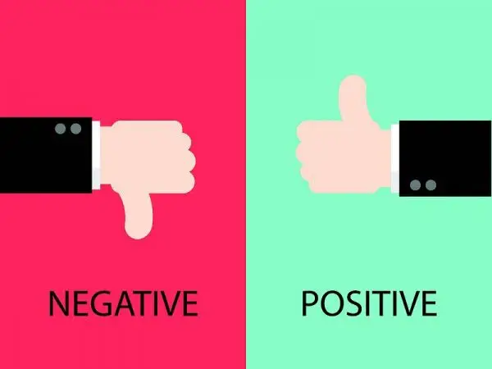
Lying (4:25)
“²⁵ Therefore, putting away lying, “Let each one of you speak truth with his neighbor,” for we are members of one another
Notes:
The negative command… don’t lie

Slide 14
Lying (4:25)
“²⁵ Therefore, putting away lying, “Let each one of you speak truth with his neighbor,” for we are members of one another
Notes:
The positive command

Slide 15
Lying (4:25)
“²⁵ Therefore, putting away lying, “Let each one of you speak truth with his neighbor,” for we are members of one another
Notes:
The spiritual principle…
As “members of one another” we affect each other, and we cannot build up one another apart from the truth

Slide 16
Anger (4:26-27)
“²⁶ “Be angry, and do not sin”: do not let the sun go down on your wrath, ²⁷ nor give place to the devil.
Notes:
The negative command…
It is possible to be angry and not sin

Slide 17
Anger (4:26-27)
“²⁶ “Be angry, and do not sin”: do not let the sun go down on your wrath, ²⁷ nor give place to the devil.
Notes:
The negative command…
but if we do sin, we must settle the matter quickly and not let the sun go down on our wrath
It is possible to be angry and not sin

Slide 18
Anger (4:26- 27)
“²⁶ “Be angry, and do not sin”: do not let the sun go down on your wrath, ²⁷ nor give place to the devil.
Notes:
The spiritual principle…
We must beware because anger can “Give place to the devil” (Eph 4:27)
As “members of one another” we affect each other, and we cannot build up one another apart from the truth

Slide 19
Stealing (4:28)
“²⁸ Let him who stole steal no longer, but rather let him labor, working with his hands what is good, that he may have something to give him who has need.
Notes:
The negative command…²⁸ Let him who stole steal no longer, but rather let him labor, working with his hands what is good, that he may have something to give him who has need.

Slide 20
Stealing (4:28)
“²⁸ Let him who stole steal no longer, but rather let him labor, working with his hands what is good, that he may have something to give him who has need.
Notes:
The positive command…

Slide 21
Anger (4:28)
“²⁸ Let him who stole steal no longer, but rather let him labor, working with his hands what is good, that he may have something to give him who has need.
Notes:
The spiritual principle…
“²⁸ Let him who stole steal no longer, but rather let him labor, working with his hands what is good, that he may have something to give him who has need.
A lazy Christian robs himself, others, and God
We work that we may be able to help others, if we steal, we hurt others
As “members of one another” we affect each other, and we cannot build up one another apart from the truth

Slide 22
Corrupt Communication (4:29)
“²⁹ Let no corrupt word proceed out of your mouth, but what is good for necessary edification, that it may impart grace to the hearers.
Notes:
The negative command… the mouth and the heart are connected

Slide 23
Corrupt Communication (4:29)
“²⁹ Let no corrupt word proceed out of your mouth, but what is good for necessary edification, that it may impart grace to the hearers.
Notes:
The positive command…

Slide 24
Anger (4:29)
“²⁹ Let no corrupt word proceed out of your mouth, but what is good for necessary edification, that it may impart grace to the hearers..
Notes:
The spiritual principle…
“²⁸ Let him who stole steal no longer, but rather let him labor, working with his hands what is good, that he may have something to give him who has need.
A lazy Christian robs himself, others, and God
We work that we may be able to help others, if we steal, we hurt others
As “members of one another” we affect each other, and we cannot build up one another apart from the truth

Slide 25
Grieving the Holy Spirit (4:30-32)
“³⁰ And do not grieve the Holy Spirit of God, by whom you were sealed for the day of redemption. ³¹ Let all bitterness, wrath, anger, clamor, and evil speaking be put away from you, with all malice. ³² And be kind to one another, tenderhearted, forgiving one another, even as God in Christ forgave you.
Notes:
The negative command…

Slide 26
Grieving the Holy Spirit (4:30-32)
“³⁰ And do not grieve the Holy Spirit of God, by whom you were sealed for the day of redemption. ³¹ Let all bitterness, wrath, anger, clamor, and evil speaking be put away from you, with all malice. ³² And be kind to one another, tenderhearted, forgiving one another, even as God in Christ forgave you.
Notes:
The positive command…

Slide 27
Grieving the Holy Spirit (4:30-32)
“³⁰ And do not grieve the Holy Spirit of God, by whom you were sealed for the day of redemption. ³¹ Let all bitterness, wrath, anger, clamor, and evil speaking be put away from you, with all malice. ³² And be kind to one another, tenderhearted, forgiving one another, even as God in Christ forgave you.
Notes:
The spiritual principle…
Bitterness in the heart makes us treat others as Satan treats them when we should be treating them the way God has treated us
In His gracious kindness He forgiven us
We should forgive others
We do not forgive for our sake (though it does help us), we donot do so for their sake, but because Christ demonstrated and commanded it

