Slide 1
Walk together in unity
Eph 4:7-11

Slide 2
Introduction
Paul has mentioned the various gifts that have been given to the church
Paul is now going to explain the purpose behind these gifts
As we study the purpose, we will see that ultimately the purpose of the gifts is to help the church grow in unity

Slide 3
Gifts for Unity (4:12-16)
Eph 4:12 “¹² for the equipping of the saints for the work of ministry, for the edifying of the body of Christ,
¹³ till we all come to the unity of the faith and of the knowledge of the Son of God, to a perfect man, to the measure of the stature of the fullness of Christ;
Notes:
1 : the reason why something is done or used : the aim or intention of something

Slide 4
Gifts for Unity (4:12-16)
Eph 4:12 “¹² for the equipping of the saints for the work of ministry, for the edifying of the body of Christ,
¹³ till we all come to the unity of the faith and of the knowledge of the Son of God, to a perfect man, to the measure of the stature of the fullness of Christ;
Notes:
To supply with necessities such as tools or provisions. See Synonyms at furnish.
2. To furnish (someone) with the qualities necessary for performance; prepare: an education that will equip you to handle such problems.
It is important to note that there are some who are equipers… that is they help others do their work
Saints: Saints is not a term describing the few chosen virtuous Christians but rather a term that includes all Christians. As we see from Ephesians chapter 1 all Christians are chosen and called and thus set apart for the Lord. All genuine Christians are saints. Even the apostles, prophets, etc. are considered saints. This group of instructors then are a subset of the larger group of Christians.

Slide 5
Gifts for Unity (4:12-16)
Eph 4:12 “¹² for the equipping of the saints for the work of ministry, for the edifying of the body of Christ,
¹³ till we all come to the unity of the faith and of the knowledge of the Son of God, to a perfect man, to the measure of the stature of the fullness of Christ;
Notes:
The idea presented is to do the work of a servant… Paul is emphasizing that the purpose of these gifts was not to do the work for the individual but to help supply the individual with the work he/she is expected to perform on their own

Slide 6
Gifts for Unity (4:12-16)
Eph 4:12 “¹² for the equipping of the saints for the work of ministry, for the edifying of the body of Christ,
¹³ till we all come to the unity of the faith and of the knowledge of the Son of God, to a perfect man, to the measure of the stature of the fullness of Christ;
Notes:
Edified… built up and strengthened

Slide 7
Gifts for Unity (4:12-16)
Eph 4:12 “¹² for the equipping of the saints for the work of ministry, for the edifying of the body of Christ,
¹³ till we all come to the unity of the faith and of the knowledge of the Son of God, to a perfect man, to the measure of the stature of the fullness of Christ;
Notes:
the church will always be moving towards complete spiritual maturity this side of heaven because 1) the church will continue to add new believers to the body which will have to mature, and 2) every Christian, regardless of how long they have walked with the Lord, will still be growing in Christ. It will only be after we exchange these temporal bodies for heavenly ones that our struggle against our sin nature will cease and the positional righteousness with have in Christ will be matched by actual righteousness. The church will continue to mature until we all reach heaven, yet these are also supposed to be the goals we presently have.

Slide 8
Gifts for Unity (4:12-16)
Eph 4:12 “¹² for the equipping of the saints for the work of ministry, for the edifying of the body of Christ,
¹³ till we all come to the unity of the faith and of the knowledge of the Son of God, to a perfect man, to the measure of the stature of the fullness of Christ;
Notes:
In this context, pistis (faith) has to do with doctrine—the body of Christian doctrine. The purpose of Christian nurture is to school believers in the revealed truths so that they might be united in their beliefs.

Slide 9
Gifts for Unity (4:12-16)
Eph 4:12 “¹² for the equipping of the saints for the work of ministry, for the edifying of the body of Christ,
¹³ till we all come to the unity of the faith and of the knowledge of the Son of God, to a perfect man, to the measure of the stature of the fullness of Christ;
Notes:
Paul is not referring to the knowledge needed for salvation, but rather the deep or full knowledge of Christ that comes through a personal relationship cultivated with Him in prayer and in study and obedience to His word. This is the knowledge Jesus spoke of in John 10 that “My sheep hear My voice, and I know them.” Paul had already prayed for the Ephesians to gain this kind of knowledge of Christ (Eph 1:17), and it was his own goal to “know Him, and the power of His resurrection and the fellowship of His sufferings” counting everything else in his own life as “rubbish” in comparison to this (Phil 3:8-10).
For on the belief not only of what He was on earth, but of what He is in heaven, all distinctive Christianity depends. If He is only “Son of Man” He cannot be the universal Saviour.

Slide 10
Gifts for Unity (4:12-16)
Eph 4:12 “¹² for the equipping of the saints for the work of ministry, for the edifying of the body of Christ,
¹³ till we all come to the unity of the faith and of the knowledge of the Son of God, to a perfect man, to the measure of the stature of the fullness of Christ;
Notes:
“to a full grown (teleios) man“ (v. 13c). The word teleios is sometimes translated perfect, but the idea here is maturity—being a full-grown adult.
The goal of Christian nurture is that believers might grow into mature spiritual people

Slide 11
Gifts for Unity (4:12-16)
Eph 4:12 “¹² for the equipping of the saints for the work of ministry, for the edifying of the body of Christ,
¹³ till we all come to the unity of the faith and of the knowledge of the Son of God, to a perfect man, to the measure of the stature of the fullness of Christ;
Notes:
This is the goal of Christian nurture—that we become like Christ.
The goal of Christian nurture is that believers might grow into mature spiritual people

Slide 12
Gifts for Unity (4:12-16)
Eph 4:12 “¹² for the equipping of the saints for the work of ministry, for the edifying of the body of Christ,
¹³ till we all come to the unity of the faith and of the knowledge of the Son of God, to a perfect man, to the measure of the stature of the fullness of Christ;
Notes:
This is the goal of Christian nurture—that we become like Christ.
The goal of Christian nurture is that believers might grow into mature spiritual people

Slide 14
Gifts for Unity (4:12-16)
¹⁴ that we should no longer be children, tossed to and fro and carried about with every wind of doctrine, by the trickery of men, in the cunning craftiness of deceitful plotting,
¹⁵ but, speaking the truth in love, may grow up in all things into Him who is the head—Christ—
Notes:
Children are characterized by ignorant trust. That is why parents spend so much time trying to teach them discernment, when to trust someone and when run away. .. New believers are susceptible to anyone that seems friendly and acts like they know what they are talking about including the cult knocking at their door or the false teacher on television.

Slide 15
Gifts for Unity (4:12-16)
¹⁴ that we should no longer be children, tossed to and fro and carried about with every wind of doctrine, by the trickery of men, in the cunning craftiness of deceitful plotting,
¹⁵ but, speaking the truth in love, may grow up in all things into Him who is the head—Christ—
Notes:
Paul also describes the immature as being tossed around as in a storm. They go and believe whichever way the wind blows. They think it must be okay because so many others believe it or are doing it, yet God’s people have always stood out from the crowd.

Slide 16
Gifts for Unity (4:12-16)
¹⁴ that we should no longer be children, tossed to and fro and carried about with every wind of doctrine, by the trickery of men, in the cunning craftiness of deceitful plotting,
¹⁵ but, speaking the truth in love, may grow up in all things into Him who is the head—Christ—
Notes:
We must always be careful of false teachers because they come with the “trickery of men” and “by craftiness in deceitful scheming.”
The point is that the author is concerned about Christians growing into maturity. He is fearful that certain kinds of very cunning people, who are skilled at deceitful scheming, should come in and teach false doctrines which would in turn stunt the growth of the believers. (NET translation notes)

Slide 17
Gifts for Unity (4:12-16)
¹⁴ that we should no longer be children, tossed to and fro and carried about with every wind of doctrine, by the trickery of men, in the cunning craftiness of deceitful plotting,
¹⁵ but, speaking the truth in love, may grow up in all things into Him who is the head—Christ—
Notes:
True love, agape love, is always kind, humble, patient, and willing to forgive, but it does not back down and will warn, admonish, and rebuke as needed. Mature Christians are to be marked by the joining of these two qualities of truth and love.
One temptation is to speak the truth so sharply that it wounds rather than heals. The opposite temptation is to avoid conflict by avoiding difficult conversations.
The needed balance was beautifully worked out in Christ. The challenge is for us to live it out. We must speak the truth in love. We speak the uncomfortable truth because people need to hear it. We speak lovingly because it is the only way to speak the truth. Otherwise we misrepresent the truth.

Slide 18
Gifts for Unity (4:12-16)
¹⁴ that we should no longer be children, tossed to and fro and carried about with every wind of doctrine, by the trickery of men, in the cunning craftiness of deceitful plotting,
¹⁵ but, speaking the truth in love, may grow up in all things into Him who is the head—Christ—
Notes:
True love, agape love, is always kind, humble, patient, and willing to forgive, but it does not back down and will warn, admonish, and rebuke as needed. Mature Christians are to be marked by the joining of these two qualities of truth and love.
One temptation is to speak the truth so sharply that it wounds rather than heals. The opposite temptation is to avoid conflict by avoiding difficult conversations.
The needed balance was beautifully worked out in Christ. The challenge is for us to live it out. We must speak the truth in love. We speak the uncomfortable truth because people need to hear it. We speak lovingly because it is the only way to speak the truth. Otherwise we misrepresent the truth.

Slide 19
Gifts for Unity (4:12-16)
¹⁴ that we should no longer be children, tossed to and fro and carried about with every wind of doctrine, by the trickery of men, in the cunning craftiness of deceitful plotting,
¹⁵ but, speaking the truth in love, may grow up in all things into Him who is the head—Christ—
Notes:
What are the “all things” in mind here? The virtues mentioned in verse 2 would certainly apply: Lowliness, humility, patience, love, unity, and peace. Unity, faith, and knowledge of the Son of God (v. 13) would also apply. None of these things is likely to come to us easily. At best, we will spend our lives growing into spiritual maturity.

Slide 20
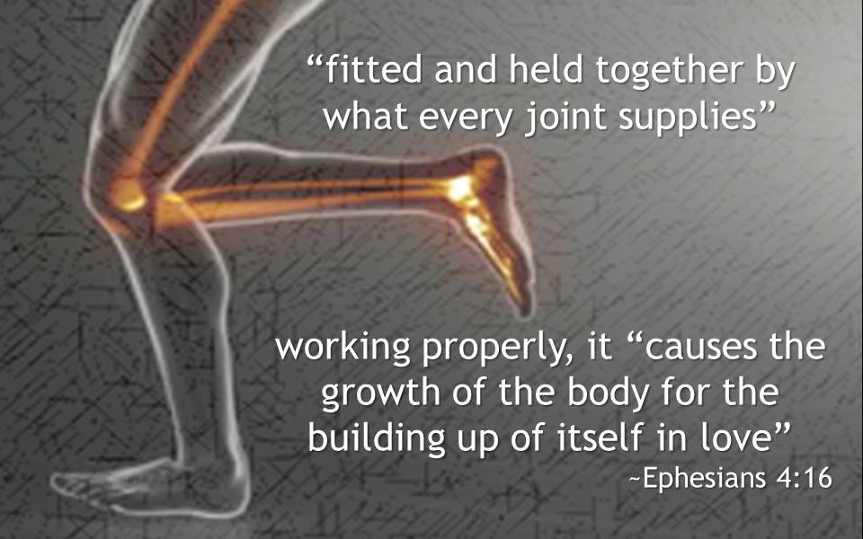
Gifts for Unity (4:12-16)
¹⁶ from whom the whole body, joined and knit together by what every joint supplies, according to the effective working by which every part does its share, causes growth of the body for the edifying of itself in love.
Notes:
The analogy here is that of a body where every part is fitted and joined together. No individual part can exist by itself, but must be attached to the body. The body did not design itself, but Christ designed it and it is by His design that the whole thing functions and grows.

Slide 21
Gifts for Unity (4:12-16)
¹⁶ from whom the whole body, joined and knit together by what every joint supplies, according to the effective working by which every part does its share, causes growth of the body for the edifying of itself in love.
Notes:
The evidence of maturity – that the leaders and the saints are all doing their job… This means every part and joint provides what it can supply in a coordinated effort. When this happens, it naturally causes the growth of the body (both in size and strength), but especially growth

Slide 22
Gifts for Unity (4:12-16)
¹⁶ from whom the whole body, joined and knit together by what every joint supplies, according to the effective working by which every part does its share, causes growth of the body for the edifying of itself in love.
Notes:
Every part of your physical body adds to the rest of the body its strength – again, by itself, it is nothing, but when all the parts are joined together in unity the body becomes powerful. When every part fulfills its proper function the body will grow, but it takes all the part otherwise the body is left handicapped.

