Slide 1
The Mystery in Christ
Eph 3:1-13

Slide 2
Introduction
Paul now begins to focus on the revelation of the mystery
This evening we will focus on the key concepts of:
The Mystery Revealed (vs 1-7)
The Responsibility of Paul (vs 8-13)

Slide 3
The Grace of God (3:1-2)
3 For this reason I, Paul, the prisoner of Christ Jesus for you Gentiles—
² if indeed you have heard of the dispensation of the grace of God which was given to me for you,
Notes:
If indeed. The author is not doubting whether his audience has heard, but is rather using provocative language (if indeed) to engage his audience in thinking about the magnificence of God’s grace.
Dispensation (Stewardship)

Slide 4
The Grace of God (3:1-2)
3 For this reason I, Paul, the prisoner of Christ Jesus for you Gentiles—
² if indeed you have heard of the dispensation of the grace of God which was given to me for you,
Notes:
If indeed. The author is not doubting whether his audience has heard, but is rather using provocative language (if indeed) to engage his audience in thinking about the magnificence of God’s grace.
Dispensation (Stewardship)

Slide 5
The Grace of God (3:1-2)
3 For this reason I, Paul, the prisoner of Christ Jesus for you Gentiles—
² if indeed you have heard of the dispensation of the grace of God which was given to me for you,
Notes:
If indeed. The author is not doubting whether his audience has heard, but is rather using provocative language (if indeed) to engage his audience in thinking about the magnificence of God’s grace.

Slide 6
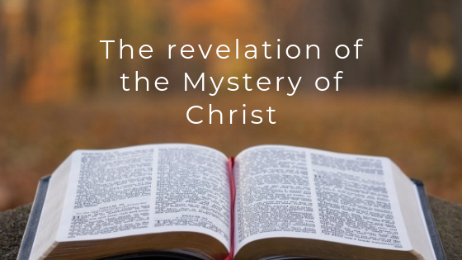
The Revelation Made Known to Paul (3:3-4)
³ that by revelation the mystery was made known to me, as I wrote before briefly.
⁴ When reading this, you will be able to understand my insight into the mystery of Christ
Notes:
“Divine Secrert"

Slide 7
The Revelation of a Mystery Once Hidden (3:5)
⁵ which in other ages was not made known to the sons of men, as it has now been revealed by the Spirit to His holy apostles and prophets:

Slide 8
The Revelation of a Mystery Once Hidden (3:5)
⁵ which in other ages was not made known to the sons of men, as it has now been revealed by the Spirit to His holy apostles and prophets:

Slide 9
The Mystery that Involved the Gentiles (3:6-7)
⁶ that the Gentiles should be fellow heirs, of the same body, and partakers of His promise in Christ through the gospel,
⁷ of which I became a minister according to the gift of the grace of God given to me by the effective working of His power.

Slide 10
The Mystery that Involved the Gentiles (3:6-7)
⁶ that the Gentiles should be fellow heirs, of the same body, and partakers of His promise in Christ through the gospel,
⁷ of which I became a minister according to the gift of the grace of God given to me by the effective working of His power.

Slide 11
The Mystery that Involved the Gentiles (3:6-7)
⁶ that the Gentiles should be fellow heirs, of the same body, and partakers of His promise in Christ through the gospel,
⁷ of which I became a minister according to the gift of the grace of God given to me by the effective working of His power.

Slide 12
Paul’s Responsibility to Preach to the Gentiles (3:8-12)
⁸ To me, who am less than the least of all the saints, this grace was given, that I should preach among the Gentiles the unsearchable riches of Christ,
⁹ and to make all see what is the fellowship of the mystery, which from the beginning of the ages has been hidden in God who created all things ^{[c]}through Jesus Christ;
Notes:
Fellowship (stewardship)

Slide 13
Paul’s Responsibility to Preach to the Gentiles (3:8-12)
⁸ To me, who am less than the least of all the saints, this grace was given, that I should preach among the Gentiles the unsearchable riches of Christ,
⁹ and to make all see what is the fellowship of the mystery, which from the beginning of the ages has been hidden in God who created all things through Jesus Christ;
Notes:
Fellowship (stewardship)

Slide 14
Paul’s Responsibility to Preach to the Gentiles (3:8-12)
¹⁰ to the intent that now the manifold wisdom of God might be made known by the church to the principalities and powers in the heavenly places,
¹¹ according to the eternal purpose which He accomplished in Christ Jesus our Lord,
Notes:
Fellowship (stewardship)

Slide 15
Paul’s Responsibility to Preach to the Gentiles (3:8-12)
¹² in whom we have boldness and access with confidence through faith in Him.
¹³ Therefore I ask that you do not lose heart at my tribulations for you, which is your glory.
Notes:
Fellowship (stewardship)

