Slide 1
Refocusing our worship
1 Thes 5:16-20

Slide 2
Resolution
a) resolving, or determining; deciding
b) the thing determined upon; decision as to future action; resolve.”
Notes:
Webster definition
Now, this sounds good, and it makes people feel better about themselves to make a promise concerning something they plan to do, or something they plan to stop. However, the problem with resolutions is that they tend to be forgotten within just a few days, or weeks, at the most.

Slide 3
Revolution
a complete or radical change of any kind
This is what is needed in many aspects of our lives today
Notes:
Webster definition

Slide 4
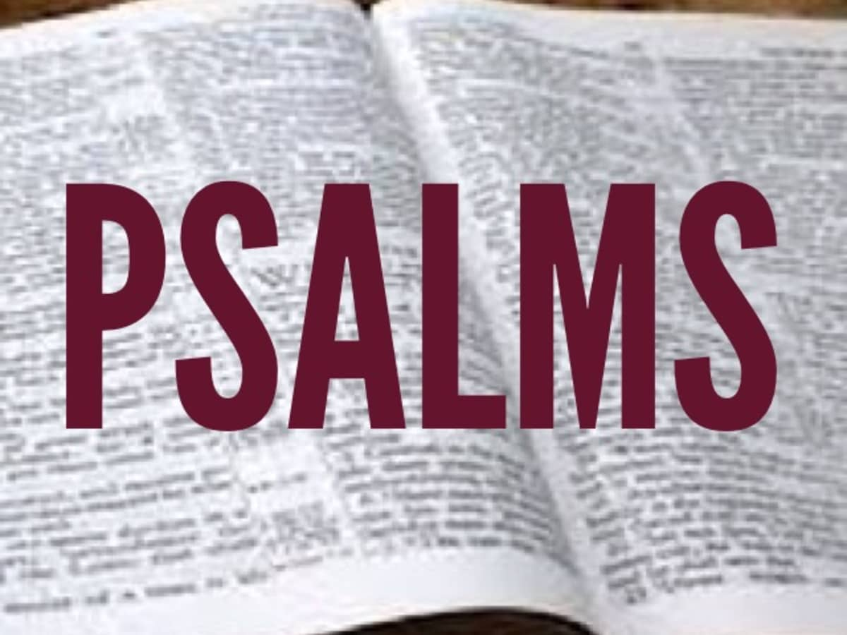
1 Thes 5:16
¹⁶ Rejoice always, (NKJV)
¹⁶ Always rejoice, (ESV)
¹⁶ Rejoice evermore. (KJV)
Notes:
Read psalm 84

Slide 5
1 Thes 5:16
¹⁶ Rejoice always, (NKJV)
¹⁶ Always rejoice, (ESV)
¹⁶ Rejoice evermore. (KJV)
Notes:
A. V. 16 There Should Be Praise - “Rejoice evermore” literally means to have a praise in our hearts to God at al times. In truth, the modern church is lacking in the praise department. There was time when the people of God were filled with His glory and were not ashamed to express it visibly and vocally. Yet, in our day, we seem petrified when it comes to praising the Lord. Now, whether we ever believe it or not, whether we ever do anything about it our not, it is still God's will for His people to praise Him - Heb 13:15;Ps 50:23. There are other verse that teach this same truth, but suffice it to say that the church, and our private lives, ought to be filled with the sounds of His praise.
(➤ There are those who say, “Well, that just isn't my style!” If you will think for a minute, you will find many areas where you have changed in your lifetime, this is one where you can as well. ➤ , there is always one good reason for praise - Lk 10:20.)
Read Psalm 150

Slide 6
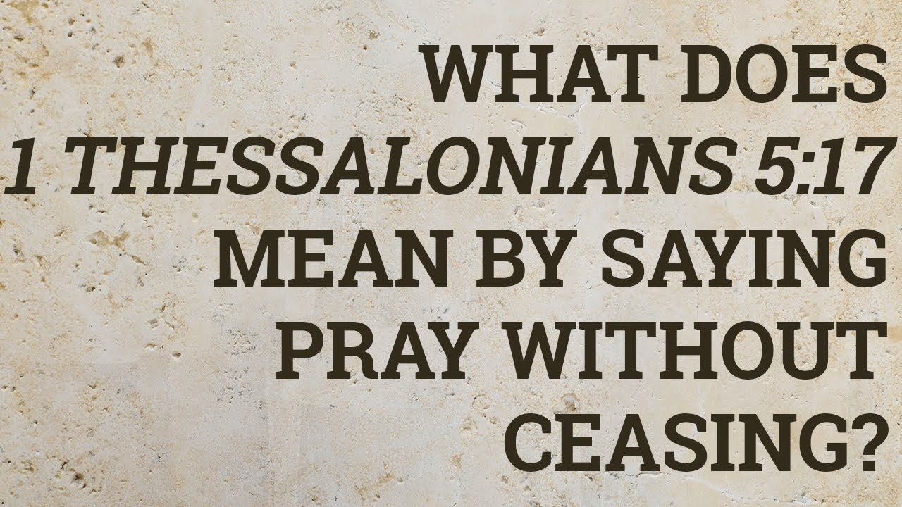
1 Thes 5:17
¹⁷ Pray without Ceasing, (NKJV)
¹⁷ Constantly pray, (ESV)
¹⁷ Pray without Ceasing. (KJV)
Notes:
“Praying without ceasing” means at least three things.
First, it means that there is a spirit of dependence that should permeate all we do. This is the very spirit and essence of prayer. So, even when we are not speaking consciously to God, there is a deep, abiding dependence on him that is woven into the heart of faith. In that sense, we “pray” or have the spirit of prayer continuously.
Second – and I think this is what Paul has in mind most immediately – praying without ceasing means praying repeatedly and often. I base this on the use of the word “without ceasing” in Romans 1:9, where Paul says, “For God is my witness, who I serve with my spirit in the gospel of his Son, that without ceasing I mention you.” Now we can be sure that Paul did not mention the Romans every minute of his waking life, or even every minute of his prayers. He prayed about many other things. But he mentioned them over and over, and often. So “without ceasing” doesn’t mean that, verbally or mentally, we have to be speaking prayers every minute of the day in the fight for joy. It means we should pray over and over, and often. Our default mental state should be: “O God, help…”
Third, praying without ceasing means not giving up on prayer. Don’t ever come to a point in your life where you cease to pray at all. Don’t abandon the God of hope and say, “There’s no use praying.” Jesus is very jealous for us to learn this lesson. One of his parables is introduced by the words, “And he told them a parable to the effect tha tthey ought always to pray and not lose heart. He knew our experience in prayer would tempt us to quit altogether. So he, along with the apostle Paul, says, Never lose heart. Go on praying. Don’t cease.
– John Piper, When I Don’t Desire God: How to Fight For Joy, 157.

Slide 7
1 Thes 5:18
¹⁸ In everything give thanks, (NKJV)
¹⁸ In everything give thanks, (ESV)
¹⁸ In everything give thanks; (KJV)
Notes:
In everything give thanks. In every circumstance - in joy and in sorrow; for everything - for prosperity and for adversity; in every place - in the house of God and on the bed of sickness; Christians should not only be engaged in constant prayer, but in constant thanksgiving; indeed, their prayers should partake largely of the nature of thanksgiving. For this; this thankful spirit. Is the will of God; his desire. In Christ Jesus; the sphere in which this will of God is displayed. Concerning you. God by the gift of his Son has laid us under the obligation of perpetual thanksgiving. Our whole lives ought to be one continued thank-offering for all the blessings of redemption. (Pulpit commentary)

Slide 8
1 Thes 5:19
¹⁹ Do not quench the Spirit. (NKJV)
¹⁹ Do not extinguish the Spirit. (ESV)
¹⁹ Quench not the Spirit (KJV)
Notes:
Fire is often used in reference to the Holy Spirit (Isaiah 4:4; Matthew 3:11; Acts 2:3–4). Paul warns his readers against dousing or smothering the ministry of the Holy Spirit, who warms the heart to love God and others. The Spirit inspires believers to serve God faithfully, to worship, to pray, and to encourage others. He ignites believers' hearts with zeal to win unbelievers to Christ. Resisting the Spirit's ministry leads to a lukewarm attitude and to the loss of reward (Revelation 3:14–22). (Bibleref.com)

Slide 9
1 Thes 5:20
²⁰ Do not despise prophecies (NKJV)
²⁰ Do not teat prophecies with contempt (ESV)
²⁰ Despise not prophesyings (KJV)
Notes:
prophecy, or, to speak in the language of our own time, the preacher’s calling, may be abused: a man may preach without a message, without sincerity, without reverence for God or respect for those to whom he speaks, he may make a mystery, a professional secret, of the truth of God, instead of declaring it even to little children; he may seek, as some who called themselves prophets in early times sought, to make the profession of godliness a source of gain; and under such circumstances no respect is due. But such circumstances are not to be assumed without cause. We are rather to assume that he who stands up in the Church to speak in God’s name has had a word of God entrusted to him; it is not wise to despise it before it is heard. It may be because we have been so often disappointed that we pitch our hopes so low; but to expect nothing is to be guilty of a sort of contempt by anticipation. To despise not prophesyings requires us to look for something from the preacher, some word of God that will build us up in godliness, or bring us encouragement or consolation; it requires us to listen as those who have a precious opportunity given them of being strengthened by Divine grace and truth. We ought not to lounge or fidget while the word of God is spoken, or to turn over the leaves of the Bible at random, or to look at the clock; we ought to hearken for that word which God has put into the preacher’s mouth for us; and it will be a very exceptional prophesying in which there is not a single thought that it would repay us to consider. (1 Thessalonians 5 Commentary)

Slide 10
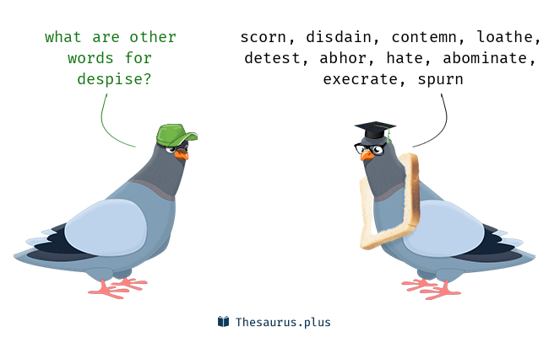
1 Thes 5:20
²⁰ Do not despise prophecies (NKJV)
²⁰ Do not teat prophecies with contempt (ESV)
²⁰ Despise not prophesyings (KJV)
Notes:
prophecy, or, to speak in the language of our own time, the preacher’s calling, may be abused: a man may preach without a message, without sincerity, without reverence for God or respect for those to whom he speaks, he may make a mystery, a professional secret, of the truth of God, instead of declaring it even to little children; he may seek, as some who called themselves prophets in early times sought, to make the profession of godliness a source of gain; and under such circumstances no respect is due. But such circumstances are not to be assumed without cause. We are rather to assume that he who stands up in the Church to speak in God’s name has had a word of God entrusted to him; it is not wise to despise it before it is heard. It may be because we have been so often disappointed that we pitch our hopes so low; but to expect nothing is to be guilty of a sort of contempt by anticipation. To despise not prophesyings requires us to look for something from the preacher, some word of God that will build us up in godliness, or bring us encouragement or consolation; it requires us to listen as those who have a precious opportunity given them of being strengthened by Divine grace and truth. We ought not to lounge or fidget while the word of God is spoken, or to turn over the leaves of the Bible at random, or to look at the clock; we ought to hearken for that word which God has put into the preacher’s mouth for us; and it will be a very exceptional prophesying in which there is not a single thought that it would repay us to consider. (1 Thessalonians 5 Commentary)

Slide 11
Refocusing our worship
1 Thes 5:16-20

