Slide 1
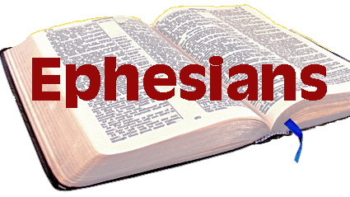
Setting the stage for the letter
Eph 1:1-3

Slide 2
Originally named Saul (Acts 7:58)
Acted in what he believed was obedience to God
Notes:
⁵⁸ When^{[a]} they had driven him out of the city, they began to stone him,^{[b]} and the witnesses laid their cloaks^{[c]} at the feet of a young man named Saul.

Slide 3
The Conversion to Paul (Acts 9)
Adversary to Advocate
Enemy to Defender
Destroyer to Builder
Persecutor to Persecuted
Notes:
Acts 7,8,9,22,26

Slide 4
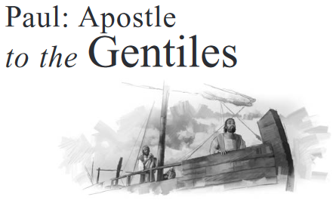
Acts 9:15 But the Lord said to him, “Go, for he is a chosen vessel of Mine to bear My name before Gentiles, kings, and the children of Israel.
Gal 2:7 But on the contrary, when they saw that the gospel for the uncircumcised had been committed to me, as the gospel for the circumcised was to Peter
Eph 3:8 To me, who am less than the least of all the saints, this grace was given, that I should preach among the Gentiles the unsearchable riches of Christ,

Slide 5
Eph 3:1 For this reason I, Paul, the prisoner of Christ Jesus for you Gentiles—
Eph 4:1 I, therefore, the prisoner of the Lord, beseech you to walk worthy of the calling with which you were called,
Eph 6:20 for which I am an ambassador in chains; that in it I may speak boldly, as I ought to speak.

Slide 6
The Addressed

Slide 7
The Addressed (those in Christ)
Saints in Christ (1:1)
Blessed in Christ (1:3)
Chosen in Christ (1:4)
Adopted in Christ (1:5)
Redeemed in Christ (1:7)
Sealed with the Holy spirit in Christ (1:12-13)
Created for good works in Christ (2:10)
Brought near to God in Christ (2:13)
Built in Christ (2:22)
Partakers in God’s promise in Christ (3:6)
All things on Heaven and earth are gathered in Christ (1:10)

Slide 8
Eph 1:3 “³ Blessed be the God and Father of our Lord Jesus Christ, who has blessed us with every spiritual blessing in the heavenly places in Christ,

Slide 9
Conclusion
The fact Paul is writing about wealth would be significant to his readers, because some considered Ephesus “The Bank of Asia”
The great temple of Diana (one of the seven wonders of the world) was there and not only a center for idol worship, but also a depository for wealth
Some of the greatest art treasures of the ancient world were housed in this building
Paul will compare the Church to a temple and will explain the great wealth that Christ has in His Church

