Slide 1
Overcoming Trials
Jam 1:2-4

Slide 2
Joy/Contentment
James 1:2 “² My brethren, count it all joy when you fall into various trials,”

Slide 3
Joy/Contentment
Acts 16:25 “²⁵ But at midnight Paul and Silas were praying and singing hymns to God, and the prisoners were listening to them.”

Slide 4
Joy/Contentment
2 Cor 12:9b “⁹ Therefore most gladly I will rather boast in my infirmities, that the power of Christ may rest upon me.”

Slide 5
Joy/Contentment
Phil 4:11 “¹¹ Not that I speak in regard to need, for I have learned in whatever state I am, to be content:”

Slide 6
Patience
Jam 1:3 “³ knowing that the testing of your faith produces patience.

Slide 7
Patience
Ps 27:14 “⁴ Wait on the Lord; Be of good courage, And He shall strengthen your heart; Wait, I say, on the Lord!

Slide 8
Patience
Ps 37:7a “⁷ Rest in the Lord, and wait patiently for Him;

Slide 9
Patience
2 Thes 1:3-4 “⁴ so that we ourselves boast of you among the churches of God for your patience and faith in all your persecutions and tribulations that you endure,”

Slide 10
Faith
Ps 37:5 “⁵ Commit your way to the Lord, Trust also in Him, And He shall bring it to pass.

Slide 11
Faith
Prov 3:5-6 “⁵ Trust in the Lord with all your heart, And lean not on your own understanding; ⁶ In all your ways acknowledge Him, And He shall direct your paths.

Slide 12
Faith
Rom 1:17b “The just shall live by faith.”

Slide 13
Faith
Rom 10:17 “¹⁷ So then faith comes by hearing, and hearing by the word of God.”

Slide 14
Faith
1 Pet 1:8-9 “⁸ whom having not seen you love. Though now you do not see Him, yet believing, you rejoice with joy inexpressible and full of glory, ⁹ receiving the end of your faith—the salvation of your souls.”

Slide 15
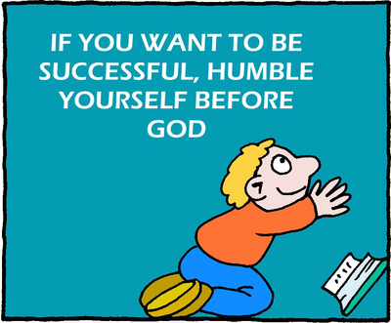
Humility
Ps 149:4 “⁴ For the Lord takes pleasure in His people; He will beautify the humble with salvation.

Slide 16
Humility
Prov 22:4 “By humility and the fear of the Lord Are riches and honor and life.

Slide 17
Humility
Mic 6:8 “⁸ He has shown you, O man, what is good; And what does the Lord require of you But to do justly, To love mercy, And to walk humbly with your God?

Slide 18
Humility
Lk 14:11 “¹¹ For whoever exalts himself will be humbled, and he who humbles himself will be exalted.”

Slide 19
Humility
Jam 4:10 “¹⁰ Humble yourselves in the sight of the Lord, and He will lift you up.

Slide 20
Humility
1 Pet 5:8-9 “⁶ Therefore humble yourselves under the mighty hand of God, that He may exalt you in due time, ⁷ casting all your care upon Him, for He cares for you.

Slide 21
Overcoming Trials
Joy/Contentment
Patience
Faith
Humility

