Slide 1
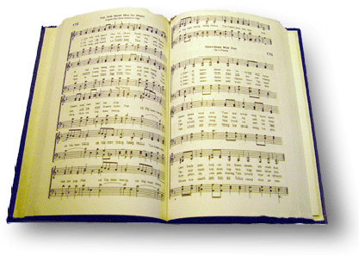
God’s Family
Song #643

Slide 2
And Tho’ some go before us, we’ll all meet again; just inside the city as we enter in
Psalm 116:15 “¹⁵ Precious in the sight of the Lord Is the death of His saints.
Eccl 12:7 “Then the dust will return to the earth as it was, And the spirit will return to God who gave it.

Slide 3
And Tho’ some go before us, we’ll all meet again; just inside the city as we enter in
1 Cor 15:51-52 “⁵¹ Behold, I tell you a mystery: We shall not all sleep, but we shall all be changed— ⁵² in a moment, in the twinkling of an eye, at the last trumpet. For the trumpet will sound, and the dead will be raised incorruptible, and we shall be changed.”

Slide 4
And Tho’ some go before us, we’ll all meet again; just inside the city as we enter in
Rom 14:8 “⁸ For if we live, we live to the Lord; and if we die, we die to the Lord. Therefore, whether we live or die, we are the Lord’s.

Slide 5
And Tho’ some go before us, we’ll all meet again; just inside the city as we enter in

Slide 6
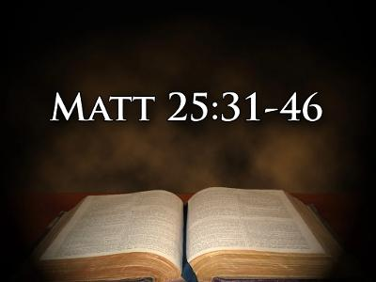
And Tho’ some go before us, we’ll all meet again; just inside the city as we enter in

Slide 7
There’ll be no more parting, with Jesus we’ll be; Together forever, God’s family.
Lk 22:69 “⁶⁹ Hereafter the Son of Man will sit on the right hand of the power of God.”
Co 3:1 “3 If then you were raised with Christ, seek those things which are above, where Christ is, sitting at the right hand of God.

Slide 8
There’ll be no more parting, with Jesus we’ll be; Together forever, God’s family.
Heb 12:2 “² looking unto Jesus, the author and finisher of our faith, who for the joy that was set before Him endured the cross, despising the shame, and has sat down at the right hand of the throne of God.

Slide 9
There’ll be no more parting, with Jesus we’ll be; Together forever, God’s family.
2 Cor 5 For we know that if our earthly house, this tent, is destroyed, we have a building from God, a house not made with hands, eternal in the heavens. ² For in this we groan, earnestly desiring to be clothed with our habitation which is from heaven, ³ if indeed, having been clothed, we shall not be found naked. ⁴ For we who are in this tent groan, being burdened, not because we want to be unclothed, but further clothed, that mortality may be swallowed up by life.

Slide 10
Conclusion: The love and hope we share
And sometimes we laugh together, sometimes we cry,
Sometimes we share together, heartache and sighs;
Sometimes we dream together of how it will be
When we all get to heaven, God’s family.

