Slide 1
The worship service
Prayer

Slide 2
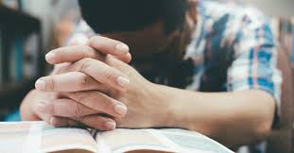
The Simple Answer
Talking to God
Notes:
The Bible (God’s Word) is how He speaks to us 2 Tim 3:16-17 Heb 1:1-2
Prayer is how we speak to Him Phil 4:6

Slide 3
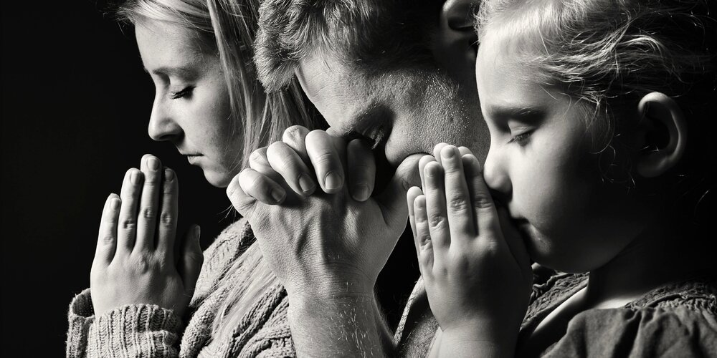
Our Focus
Talking to God “Together”

Slide 4
Examples of Prayer Together in Acts Chapter 1
¹³ And when they had entered, they went up into the upper room where they were staying: Peter, James, John, and Andrew; Philip and Thomas; Bartholomew and Matthew; James the son of Alphaeus and Simon the Zealot; and Judas the son of James.
¹⁴ These all continued with one accord in prayer and supplication, with the women and Mary the mother of Jesus, and with His brothers.

Slide 5
Examples of Prayer Together in Acts Chapter 1
²⁴ And they prayed and said, “You, O Lord, who know the hearts of all, show which of these two You have chosen ²⁵ to take part in this ministry and apostleship from which Judas by transgression fell, that he might go to his own place.”
Notes:
The replacement for Judas (number of about 120 names vs 8}

Slide 6
Examples of Prayer Together in Acts Chapter 2
⁴² And they continued steadfastly in the apostles’ doctrine and fellowship, in the breaking of bread, and in prayers.

Slide 7
Examples of Prayer Together in Acts Chapter 12
⁵ Peter was therefore kept in prison, but constant prayer was offered to God for him by the church. …
¹² So, when he had considered this, he came to the house of Mary, the mother of John whose surname was Mark, where many were gathered together praying.
Notes:
The church was praying for Peter while he was in prison (1-12)

Slide 9
Mathew Chapter 6
¹¹ Give us this day our daily bread.
¹² And forgive us our debts, As we forgive our debtors.

Slide 10
Mathew Chapter 6
¹³ And do not lead us into temptation, But deliver us from the evil one.

Slide 11
Notes:
1 Thes 5:16-17

Slide 12
Acts 2:42 “⁴² And they continued steadfastly in the apostles’ doctrine and fellowship, in the breaking of bread, and in prayers.
Acts 6:4 “⁴ but we will give ourselves continually to prayer and to the ministry of the word.”

Slide 13
Romans 12:12 “¹² rejoicing in hope, patient in tribulation, continuing steadfastly in prayer;
Col 4:2 “² Continue earnestly in prayer, being vigilant in it with thanksgiving;

Slide 15
1 Tim 2:1-4 Therefore I exhort first of all that supplications, prayers, intercessions, and giving of thanks be made for all men, ² for kings and all who are in authority, that we may lead a quiet and peaceable life in all godliness and reverence. ³ For this is good and acceptable in the sight of God our Savior, ⁴ who desires all men to be saved and to come to the knowledge of the truth.

