Slide 1
Now that I am a Christian…
What can I do for the local congregation?

Slide 2
I can Assemble with the Saints
Hebrews 10:24-25 New King James Version
²⁴ And let us consider one another in order to stir up love and good works, ²⁵ not forsaking the assembling of ourselves together, as is the manner of some, but exhorting one another, and so much the more as you see the Day approaching.

Slide 3
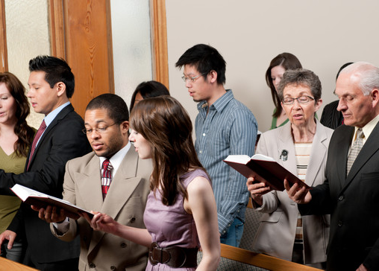
I can Sing with the Saints
Colossians 3:16 New King James Version
¹⁶ Let the word of Christ dwell in you richly in all wisdom, teaching and admonishing one another in psalms and hymns and spiritual songs, singing with grace in your hearts to the Lord.

Slide 4
I can Sing with the Saints
Ephesians 5:19 New King James Version
¹⁹ speaking to one another in psalms and hymns and spiritual songs, singing and making melody in your heart to the Lord,

Slide 5
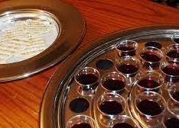
I can Partake of the Lord’s Supper with the Saints
Acts 20:7 New King James Version
⁷ Now on the first day of the week, when the disciples came together to break bread, Paul, ready to depart the next day, spoke to them and continued his message until midnight.

Slide 6
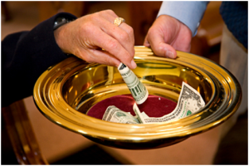
I can set Aside Funds for the Work of the Church
1 Corinthians 16:2 New King James Version
² On the first day of the week let each one of you lay something aside, storing up as he may prosper, that there be no collections when I come.
Notes:
The whole of the Gospel is based on the idea of giving
God gave His Son (Jn 3:16)
Christ “Gave Himself for us” (Tit 2:14)
We are to give ourselves to the Lord
2 Cor 8:5 “⁵ And not only as we had hoped, but they first gave themselves to the Lord, and then to us by the will of God.”

Slide 7
I can set Aside Funds for the Work of the Church
2 Corinthians 9:7 New King James Version
⁷ So let each one give as he purposes in his heart, not grudgingly or of necessity; for God loves a cheerful giver.
Notes:
The whole of the Gospel is based on the idea of giving
God gave His Son (Jn 3:16)
Christ “Gave Himself for us” (Tit 2:14)
We are to give ourselves to the Lord
2 Cor 8:5 “⁵ And not only as we had hoped, but they first gave themselves to the Lord, and then to us by the will of God.”

Slide 8
I can Labor to Help Save the lost
Luke 19:10 New King James Version
¹⁰ for the Son of Man has come to seek and to save that which was lost.”

Slide 9
I can Labor to Help Save the lost
1 Timothy 1:15 New King James Version
¹⁵ This is a faithful saying and worthy of all acceptance, that Christ Jesus came into the world to save sinners, of whom I am chief.

Slide 10
I can Labor to Help Save the lost
Matthew 28:19-20 New King James Version
¹⁹ Go therefore and make disciples of all the nations, baptizing them in the name of the Father and of the Son and of the Holy Spirit, ²⁰ teaching them to observe all things that I have commanded you; and lo, I am with you always, even to the end of the age.” Amen.
Notes:
³⁷ Then He said to His disciples, “The harvest truly is plentiful, but the laborers are few.

Slide 11
I can Labor to Help Save the lost
Acts 5:42 New King James Version
⁴² And daily in the temple, and in every house, they did not cease teaching and preaching Jesus as the Christ.
Acts 8:4 New King James Version
⁴ Therefore those who were scattered went everywhere preaching the word.
Notes:
1 Cor 15:58 “⁵⁸ Therefore, my beloved brethren, be steadfast, immovable, always abounding in the work of the Lord, knowing that your labor is not in vain in the Lord.”

Slide 12
I can Practice Hospitality
Romans 12:13 New King James Version
¹³ distributing to the needs of the saints, given to hospitality.
1 Peter 4:9 New King James Version
⁹ Be hospitable to one another without grumbling.

Slide 13
I can Show My Love for the Saints
John 13:34-35 New King James Version
³⁴ A new commandment I give to you, that you love one another; as I have loved you, that you also love one another. ³⁵ By this all will know that you are My disciples, if you have love for one another.”
Notes:
Rom 12:15 “¹⁵ Rejoice with those who rejoice, and weep with those who weep.”

Slide 14
Now that I am a Christian…
There is Much I can do for the Local Congregation

