Slide 2
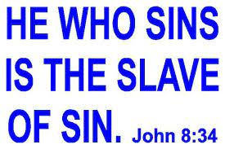
Introduction
The people believed they were free because they were “Sons of Abraham”
Verses 33-34 remind them that because they are sinners, they are slaves to sin
Notes:
Because they are slaves to sin they are not truly free

Slide 3
Introduction
A Slave is not a permanent part of the family, but a son is (vs 35)
Jesus is the “Son” and He has the power to make one fully free (vs 36)

Slide 4
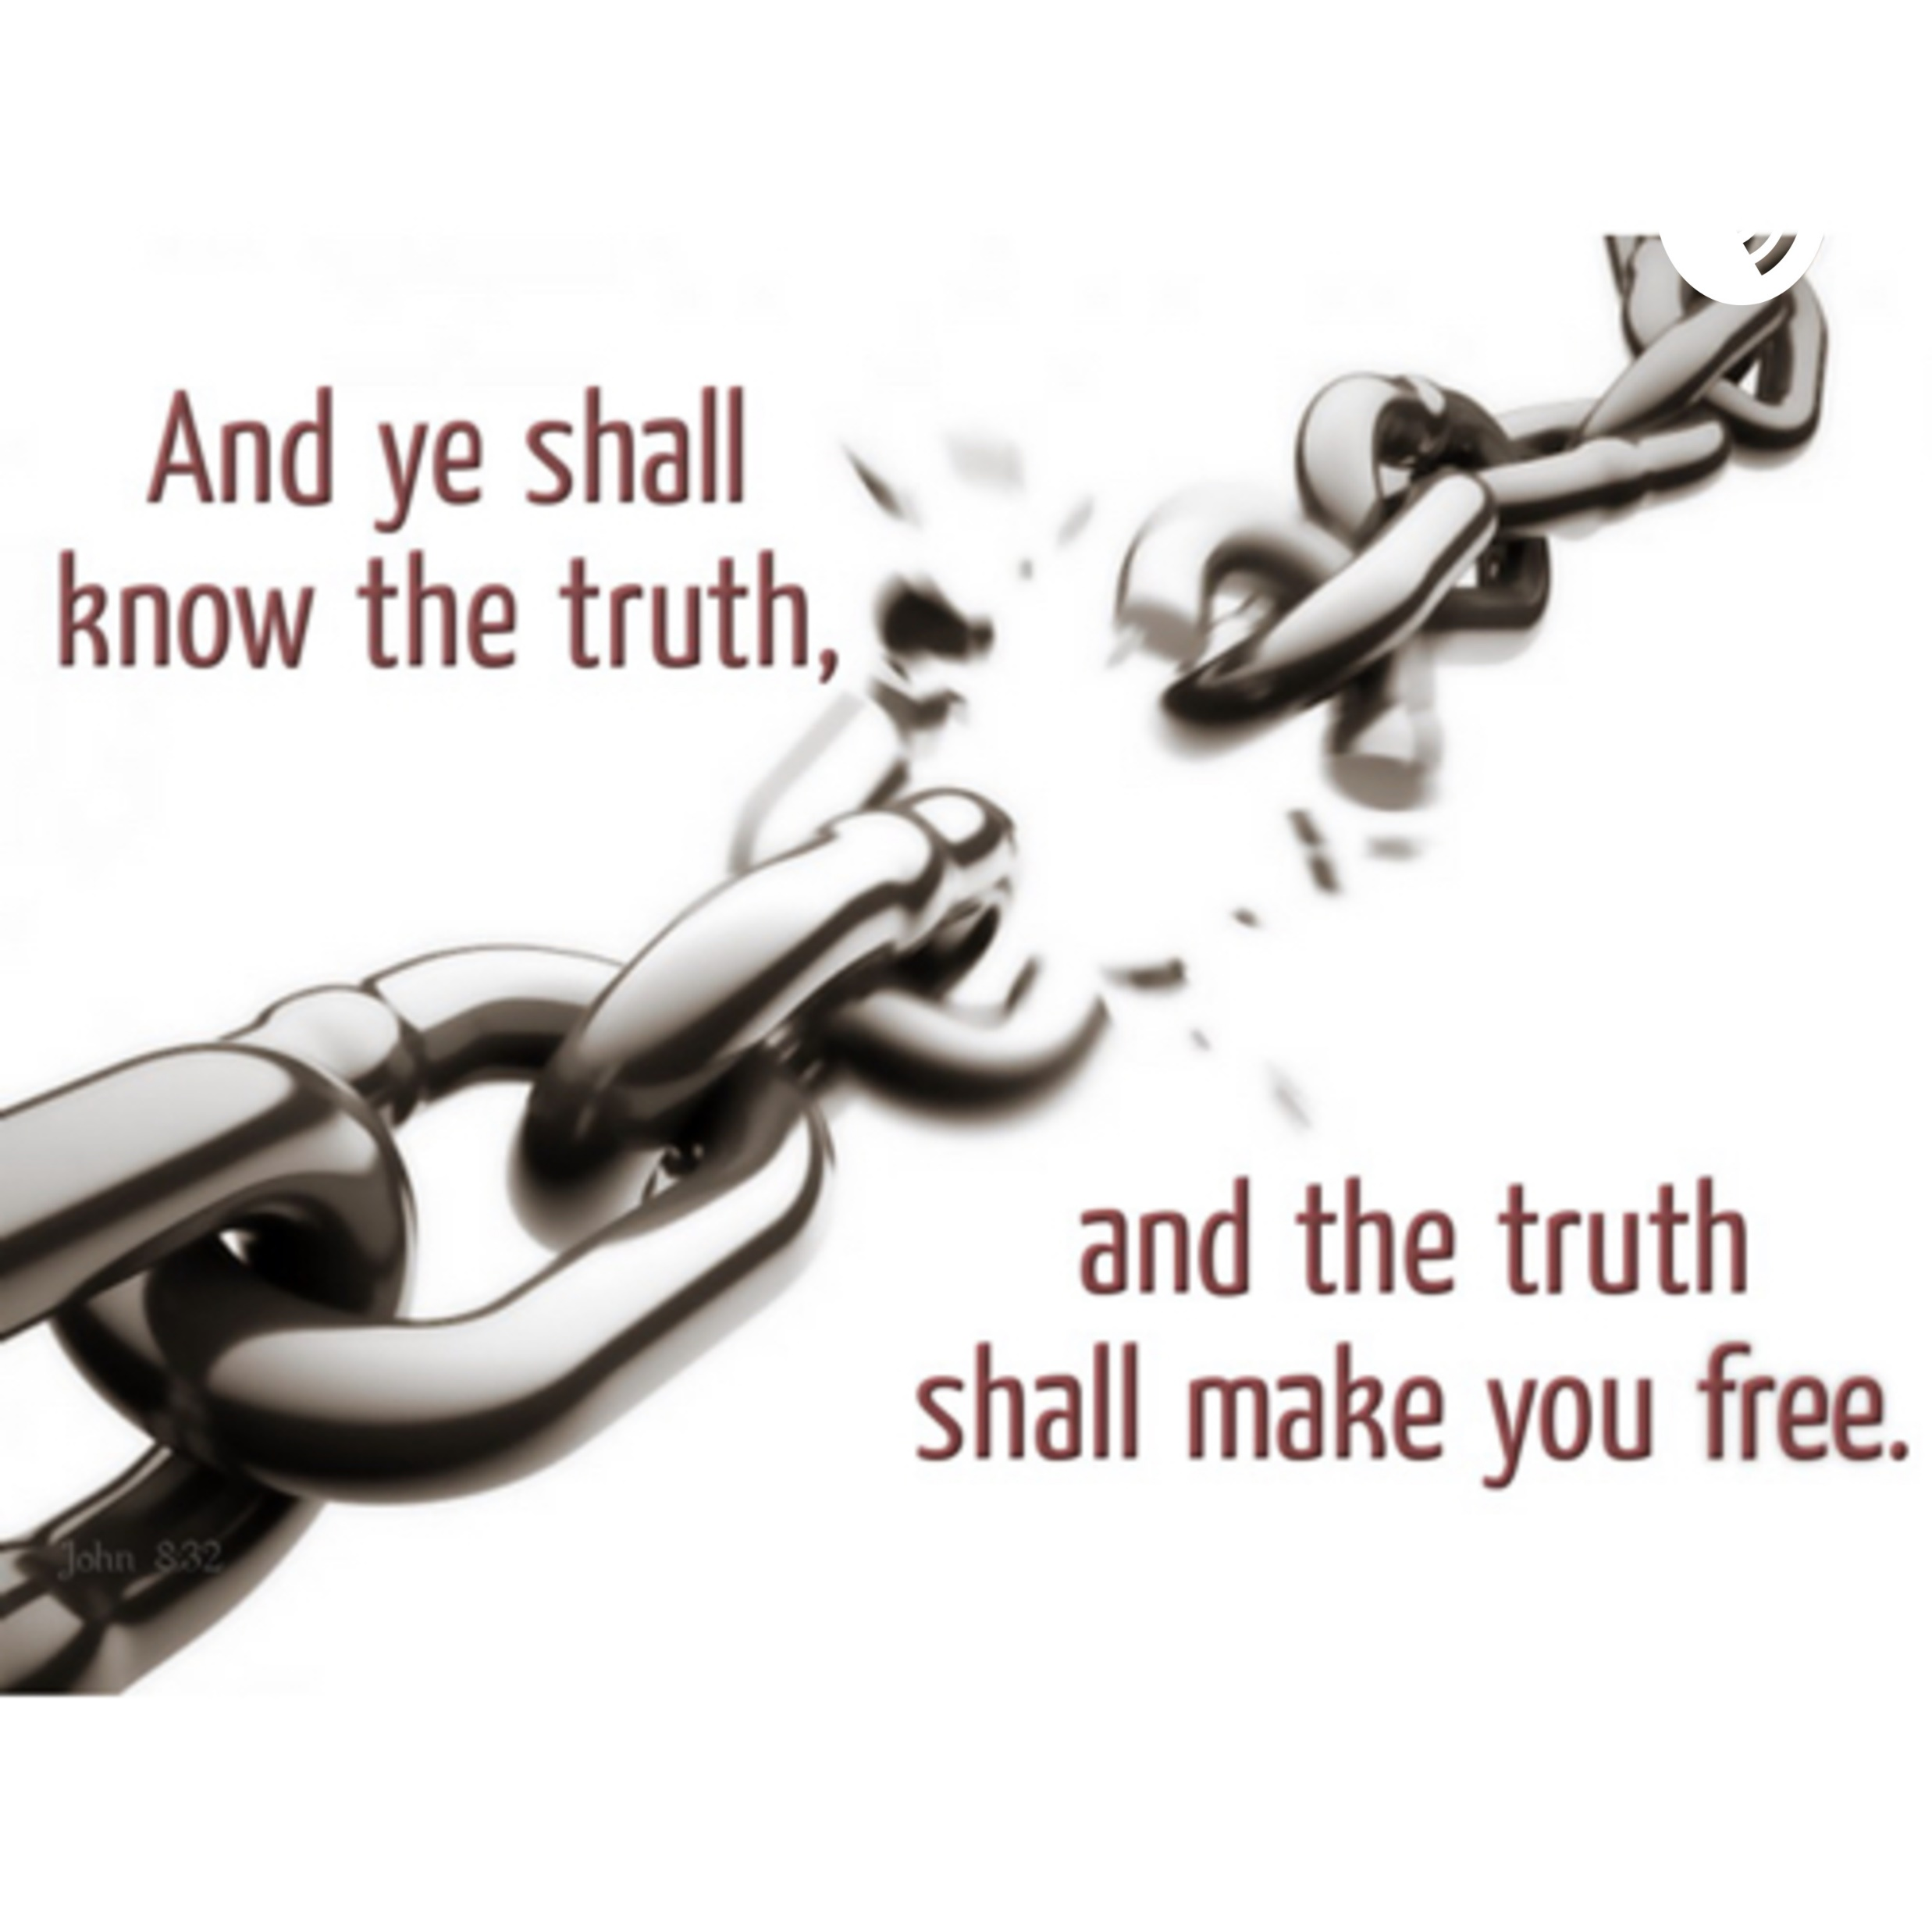
The source of our freedom (vs32)
Jn 17:17 “¹⁷ Sanctify them by Your truth. Your word is truth.”
Ps 119:60 “The entirety of Your word is truth, And every one of Your righteous judgments endures forever.”

Slide 5
The source of our freedom (vs32)
Jn 14:16 “⁶ Jesus said to him, “I am the way, the truth, and the life. No one comes to the Father except through Me.”

Slide 6
The source of our freedom (vs36)
Gal 5:1 “5 Stand fast therefore in the liberty by which Christ has made us free, and do not be entangled again with a yoke of bondage.”
Jn 8:36 “³⁶ Therefore if the Son makes you free, you shall be free indeed.”

Slide 7
Freedom from what?
Rom 6:23 “²³ For the wages of sin is death, but the gift of God is eternal life in Christ Jesus our Lord.”
Rom 3:23 “²³ for all have sinned and fall short of the glory of God,”

Slide 8
Freedom from what?
Rom 8:1 “8 There is therefore now no condemnation to those who are in Christ Jesus, who do not walk according to the flesh, but according to the Spirit.”
Jn 3:17 “¹⁷ For God did not send His Son into the world to condemn the world, but that the world through Him might be saved.”

Slide 9
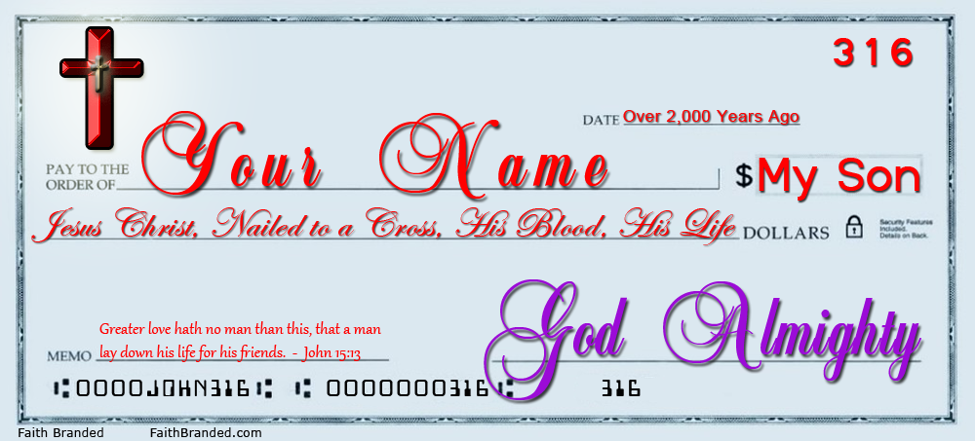
The Price of Freedom

Slide 10
The price of freedom
Is 53:6 “⁶ All we like sheep have gone astray; We have turned, every one, to his own way; And the Lord as laid on Him the iniquity of us all.”
Is 53:5 “⁵ But He was wounded for our transgressions, He was bruised for our iniquities; The chastisement for our peace was upon Him, And by His stripes we are healed.”

Slide 11
The price of freedom
1 Tim 2:5-6 “⁵ For there is one God and one Mediator between God and men, the Man Christ Jesus, ⁶ who gave Himself a ransom for all, to be testified in due time, “

