Slide 1
I’ve been baptized…Now what?

Slide 2
I Should be Overjoyed
Acts 8:38 “³⁹ Now when they came up out of the water, the Spirit of the Lord caught Philip away, so that the eunuch saw him no more; and he went on his way rejoicing.
Acts 16:33-34 “³³ And he took them the same hour of the night and washed their stripes. And immediately he and all his family were baptized. ³⁴ Now when he had brought them into his house, he set food before them; and he rejoiced, having believed in God with all his household.

Slide 3
Lk 15:4-10

Slide 4
I am a New Creation
2 cor 5:17 “¹⁷ Therefore, if anyone is in Christ, he is a new creation; old things have passed away; behold, all things have become new.”
Gal 5:20 ‘²⁰ I have been crucified with Christ; it is no longer I who live, but Christ lives in me; and the life which I now live in the flesh I live by faith in the Son of God, who loved me and gave Himself for me.

Slide 5
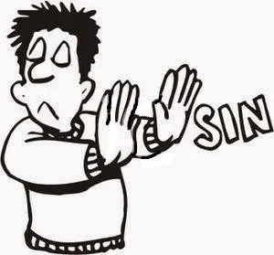
I am a new creature
Rom 6:1-4 “6 What shall we say then? Shall we continue in sin that grace may abound? ² Certainly not! How shall we who died to sin live any longer in it? ³ Or do you not know that as many of us as were baptized into Christ Jesus were baptized into His death? ⁴ Therefore we were buried with Him through baptism into death, that just as Christ was raised from the dead by the glory of the Father, even so we also should walk in newness of life.

Slide 6
I Must Grow in the Knowledge of God
Acts 2:42-42 “⁴¹ Then those who gladly received his word were baptized; and that day about three thousand souls were added to them. ⁴² And they continued steadfastly in the apostles’ doctrine and fellowship, in the breaking of bread, and in prayers.”
2 Pet 3:18 “¹⁸ but grow in the grace and knowledge of our Lord and Savior Jesus Christ. To Him be the glory both now and forever. Amen.”

Slide 7
I Must Grow in the Knowledge of God
2 Tim 2:15 “¹⁵ Be diligent to present yourself approved to God, a worker who does not need to be ashamed, rightly dividing the word of truth.”
2 Tim 3:16-17 “¹⁶ All Scripture is given by inspiration of God, and is profitable for doctrine, for reproof, for correction, for instruction in righteousness, ¹⁷ that the man of God may be complete, thoroughly equipped for every good work.”

Slide 8
I Must Grow in the Knowledge of God

