Slide 1
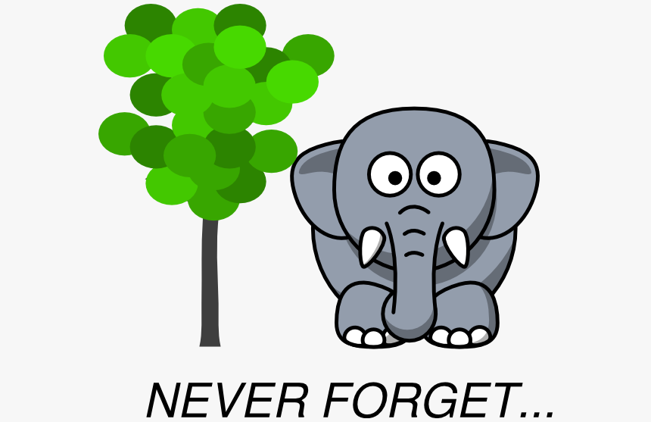

Slide 2
Old Testament Commands to God’s People
Deuteronomy 4:9-10 New King James Version
⁹ Only take heed to yourself, and diligently keep yourself, lest you forget the things your eyes have seen, and lest they depart from your heart all the days of your life. And teach them to your children and your grandchildren, ¹⁰ especially concerning the day you stood before the Lord your God in Horeb, when the Lord said to me, ‘Gather the people to Me, and I will let them hear My words, that they may learn to fear Me all the days they live on the earth, and that they may teach their children.’

Slide 3
Old Testament Commands to God’s People
Deuteronomy 8:18-19 New King James Version
¹⁸ “And you shall remember the Lord your God, for it is He who gives you power to get wealth, that He may establish His covenant which He swore to your fathers, as it is this day. ¹⁹ Then it shall be, if you by any means forget the Lord your God, and follow other gods, and serve them and worship them, I testify against you this day that you shall surely perish.

Slide 4
Old Testament Commands to God’s People
Praise for the Lord’s Mercies
103 Bless the Lord, O my soul; And all that is within me, bless His holy name! ² Bless the Lord, O my soul, And forget not all His benefits: ³ Who forgives all your iniquities, Who heals all your diseases, ⁴ Who redeems your life from destruction, Who crowns you with lovingkindness and tender mercies, ⁵ Who satisfies your mouth with good things, So that your youth is renewed like the eagle’s.

Slide 5
Old Testament Commands to God’s People
Deuteronomy 16:3 New King James Version
³ You shall eat no leavened bread with it; seven days you shall eat unleavened bread with it, that is, the bread of affliction (for you came out of the land of Egypt in haste), that you may remember the day in which you came out of the land of Egypt all the days of your life.
Psalm 77:11 New King James Version
¹¹ I will remember the works of the Lord; Surely I will remember Your wonders of old.

Slide 6
The Memorial Stones (Joshua 4)
Joshua 4:19-24 New King James Version
¹⁹ Now the people came up from the Jordan on the tenth day of the first month, and they camped in Gilgal on the east border of Jericho. ²⁰ And those twelve stones which they took out of the Jordan, Joshua set up in Gilgal. ²¹ Then he spoke to the children of Israel, saying: “When your children ask their fathers in time to come, saying, ‘What are these stones?’ ²² then you shall let your children know, saying, ‘Israel crossed over this Jordan on dry land’; ²³ for the Lord your God dried up the waters of the Jordan before you until you had crossed over, as the Lord your God did to the Red Sea, which He dried up before us until we had crossed over, ²⁴ that all the peoples of the earth may know the hand of the Lord, that it is mighty, that you may fear the Lord your God [orever.”
Notes:
A sign to the people of Israel
A sign to teach their childfren
A sign for the all the people of the earth

Slide 7
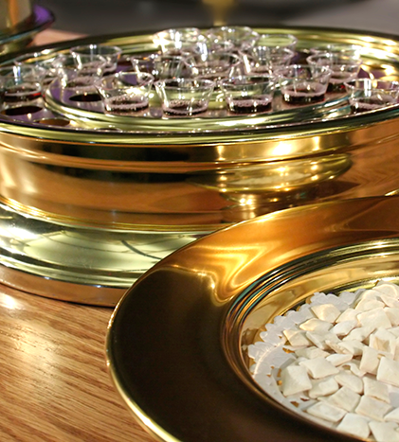
The Lord’s Supper
1 Corinthians 11:23-26 New King James Version
²³ For I received from the Lord that which I also delivered to you: that the Lord Jesus on the same night in which He was betrayed took bread; ²⁴ and when He had given thanks, He broke it and said, “Take, eat; this is My body which is broken for you; do this in remembrance of Me.” ²⁵ In the same manner He also took the cup after supper, saying, “This cup is the new covenant in My blood. This do, as often as you drink it, in remembrance of Me.” ²⁶ For as often as you eat this bread and drink this cup, you proclaim the Lord’s death till He comes.
Notes:
A sign to the people of Israel
A sign to teach their childfren
A sign for the all the people of the earth

