Slide 1
In the Lord I put my Trust
Psalm 11, 33

Slide 3
David is Making a Refuge in the Lord
Psalm 118:8 English Standard Version
⁸ It is better to take refuge in the Lord than to trust in man.

Slide 4
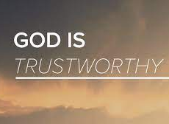
Verses to Consider
Num 23:19
Ps 9:10
Nahum 1:7
1 Cor 1:9, 10:13
2 Tim 2:13
Heb 6:16-19

Slide 5
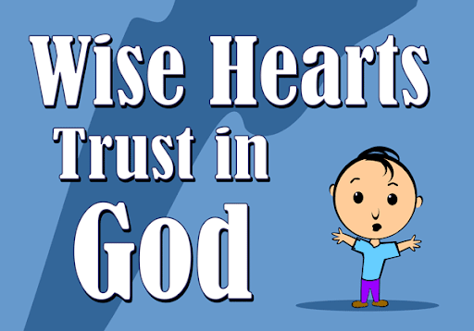
People put their trust in things all the time
Jobs always there to provide security
Cars to get them where they need to go safely
Technology
Friends and family
Notes:
The important consideration is not whether we trust or not...the important consideration is where do we place that trust.

Slide 6
People put their trust in things all the time
Psalm 20:7 English Standard Version
⁷ Some trust in chariots and some in horses, but we trust in the name of the Lord our God.
Proverbs 21:31 English Standard Version
³¹ The horse is made ready for the day of battle, but the victory belongs to the Lord.
Notes:
The important consideration is not whether we trust or not...the important consideration is where do we place that trust.

Slide 7
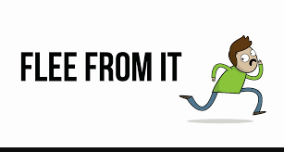
How can you say to my soul, “Flee as a bird to your mountain”?
Don’t trust in God
Flee to something more tangible
Flee from your troubles
Take flight and run

Slide 8
How can you say to my soul, “Flee as a bird to your mountain”?
Don’t trust in God
Flee to something more tangible
Flee from your troubles
Take flight and run

Slide 9
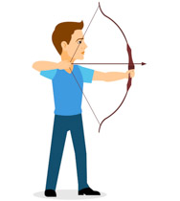
For look! The wicked bend their bow, They make ready their arrow on the string,
Those who try to destroy your trust in God are called “Wicked”
There will always be someone who wants to shoot at the heart of the righteous
When one stands for what is right, he can expect attack from others
Notes:
They make ready their arrow on the string, That they may shoot ^{[a]}secretly at the upright in heart. ³ If the foundations are destroyed, What can the righteous do?

Slide 10
The Lord is in His holy temple, The Lord’s throne is in heaven; His eyes behold, His eyelids test the sons of men.
Acts 7:49-50
New King James Version
⁴⁹ ‘Heaven is My throne, And earth is My footstool. What house will you build for Me? says the Lord, Or what is the place of My rest? ⁵⁰ Has My hand not made all these things?’
Notes:
The Lord is in His holy temple denotes He is right where He needs to be.
1. God is not bound by time or space. He is omnipresent.
2. You can’t place Him in a box.
C. To further explain the vast presence of God, the Bible says, the Lord’s throne is in heaven.”
1. This literally means the universe.

Slide 11
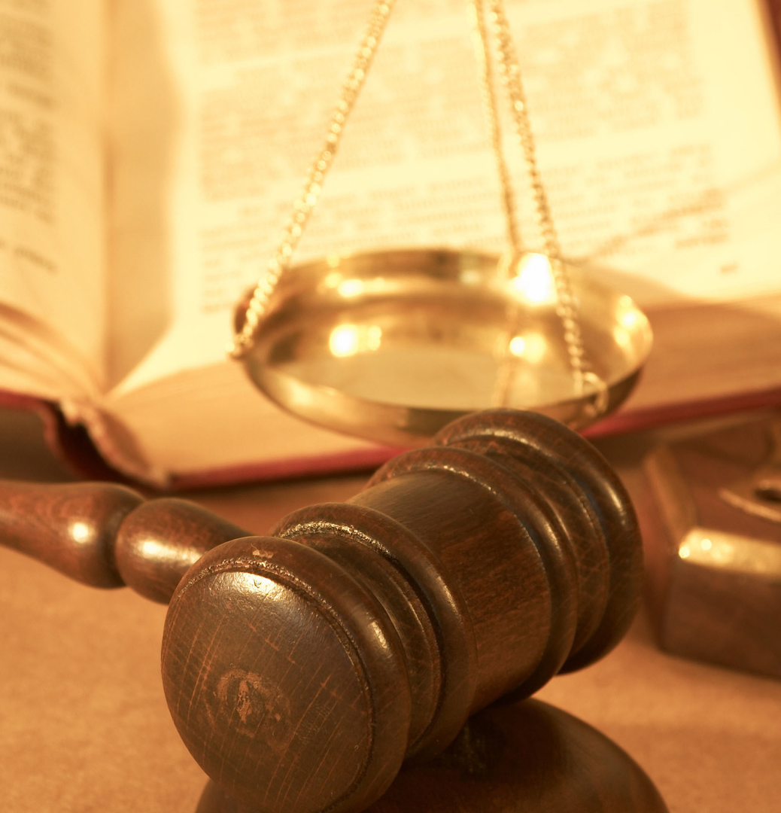
The Lord loves righteousness and justice
New King James Version
⁵ The Lord tests the righteous, But the wicked and the one who loves violence His soul hates. ⁶ Upon the wicked He will rain coals; Fire and brimstone and a burning wind Shall be the portion of their cup. ⁷ For the Lord is righteous, He loves righteousness; His countenance beholds the upright.
Notes:
The important consideration is not whether we trust or not...the important consideration is where do we place that trust.

Slide 12
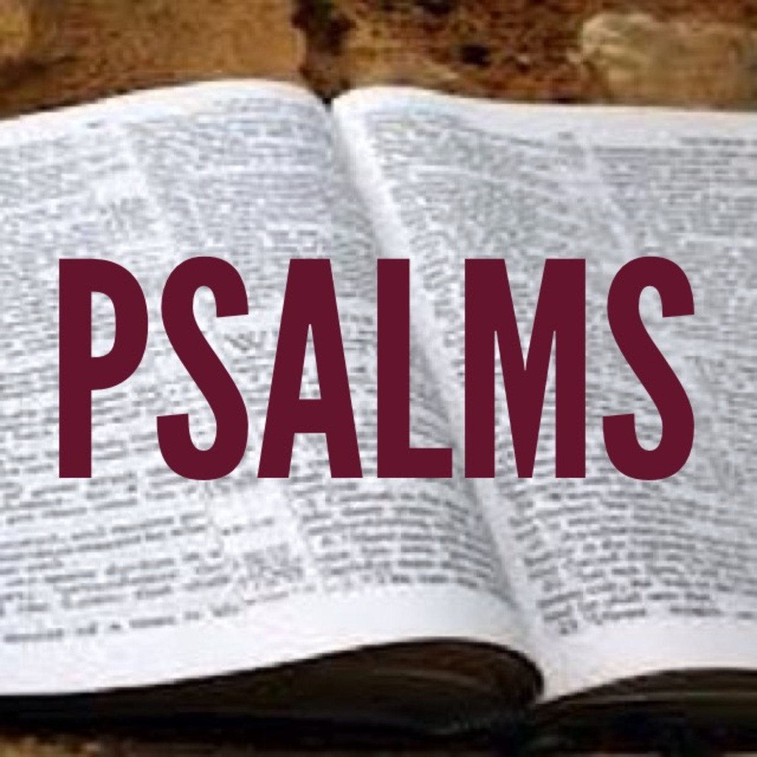
The Lord loves righteousness and justice
New King James Version
⁴ For the word of the Lord is right, And all His work is done in truth. ⁵ He loves righteousness and justice; The earth is full of the goodness of the Lord.
33

Slide 13
The Lord loves righteousness and justice
New King James Version
¹³ The Lord looks from heaven; He sees all the sons of men. ¹⁴ From the place of His dwelling He looks On all the inhabitants of the earth; ¹⁵ He fashions their hearts individually; He considers all their works.
33

Slide 14
The Lord loves righteousness and justice
New King James Version
²⁰ Our soul waits for the Lord; He is our help and our shield. ²¹ For our heart shall rejoice in Him, Because we have trusted in His holy name. ²² Let Your mercy, O Lord, be upon us, Just as we hope in You.
33

Slide 15
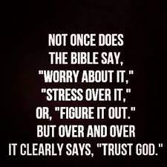

Slide 16
Conclusion

