Slide 1
Rebuilding the Walls
A Lesson in Overcoming Obstacles from Nehemiah 4

Slide 2
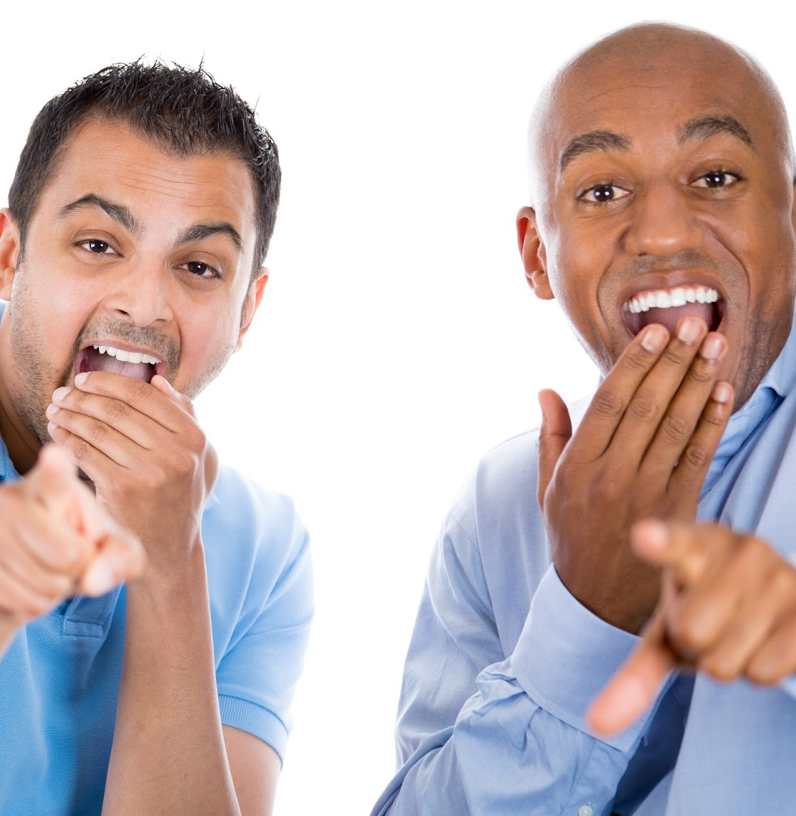
Obstacle 1: Mocking
Nehemiah 4:1-3 “4 But it so happened, when Sanballat heard that we were rebuilding the wall, that he was furious and very indignant, and mocked the Jews. ² And he spoke before his brethren and the army of Samaria, and said, “What are these feeble Jews doing? Will they fortify themselves? Will they offer sacrifices? Will they complete it in a day? Will they revive the stones from the heaps of rubbish—stones that are burned?” ³ Now Tobiah the Ammonite was beside him, and he said, “Whatever they build, if even a fox goes up on it, he will break down their stone wall.”

Slide 3
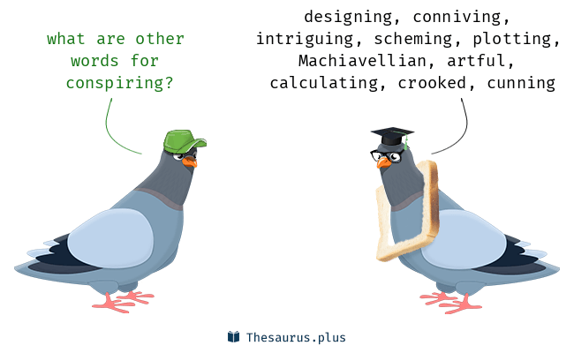
Obstacle 2: Conspiring
Nehemiah 4:7-8 “⁷ Now it happened, when Sanballat, Tobiah, the Arabs, the Ammonites, and the Ashdodites heard that the walls of Jerusalem were being restored and the gaps were beginning to be closed, that they became very angry, ⁸ and all of them conspired together to come and attack Jerusalem and create confusion.”

Slide 4
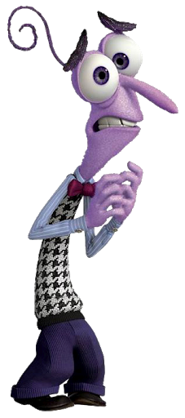
Obstacle 3: Worry/Fear
Nehemiah 4:10-12 “¹⁰ Then Judah said, “The strength of the laborers is failing, and there is so much rubbish that we are not able to build the wall.” ¹¹ And our adversaries said, “They will neither know nor see anything, till we come into their midst and kill them and cause the work to cease.” ¹² So it was, when the Jews who dwelt near them came, that they told us ten times, “From whatever place you turn, they will be upon us.”

Slide 6
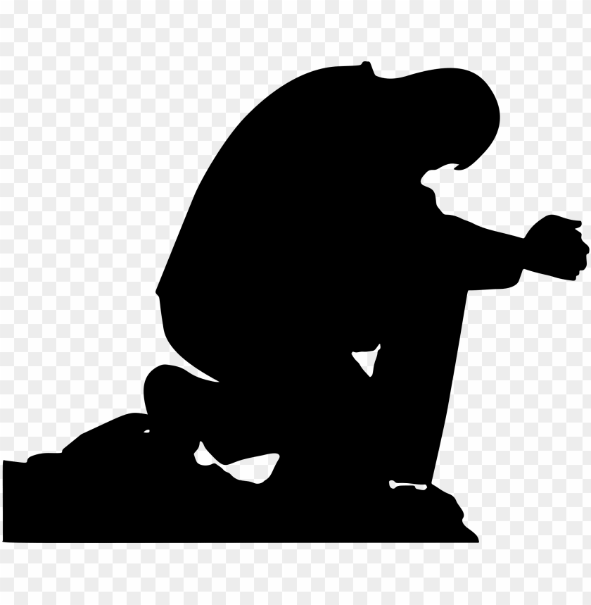
Method 1: Prayer
The leaders prayed
Nehemiah 4:4-5 “⁴ Hear, O our God, for we are despised; turn their reproach on their own heads, and give them as plunder to a land of captivity! ⁵ Do not cover their iniquity, and do not let their sin be blotted out from before You; for they have provoked You to anger before the builders.
The laborers prayed
Nehemiah 9a “⁹ Nevertheless we made our prayer to our God,”

Slide 7
Method 2: Work
Nehemiah 4:6 “⁶ So we built the wall, and the entire wall was joined together up to half its height, for the people had a mind to work.”

Slide 8
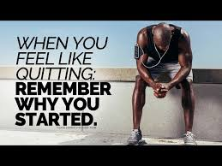
Method 3: Remember…
Nehemiah 4:14 “¹⁴ And I looked, and arose and said to the nobles, to the leaders, and to the rest of the people, “Do not be afraid of them. Remember the Lord, great and awesome, and fight for your brethren, your sons, your daughters, your wives, and your houses.”

Slide 9
Conclusion

