Slide 1
Procrastination
Heb 3:7-19, 4:7

Slide 2
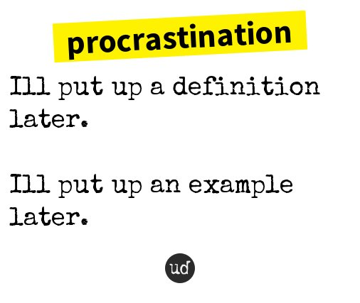

Slide 3
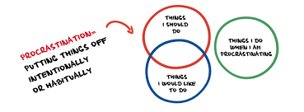

Slide 4
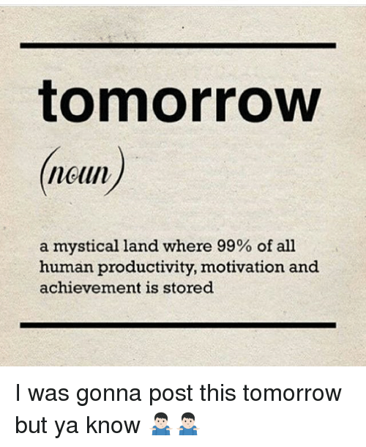

Slide 5
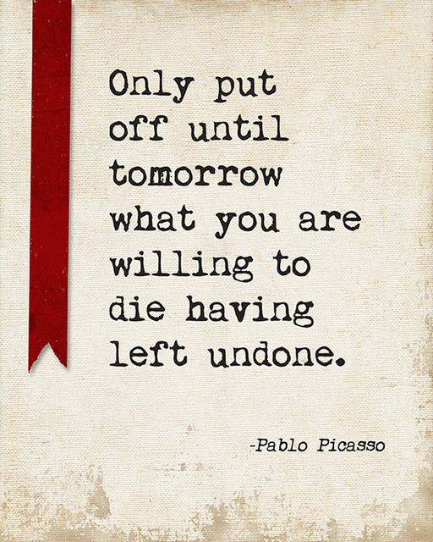

Slide 6
Are these Really Benefits?
Not having to face the issue due to postponement
Not having to make a final decision
Not having to tell someone “No”
Not having to suffer the consequences of out actions
Not having to close the door on other possibilities

Slide 7
When you say I’ll do it later…
It’s not really that important
It really won’t make a difference
I have plenty of time
There are other things much more important to do
Someone or something is more important to me

Slide 8
Spiritual Procrastination
It’s not really that important
It really won’t make a difference
I have plenty of time
There are other things much more important to do
Someone or something is more important to me

Slide 10
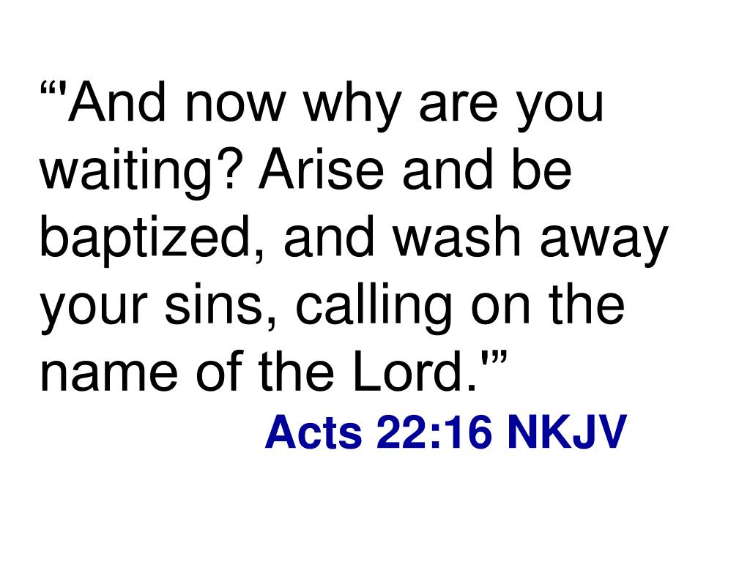
What are you waiting for?

