Slide 1
Keep Your Heart Clean
Scriptures: Prov 4:23; 2 Cor 7:1

Slide 3
Action 1:
1 Corinthians 6:9-11 New King James Version (NKJV)
⁹ Do you not know that the unrighteous will not inherit the kingdom of God? Do not be deceived. Neither fornicators, nor idolaters, nor adulterers, nor homosexuals, nor sodomites, ¹⁰ nor thieves, nor covetous, nor drunkards, nor revilers, nor extortioners will inherit the kingdom of God. ¹¹ And such were some of you. But you were washed, but you were sanctified, but you were justified in the name of the Lord Jesus and by the Spirit of our God.

Slide 4
Action 1:
1 Peter 1:18-19 New King James Version (NKJV)
¹⁸ knowing that you were not redeemed with corruptible things, like silver or gold, from your aimless conduct received by tradition from your fathers,
¹⁹ but with the precious blood of Christ, as of a lamb without blemish and without spot.

Slide 5
Action 2:
1 Timothy 6:10-11 New King James Version (NKJV)
¹⁰ For the love of money is a root of all kinds of evil, for which some have strayed from the faith in their greediness, and pierced themselves through with many sorrows.
¹¹ But you, O man of God, flee these things and pursue righteousness, godliness, faith, love, patience, gentleness.

Slide 6
Action 2:
2 Timothy 2:22 New King James Version (NKJV)
²² Flee also youthful lusts; but pursue righteousness, faith, love, peace with those who call on the Lord out of a pure heart.
1 Thessalonians 5:22 New King James Version (NKJV)
²² Abstain from every form of evil.

Slide 7
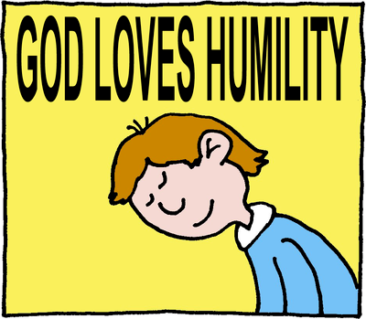
Action 3:
James 4:6 New King James Version (NKJV)
⁶ But He gives more grace. Therefore He says: “God resists the proud, But gives grace to the humble.”
1 Peter 5:6 New King James Version (NKJV)
⁶ Therefore humble yourselves under the mighty hand of God, that He may exalt you in due time,

Slide 8
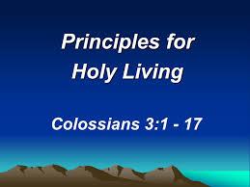
Action 4:

Slide 9
Action 5:
Matthew 22:35-40 New King James Version (NKJV)
³⁵ Then one of them, a lawyer, asked Him a question, testing Him, and saying, ³⁶ “Teacher, which is the great commandment in the law?”
³⁷ Jesus said to him, “‘You shall love the Lord your God with all your heart, with all your soul, and with all your mind.’ ³⁸ This is the first and great commandment. ³⁹ And the second is like it: ‘You shall love your neighbor as yourself.’ ⁴⁰ On these two commandments hang all the Law and the Prophets.”

Slide 10
Keep Your Heart Clean
Scriptures: Prov 4:23; 2 Cor 7:1

