Slide 1
Who was Nehemiah?
Lesson 1

Slide 2
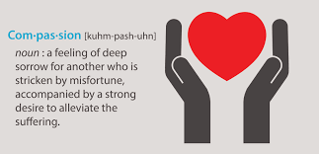
A man of Compassion 1:1-4
Sat down and wept
Mourned
Fasted
Prayed

Slide 3
A man of Prayer

Slide 4
A Servant to the King… a Servant of God

Slide 5
A Servant to the King… a servant of God

Slide 6
A man of Honesty and Confession
Notes:
Nehemiah 1:6-7

Slide 7
A man who Knew God’s Promises
Notes:
Nehemiah 1:6-7

Slide 8
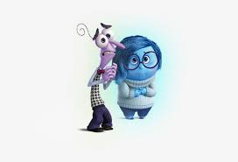
A man of Emotions
Nehemiah 2:2-3 New King James Version (NKJV)
² Therefore the king said to me, “Why is your face sad, since you are not sick? This is nothing but sorrow of heart.”
So I became dreadfully afraid, ³ and said to the king, “May the king live forever! Why should my face not be sad, when the city, the place of my fathers’ tombs, lies waste, and its gates are burned with fire?”

