Slide 3
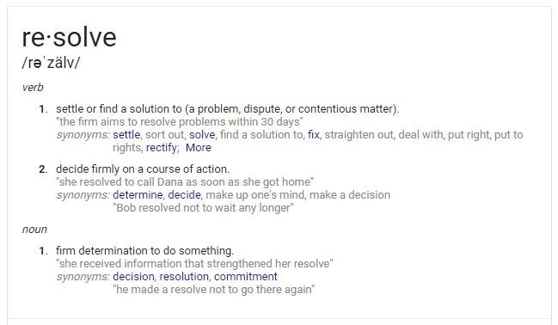

Slide 4
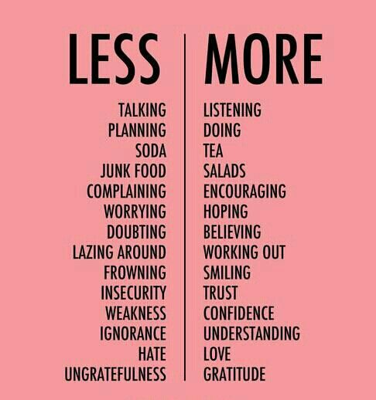

Slide 7
Resolution 1: I will Keep God’s Commands in my heart
Proverbs 3:1-2 New King James Version (NKJV)
3 My son, do not forget my law, But let your heart keep my commands;
² For length of days and long life And peace they will add to you.

Slide 8
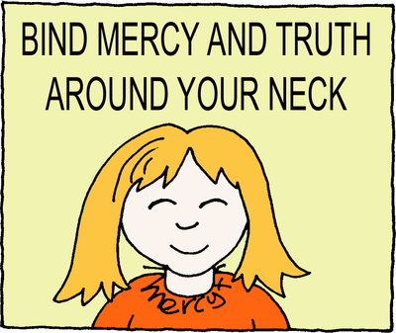
Resolution 2: I will be truthful and merciful
Proverbs 3:3-4 New King James Version (NKJV)
³ Let not mercy and truth forsake you; Bind them around your neck, Write them on the tablet of your heart,
⁴ And so find favor and high esteem In the sight of God and man.

Slide 9
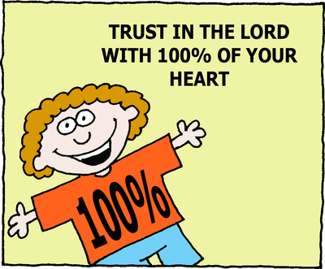
Resolution 3: I Will Trust in the Lord with all my Heart
Proverbs 3:5-6 New King James Version (NKJV)
⁵ Trust in the Lord with all your heart, And lean not on your own understanding;
⁶ In all your ways acknowledge Him, And He shall direct your paths.

Slide 10
Resolution 4: I Will not be Wise in my own Eyes
Proverbs 3:7-8 New King James Version (NKJV)
⁷ Do not be wise in your own eyes; Fear the Lord and depart from evil.
⁸ It will be health to your flesh, And strength to your bones.

Slide 11
Resolution 5: I Will Honor God
Proverbs 3:9-10 New King James Version (NKJV)
⁹ Honor the Lord with your possessions, And with the firstfruits of all your increase;
¹⁰ So your barns will be filled with plenty, And your vats will overflow with new wine.

Slide 12
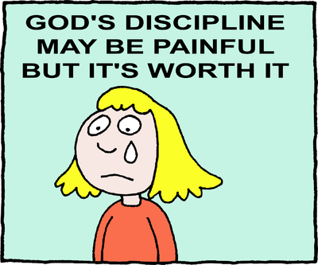
Resolution 6: I Will Accept God’s Chastening
Proverbs 3:11-12 New King James Version (NKJV)
¹¹ My son, do not despise the chastening of the Lord, Nor detest His correction;
¹² For whom the Lord loves He corrects, Just as a father the son in whom he delights.

Slide 13
Resolution 7: I Will Actively seek God’s Wisdom
Prov 3:13-24

Slide 14
Resolution 8: I Will not be afraid
Proverbs 3:25-26 New King James Version (NKJV)
²⁵ Do not be afraid of sudden terror, Nor of trouble from the wicked when it comes;
²⁶ For the Lord will be your confidence, And will keep your foot from being caught.

Slide 15
Resolution 9: I Will Help Others as I Have Ability
Proverbs 3:27-28 New King James Version (NKJV)
²⁷ Do not withhold good from those to whom it is due, When it is in the power of your hand to do so.
²⁸ Do not say to your neighbor, “Go, and come back, And tomorrow I will give it,” When you have it with you.

Slide 16
Resolution 10: I Will be a Good Neighbor
Proverbs 3:29-30 New King James Version (NKJV)
²⁹ Do not devise evil against your neighbor, For he dwells by you for safety’s sake.
³⁰ Do not strive with a man without cause, If he has done you no harm.

Slide 17
Resolution 11: I Will not Envy others
Proverbs 3:31-32 New King James Version (NKJV)
³¹ Do not envy the oppressor, And choose none of his ways;
³² For the perverse person is an abomination to the Lord, But His secret counsel is with the upright.

