Slide 2
What He didn’t ask…

Slide 3
What He did ask

Slide 4
Mk 8:29a “²⁹ He said to them, “But who do you say that I am?”
In contrast to the popular opinions of Christ
In contrast to what others say
Who do YOU say I am?

Slide 5
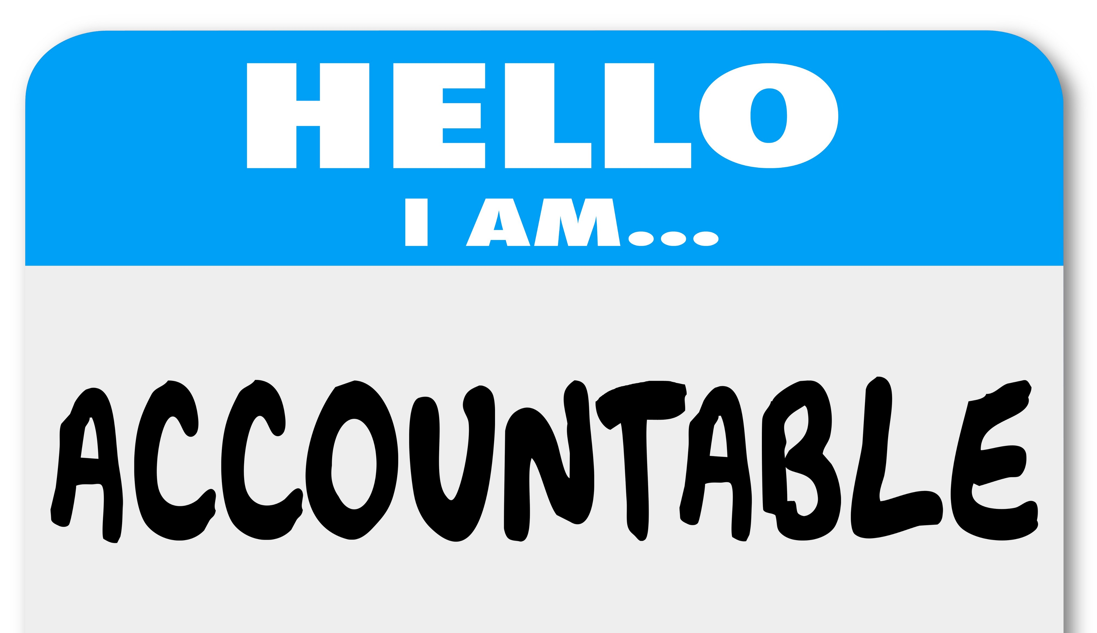
Mk 8:29a “²⁹ He said to them, “But who do you say that I am?”
The question was for each of them to consider
Another’s confession wouldn’t help them
It didn’t matter what others thought, Jesus was concerned with what each individual thought

Slide 6
Mk 8:29a “²⁹ He said to them, “But who do you say that I am?”
The same expectation is true for us to day
Most of the world has rejected who He really is
He forgives and pardons those who accept Him as He really is (cf. Mt 10:32-33)

Slide 7
Mk 8:29b “Peter answered and said to Him, “You are the Christ.”
He was certain of who Jesus was and was not afraid or ashamed to admit it
There was not doubt this was the Messiah (Anointed one of God)
He recognized Jesus wasn’t just a great prophet or teacher…He wasn’t just one who could perform miracles…He was the Christ

Slide 8
Mk 8:30 “³⁰ Then He strictly warned them that they should tell no one about Him.”
Jesus knew that now was not the time for this declaration to the world
The Jews were seeking a political Messiah, one who would liberate the people from Rome
Declaring Jesus as the Messiah would create confusion and false hope for those expecting Him to overthrow Rome

Slide 9
Mk 8:30 “³⁰ Then He strictly warned them that they should tell no one about Him.”
Mk 8:31 “³¹ And He began to teach them that the Son of Man must suffer many things, and be rejected by the elders and chief priests and scribes, and be killed, and after three days rise again.”

Slide 10
Conclusion
Who do you say Jesus is?
Your response to that question will determine your eternal destiny

