Slide 1
Necessary
or Just Tradition?

Slide 3
Gospel invitation recognizes that Christ will return (Rev 22:12)
Mt 24:36-44
Acts 1:9-11
1 Thes 4:13-18

Slide 4
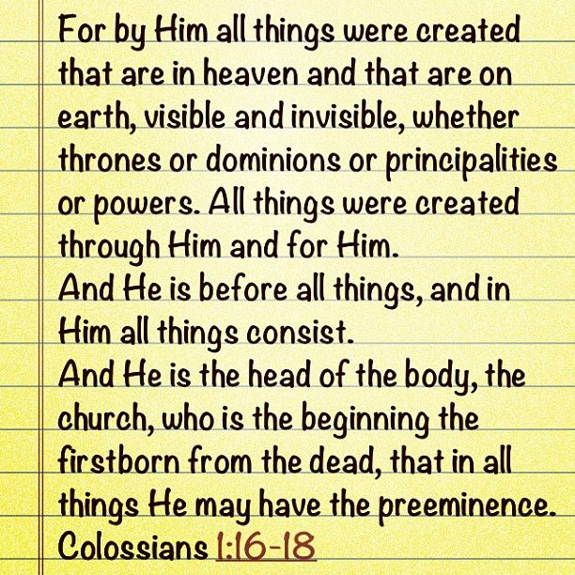
Gospel invitation is based on who Jesus is (Rev 22:13, 16)

Slide 5
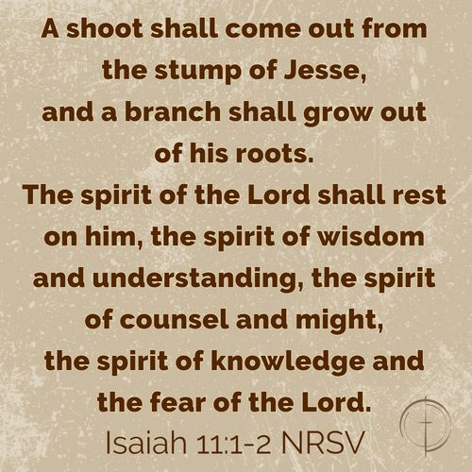
Gospel invitation is based on who Jesus is (Rev 22:13, 16)
Notes:
In light of who Jesus is, we must offer and respond to the gospel invitation

Slide 6
Gospel invitation reminds man we must obey to be saved (Rev 22:14-15)
Mt 7:21
Heb 5:9
1 Pet 4:17-18
Notes:
In light of the blessings that come from obedience, we must offer and respond to the gospel invitation

Slide 7
Gospel invitation reminds man we must obey to be saved (Rev 22:14-15)
Notes:
In light of the punishment for sin, we must offer and respond to the gospel invitation

Slide 8
Gospel invitation must always be offered because it’s a Christian’s responsibility (Rev 22:17)
Notes:
In light of the fact it is our responsibility, we must offer and respond to the gospel invitation

Slide 9
Necessary,
not Just Tradition!

