Slide 1
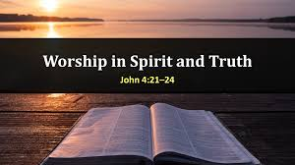

Slide 2
A Common Question We May Face

Slide 3
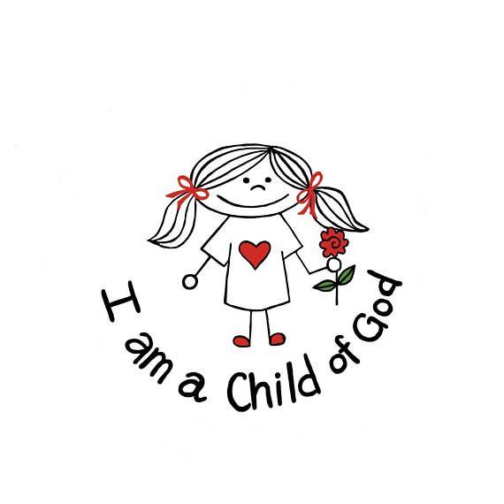
True worship gives a sense of belonging
1 Pet 2:9-10 “⁹ But you are a chosen generation, a royal priesthood, a holy nation, His own special people, that you may proclaim the praises of Him who called you out of darkness into His marvelous light; ¹⁰ who once were not a people but are now the people of God, who had not obtained mercy but now have obtained mercy.
1 Jn 3:2 “² Beloved, now we are children of God; and it has not yet been revealed what we shall be, but we know that when He is revealed, we shall be like Him, for we shall see Him as He is.

Slide 4
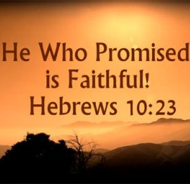
True worship gives a sense of security
2 Tim 2:19 “¹⁹ Nevertheless the solid foundation of God stands, having this seal: “The Lord knows those who are His,” and, “Let everyone who names the name of Christ depart from iniquity.”
Heb 10:35-36 “³⁵ Therefore do not cast away your confidence, which has great reward. ³⁶ For you have need of endurance, so that after you have done the will of God, you may receive the promise:

Slide 5
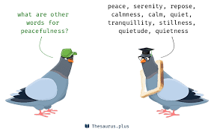
True worship gives a sense of peacefulness
Phil 4:6-7 “⁶ Be anxious for nothing, but in everything by prayer and supplication, with thanksgiving, let your requests be made known to God; ⁷ and the peace of God, which surpasses all understanding, will guard your hearts and minds through Christ Jesus.

Slide 6
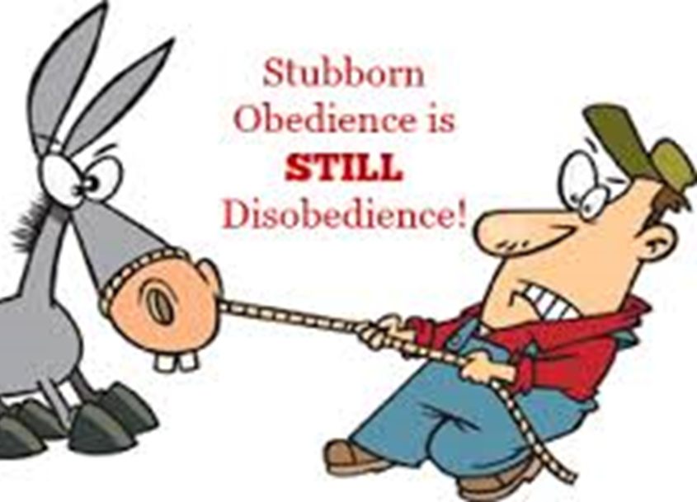
True worship gives a sense of joyful obedience
Jn 14:15 “¹⁵ “If you love Me, keep My commandments.”
Jn 14:23 “²³ Jesus answered and said to him, “If anyone loves Me, he will keep My word; and My Father will love him, and We will come to him and make Our home with him.”
Ps 112:1 “112 Praise the Lord! Blessed is the man who fears the Lord, Who delights greatly in His commandments.

Slide 7
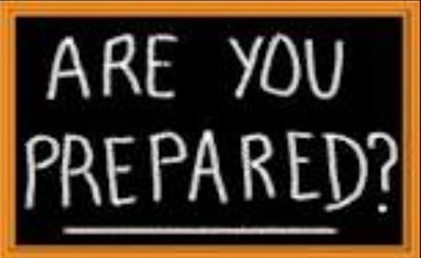
True worship prepares us for heaven
Mt 7:21-23 “Mt 7:21-23 “²¹ “Not everyone who says to Me, ‘Lord, Lord,’ shall enter the kingdom of heaven, but he who does the will of My Father in heaven. ²² Many will say to Me in that day, ‘Lord, Lord, have we not prophesied in Your name, cast out demons in Your name, and done many wonders in Your name?’ ²³ And then I will declare to them, ‘I never knew you; depart from Me, you who practice lawlessness!’

