Slide 1
4:26-34

Slide 2
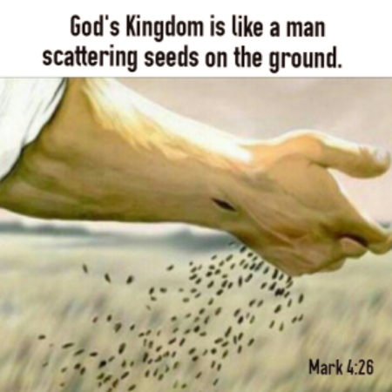
Mark 4:26 “²⁶ And He said, “The kingdom of God is as if a man should scatter seed on the ground,”
Of first note is the idea that a man (individual work) should scatter seed on the ground
We understand from the previous parable that the seed is the Word of God
Like the parable above we find that the seed is to be scattered everywhere

Slide 3
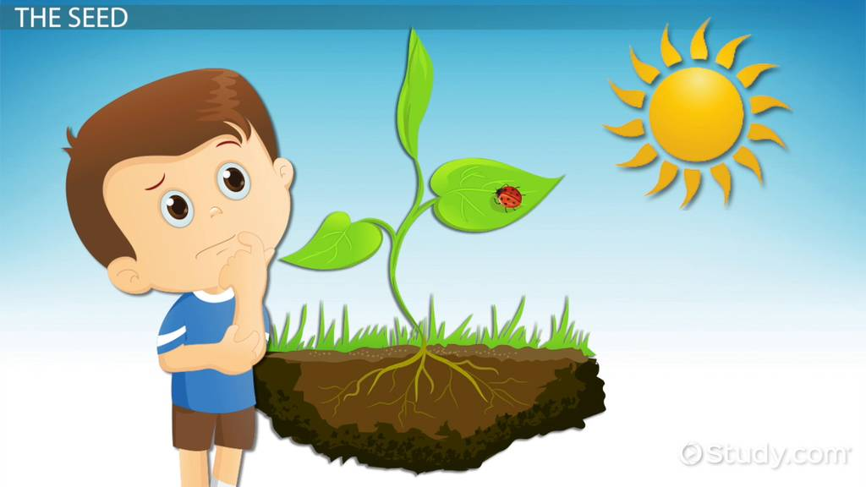
Mark 4:27 “²⁷ and should sleep by night and rise by day, and the seed should sprout and grow, he himself does not know how”
The farmer performs his work by day and then sleeps by night…when he wakes in the morning he sees that the seed has sprouted”
The farmer does not know how this takes place he just sees the results of his labor
We do not know how the Word of God may work in ones’ heart, we just have to scatter and let the seed do its work

Slide 4
The blade: This speaks of the new believer who needs to be nurtured and loved as he/she gains strength and while growing to maturity
The ear: the middle stages of a Christian as he/she has grown stronger and shows the promise of bearing fruit but still has need of growth
The full ear: represents the mature Christian capable of helping to grow others as well

Slide 5
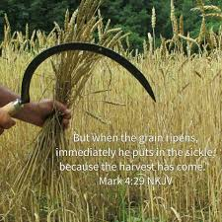
There are different views as to exactly what the point of this verse may be
I prefer to keep it simple and see it as a completion of the simile Jesus is using… He explains the last thing that happens in the lifecycle of the seed
The emphasis still must remain on the process of how the word is sown (man’s work), how it works in the life of individuals (God’s work) and the importance of recognizing the stages throughout the process and its growth in the individual

Slide 6
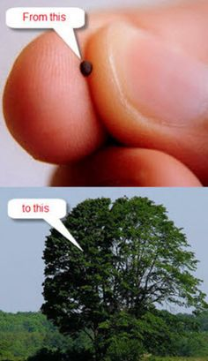
Mk 4:30-32 “³⁰ Then He said, “To what shall we liken the kingdom of God? Or with what parable shall we picture it? ³¹ It is like a mustard seed which, when it is sown on the ground, is smaller than all the seeds on earth; ³² but when it is sown, it grows up and becomes greater than all herbs, and shoots out large branches, so that the birds of the air may nest under its shade.”
God’s Kingdom starts small from humble beginnings
God’s Kingdom starts small but will grow and finish strong

Slide 7
Mk 4:33-34 “³³ And with many such parables He spoke the word to them as they were able to hear it. ³⁴ But without a parable He did not speak to them. And when they were alone, He explained all things to His disciples.”

