Slide 2
Introduction: What can we Learn from These Women
These were two very important women
Paul took the time to write about them
What can we learn from these women today?

Slide 3
The Home Situation: Acts 16:1-3
16 Then he came to Derbe and Lystra. And behold, a certain disciple was there, named Timothy, the son of a certain Jewish woman who believed, but his father was Greek. ² He was well spoken of by the brethren who were at Lystra and Iconium. ³ Paul wanted to have him go on with him. And he took him and circumcised him because of the Jews who were in that region,”
Eunice was a Jewish woman who had become a Christian
Eunice’s husband was a Greek
Timothy was raised in a split household
Mom was a Christian but dad was not

Slide 4
The Home Situation: A Difficult Situation
It can be very difficult to instill Christian values if parents are not on the same page
The mention of Eunice in 2 Timothy can be seen as a compliment to how she was able to raise Timothy despite the difficult circumstances in the home
If Eunice could do it, mothers today can do it too

Slide 5
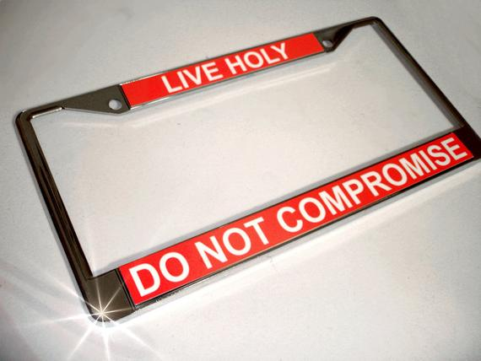
How can a mother today overcome a split household and teach her children?
1 Cor 7:13-16 “¹³ And a woman who has a husband who does not believe, if he is willing to live with her, let her not divorce him. ¹⁴ For the unbelieving husband is sanctified by the wife, and the unbelieving wife is sanctified by the husband; otherwise your children would be unclean, but now they are holy. ¹⁵ But if the unbeliever departs, let him depart; a brother or a sister is not under bondage in such cases. But God has called us to peace. ¹⁶ For how do you know, O wife, whether you will save your husband? Or how do you know, O husband, whether you will save your wife?”

Slide 6
How can a mother today overcome a split household and teach her children?
Don’t let go of your faith
Love your husband
Let your husband and your children see what a real Christian looks like

Slide 7
Mothers Can Influence Their Children to Read the Word of God
2 Tim 3:14-15 “¹⁴ But you must continue in the things which you have learned and been assured of, knowing from whom you have learned them, ¹⁵ and that from childhood you have known the Holy Scriptures, which are able to make you wise for salvation through faith which is in Christ Jesus.”
Timothy had learned the scriptures from childhood
His father didn’t teach them to him, he was a Greek
He must have been taught by his mother
Mothers, if Eunice could do it, you can too

Slide 8
Mothers can Influence Future Generations
We have been looking at the influence of Eunice on timothy
Who influenced Eunice?
We are told that the genuine faith in Timothy first dwelt in his grand mother and mother

Slide 9
Be a Mother that Influences Future Generations
Pour yourself into your children’s lives
Show your children what a real Christian looks like
Pour yourself into your grandchildren’s lives
If you can’t be there with them, pray for them and let them know the importance of God in your life

Slide 10
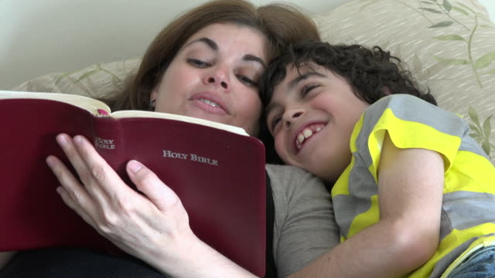
Mothers can Influence Their Children’s Faith
When Paul arrived in Lystra in Acts 16 Timothy was already a disciple
His mother was a believer, his grandmother was a believer, and he was a believer
God honored Eunice and Lois’ faith by using them to influence Timothy’s faith in Jesus
If they could do it, you can too

Slide 11
Mothers can Influence Their Children’s Faith
Let your children see you study and pray
Make service your top priority and take them with you to every one
Teach them what Jesus has done for you and them
Teach them what they must do to obey Jesus

Slide 12
Conclusion
If Lois and Eunice could raise a child like Timothy into the man he would become
Mothers (and fathers) you can do it too

