Slide 1
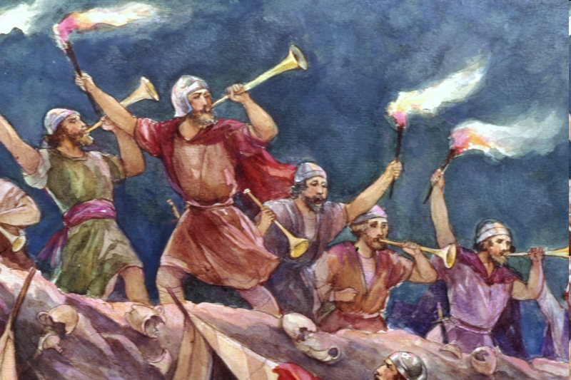
Lessons from the life of Gideon: God’s way is the best way
James 4:13-17 & Judges 7

Slide 2
Man’s Plan vs God’s Plan
Peter vs God – Luke 5:1-11
Peter vs God – Matt 16:21-23
Goliath vs God – 1 Sam 17
Israel vs God – Num 13-14
Gideon vs God – Judges 7
God Has The Best Plan!
Notes:
Mt 16:21-23 “²¹ From that time on Jesus began to explain to his disciples that he must go to Jerusalem and suffer many things at the hands of the elders, the chief priests and the teachers of the law, and that he must be killed and on the third day be raised to life. ²² Peter took him aside and began to rebuke him. “Never, Lord!” he said. “This shall never happen to you!” ²³ Jesus turned and said to Peter, “Get behind me, Satan! You are a stumbling block to me; you do not have in mind the concerns of God, but merely human concerns.”

Slide 3
God’s plan is a DIFFERENT plan Judges 7
vs 2-7 We have plans that God can change
David was just a shepherd
Job wanted to enjoy his wealth and family
Joseph & Mary wanted to get married raise a family
Saul of Tarsus wanted to destroy Christianity
Submit your plans to God – Luke 22:42
Notes:
Lk 22:42 “⁴² “Father, if you are willing, take this cup from me; yet not my will, but yours be done.”

Slide 4
God’s Plan is a DECLARED Plan Judges 7
vs 9-14 God ask for a clear step of faith
Walk in obedience to His will with clarity
God speaks to us through…
His word – Rom 10:17
The Spirit – Acts 13:2; 16:6-8
Other believers – Acts 9:17-18
Circumstances of life – Gen 24:12-20
God will direct you but this requires prayer, holiness & patience, and HIS timing
Notes:
Acts 13:2 “² While they were worshiping the Lord and fasting, the Holy Spirit said, “Set apart for me Barnabas and Saul for the work to which I have called them.”
Acts 9:17-18 “¹⁷ Then Ananias went to the house and entered it. Placing his hands on Saul, he said, “Brother Saul, the Lord—Jesus, who appeared to you on the road as you were coming here—has sent me so that you may see again and be filled with the Holy Spirit. ¹⁸ Immediately, something like scales fell from Saul’s eyes, and he could see again. He got up and was baptized,”
Gen 24:12-20 Turn and read

Slide 5
God’s Plan is a DISTINCT Plan Judges 7
vs 15-23 God said these actions would give them victory and they did
No man would ever come up with that plan
If they didn’t obey God they would have missed out on the best plan for their lives
God has the best plan for your life

Slide 6
God’s Plan Requires… Judges 7
Surrender – vs13
Trust God – Rom 8:28, Jer 29:11
Submission
Obedience is important – 1 Sam 15:22
His command for us – Eph 6:6
Steadfastness
God honors faith – Heb 11:6
Notes:
Rom 8:28 “²⁸ And we know that in all things God works for the good of those who love him, who^{[a]} have been called according to his purpose.”
1 Sam 15:22 “²² But Samuel replied:
“Does the Lord delight in burnt offerings and sacrifices as much as in obeying the Lord? To obey is better than sacrifice, and to heed is better than the fat of rams.
Eph 6:6 “⁶ Obey them not only to win their favor when their eye is on you, but as slaves of Christ, doing the will of God from your heart.”
Heb 11:6 “⁶ And without faith it is impossible to please God, because anyone who comes to him must believe that he exists and that he rewards those who earnestly seek him.”

Slide 7
The Results of God’s Plan Judges 7
God’s Enemies are Defeated – vs 21-22
God’s People are Victorious – vs 23 & 7-8
God wants us to walk in victory – Rom 8:37; 2 Cor 2:14; 1 Cor 15:57
Victory only comes when following HIS plan – 2 Cor 4:7-10; 2 Cor 12:7-10
God’s Name is Glorified – vs 2 & 15-23
1 Cor 10:31; Matt 5:16
Notes:
1 Cor 15:57 “⁵⁷ But thanks be to God, who gives us the victory through our Lord Jesus Christ.”
2 Cor 4:7-10 Turn and read
2 Cor 12:7-10
1 Cor 10:31 “³¹ Therefore, whether you eat or drink, or whatever you do, do all to the glory of God.”
Mt 5:16 “¹⁶ Let your light so shine before men, that they may see your good works and glorify your Father in heaven.

Slide 8
Conclusion
He has the best plan for living
He has the best plan for leaving
John 14:6; Acts 4:12
Notes:
John 14:6 “⁶ Jesus said to him, “I am the way, the truth, and the life. No one comes to the Father except through Me.”
Acts 4:12 “¹² Nor is there salvation in any other, for there is no other name under heaven given among men by which we must be saved.”

