Slide 1
READ
CAREFULLY

Slide 2
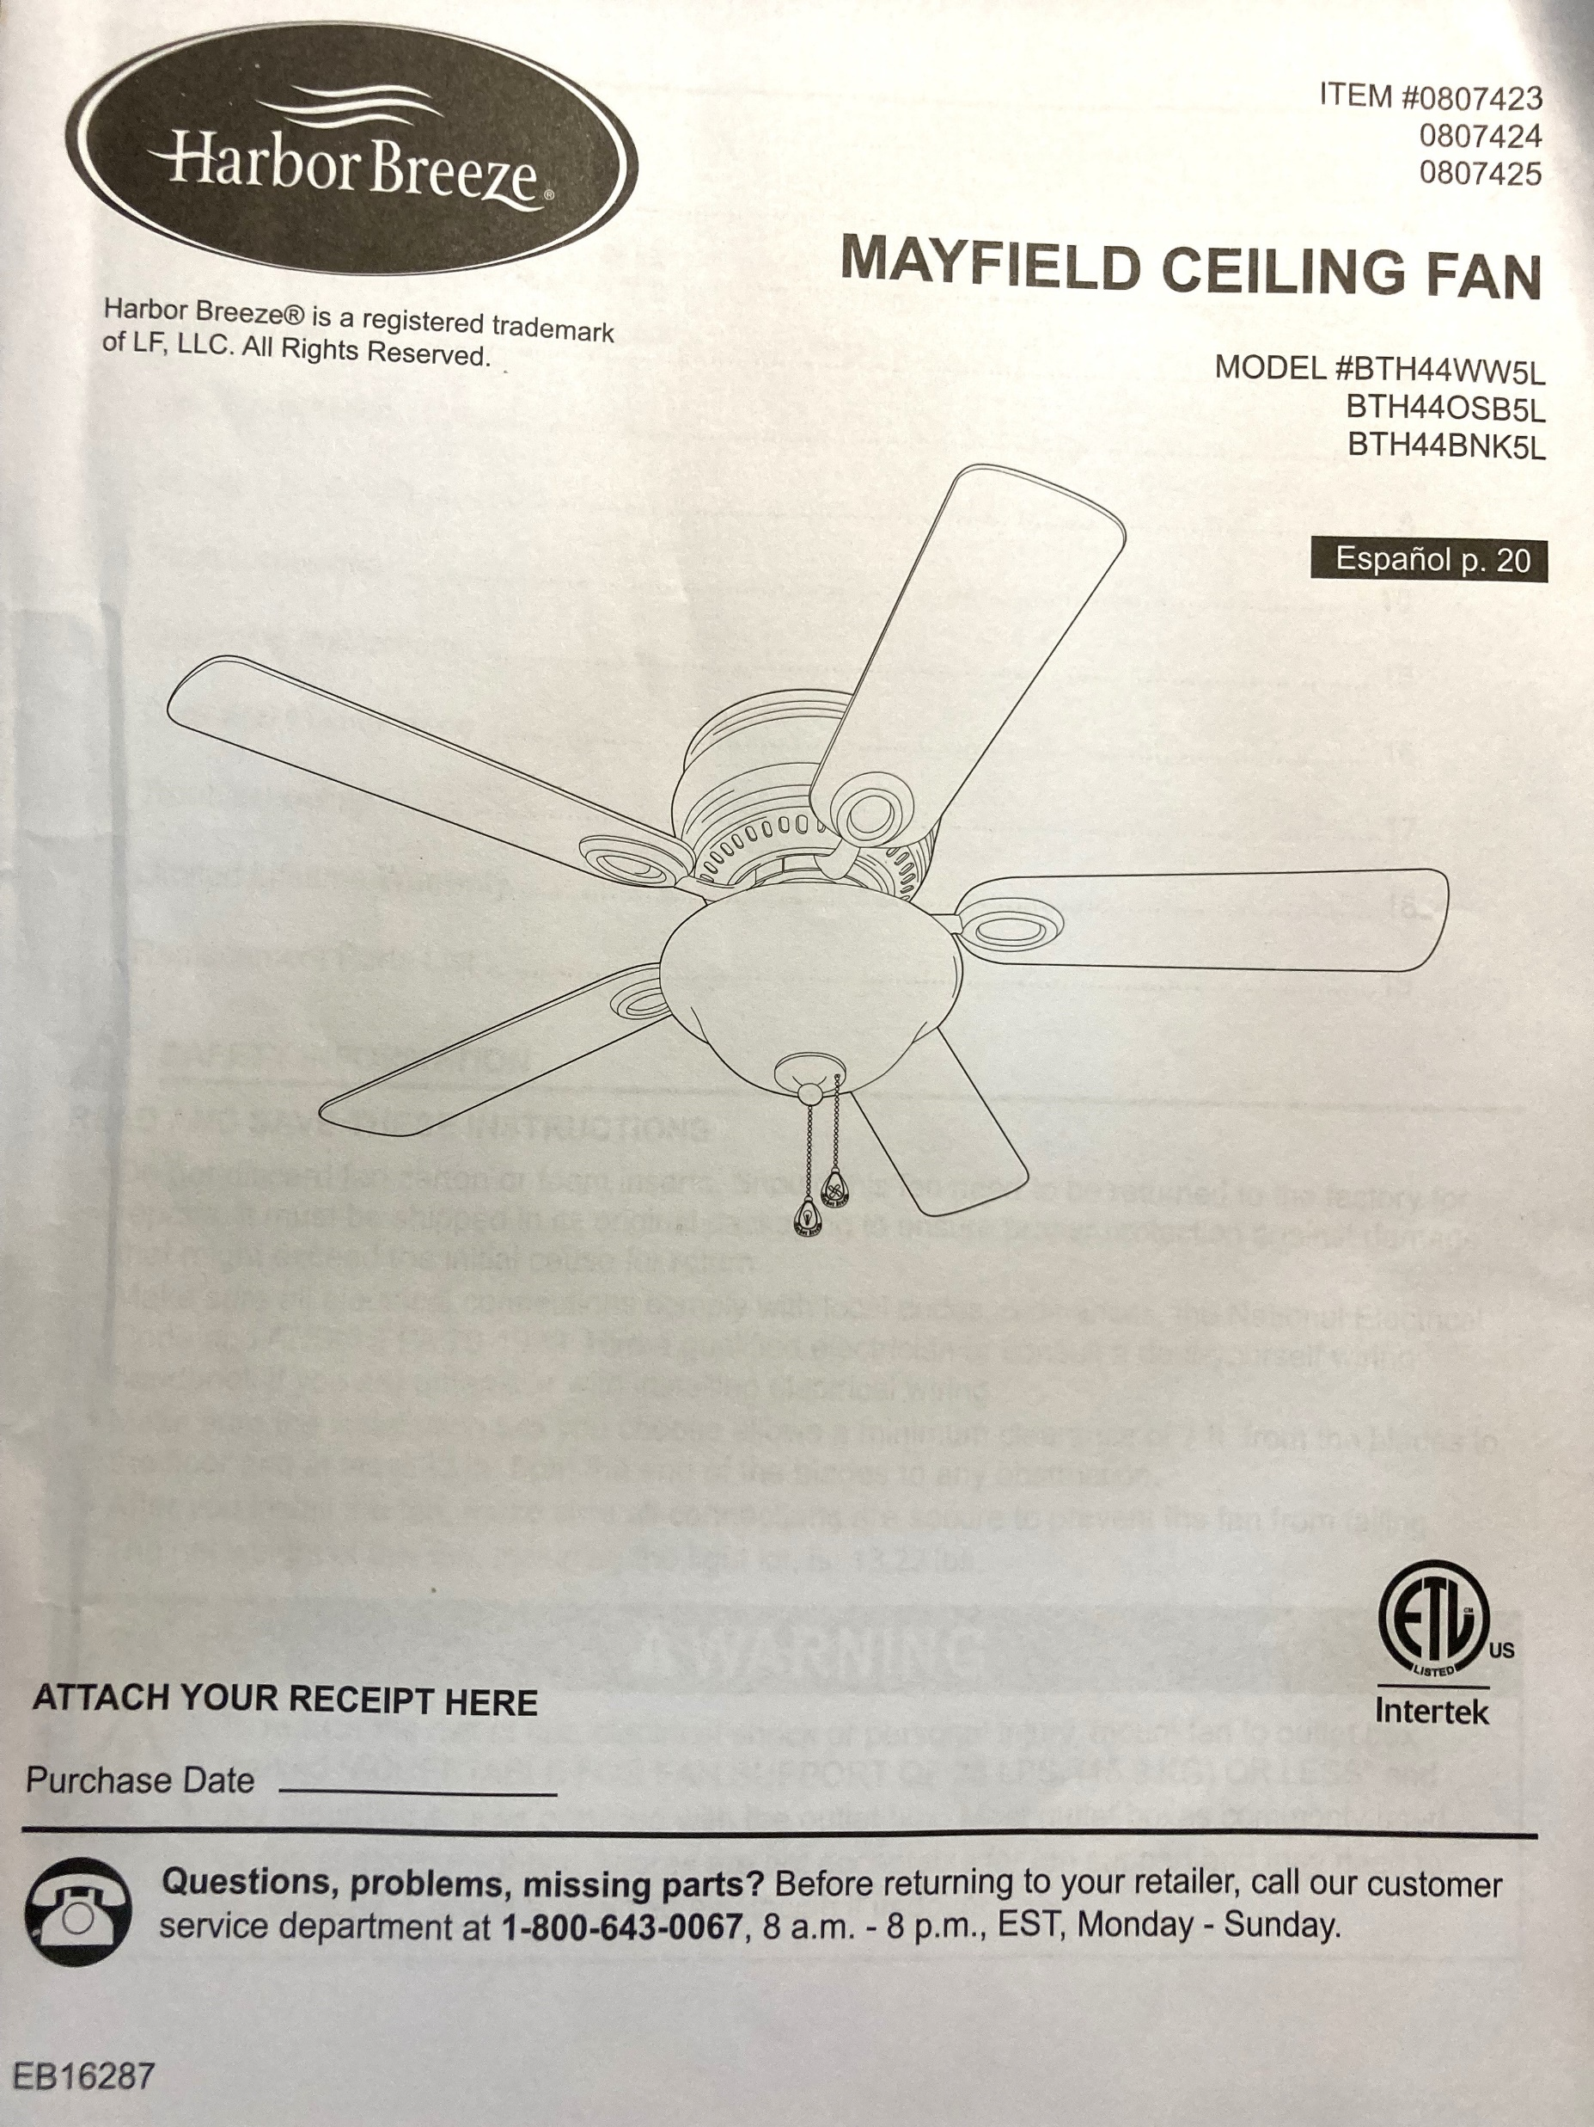
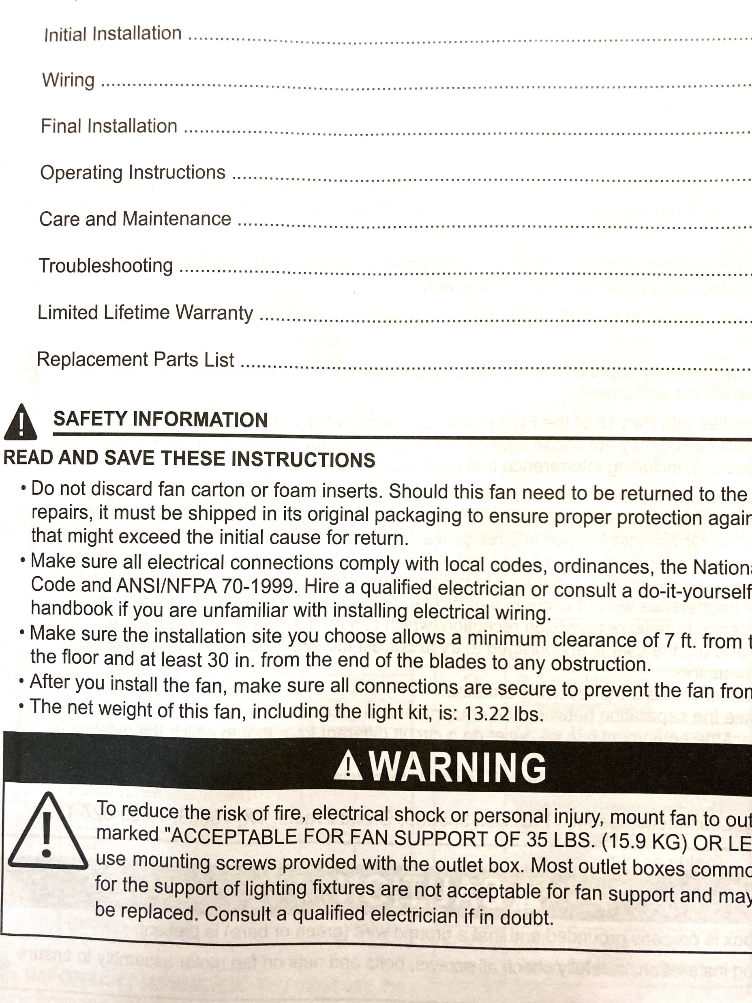

Slide 3
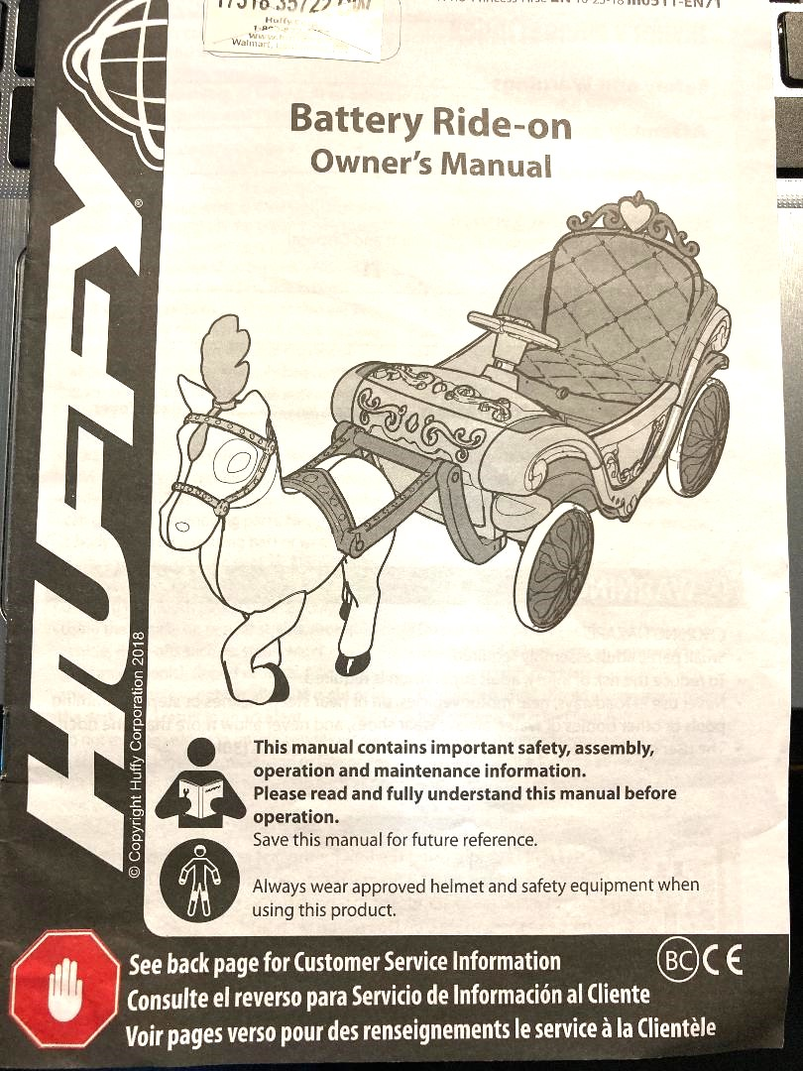
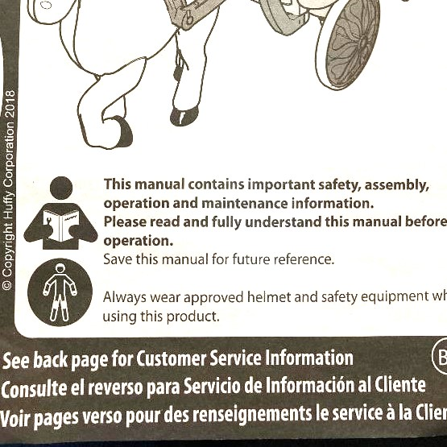

Slide 4
READ
CAREFULLY
“For there is no partiality with God.
For as many as have sinned without law will also perish without law, and as many as have sinned in the law will be judged by the law for not the hearers of the law are just in the sight of God, but the doers of the law will be justified;”
Romans 2:11-13

Slide 5
READ
CAREFULLY
Let us Understand that
it will be by the
LAW
that we will be judged.

Slide 6
READ
CAREFULLY
We must Understand what
“THE LAW” is,
then we must
FOLLOW it.

Slide 7
We Are All the Same
READ
CAREFULLY

Slide 8
We Are All the Same
READ
CAREFULLY
Romans 3:9-20

Slide 9
The Law
READ
CAREFULLY

Slide 10
The Law
READ
CAREFULLY
“Therefore you shall lay up these words of mine in your heart and in your soul, and bind them as a sign on your hand, and they shall be as frontlets between your eyes. You shall teach them to your children, speaking of them when you sit in your house, when you walk by the way, when you lie down, and when you rise up…
Deuteronomy 11:18-21

Slide 11
The Law
READ
CAREFULLY
…And you shall write them on the doorposts of your house and on your gates, that your days and the days of your children may be multiplied in the land of which the Lord swore to your fathers to give them,
like the days of the heavens above the earth.”
Deuteronomy 11:18-21

Slide 12
The Law
READ
CAREFULLY
“Now learn this parable from the fig tree:
When its branch has already become tender and puts forth leaves, you know that summer is near. So you also, when you see all these things, know that it is near
— at the doors!...
Matthew 24:32-35

Slide 13
The Law
READ
CAREFULLY
…Assuredly, I say to you, this generation will by no means pass away till all these things take place.
Heaven and earth will pass away,
but My words will by no means pass away.”
Matthew 24:32-35

Slide 14
The Law
READ
CAREFULLY
John 12:44-50

Slide 15
Obedience to The Law
READ
CAREFULLY

Slide 16
Obedience to The Law
READ
CAREFULLY
Philippians 2:5-16

Slide 17
READ
CAREFULLY

Slide 18
- We all are the same
READ
CAREFULLY

Slide 19
- We all are the same
- We must know and obey the Law
READ
CAREFULLY

Slide 20
- We all are the same
- We must know and obey the Law
- We must be obedient to THAT LAW unto death!
READ
CAREFULLY

