Slide 1
ABSTAIN FROM ALL APPEARANCE EVIL
OF
1 Thessalonians 5:22

Slide 2
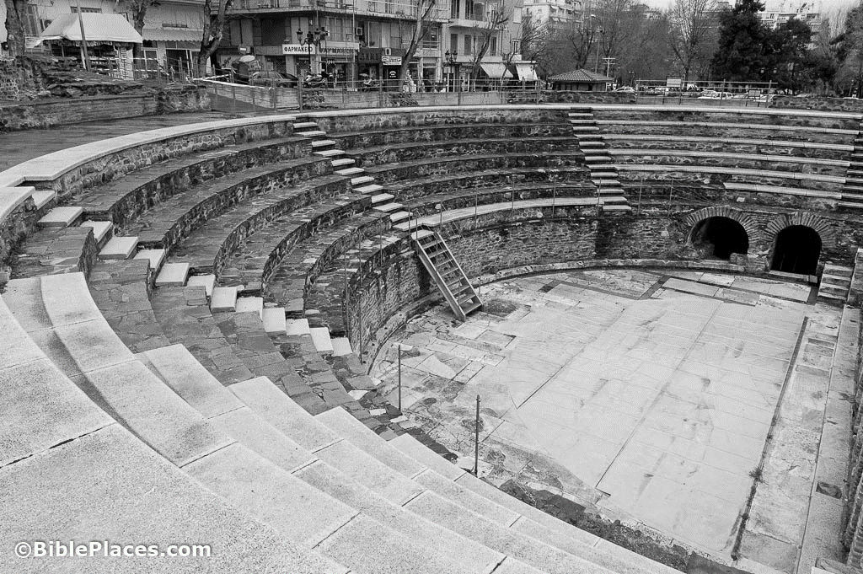
THE CHURCH AT THESSALONICA
1 Thessalonians 1:1- 9

Slide 3
THE CHURCH AT THESSALONICA
- Great example of
Holy Living

Slide 4
ABSTAIN FROM ALL APPEARANCE EVIL
OF
The Authority of the Bible & Ethics

Slide 5
ABSTAIN FROM ALL APPEARANCE EVIL
OF
The Authority of the Bible & Ethics
Authority – the power or right
to act or command

Slide 6
ABSTAIN FROM ALL APPEARANCE EVIL
OF
The Authority of the Bible & Ethics
Authority – the power or right
to act or command
Ethics – a set of moral principles or values; the principles or conduct governing an individual or group

Slide 7
ABSTAIN FROM ALL APPEARANCE EVIL
OF
The Authority of the Bible
“Now when He came into the temple, the chief priests and the elders of the people confronted Him as He was teaching, and said, “By what authority are You doing these things? And who gave You this authority?”
Matthew 21:23

Slide 8
ABSTAIN FROM ALL APPEARANCE EVIL
OF
The Authority of the Bible
“but if I am delayed, I write so that you may know how you ought to conduct yourself in the house of God, which is the church of the living God,
the pillar and ground of the truth.”
1 Timothy 3:15

Slide 9
ABSTAIN FROM ALL APPEARANCE EVIL
OF
Absolute Ethics
vs.
Human “Situation Ethics”

Slide 10
ABSTAIN FROM ALL APPEARANCE EVIL
OF
Human “Situation Ethics”
Situation Ethics
is not geared to
rules and regulations

Slide 11
“Situation Ethics”
Six Fundamental Principles:
Only love is intrinsically good, nothing else.

Slide 12
“Situation Ethics”
Six Fundamental Principles:
Only love is intrinsically good, nothing else.
In Christian decision making, love is the ruling norm.

Slide 13
“Situation Ethics”
Six Fundamental Principles:
Only love is intrinsically good, nothing else.
In Christian decision making, love is the ruling norm.
Justice is love distributed.

Slide 14
“Situation Ethics”
Six Fundamental Principles:
Only love is intrinsically good, nothing else.
In Christian decision making, love is the ruling norm.
Justice is love distributed.
Love should be shown, regardless of relationship or personal hostility.

Slide 15
“Situation Ethics”
Six Fundamental Principles:
Only love is intrinsically good, nothing else.
In Christian decision making, love is the ruling norm.
Justice is love distributed.
Love should be shown, regardless of relationship or personal hostility.
Only the loving outcome matters (the end justifies the means)

Slide 16
“Situation Ethics”
Six Fundamental Principles:
Only love is intrinsically good, nothing else.
In Christian decision making, love is the ruling norm.
Justice is love distributed.
Love should be shown, regardless of relationship or personal hostility.
Only the loving outcome matters (the end justifies the mean)
Decisions based on love should be made situationally, not prescriptively. This means that there should be no pre-existing rules governing one’s ethical decisions.

Slide 17
“Situation Ethics”
Situation ethics was most famously championed by
Joseph Fletcher (1905-1991).
He believed that we should follow the rules until we need to break them for reasons of love.
This theology is based on agape love (Christian unconditional love), and says that we should always do the most loving thing in
any situation.
Situation Ethics – Revision World

Slide 18
“Situation Ethics”
Fletcher’s view was influential in Christian communities both in America and Europe for decades, reaching its peak in the 1980’s, after which it began to wane.
His ethical framework bore strong affinities with the version of pragmatism proposed by the American philosopher, social reformer, and educator John Dewey.
Encyclopedia Britannica

Slide 19
“Situation Ethics”
In Dewey’s framework, moral principles are tools or instruments that are used because they work in resolving the conflicts within complex situations in the most harmonious way for all who are involved.
These principles are experimental hypotheses that are constantly subject to ongoing verification or revision by the demand of the unique conditions of experience.
Encyclopedia Britannica

Slide 20
ABSTAIN FROM ALL APPEARANCE EVIL
OF
Jesus’ Response to Situation Ethics
Matthew 12:1-8

Slide 21
ABSTAIN FROM ALL APPEARANCE EVIL
OF
God is Always Correct
in His Guidance

Slide 22
ABSTAIN FROM ALL APPEARANCE EVIL
OF
God is Always Correct in His Guidance
“O Lord, I know the way of man is not in himself;
It is not in man who walks to direct his own steps.”
Jeremiah 10:23

Slide 23
ABSTAIN FROM ALL APPEARANCE EVIL
OF
God is Always Correct in His Guidance
“The way of a fool is right in his own eyes,
But he who heeds counsel is wise.”
Proverb 12:15

Slide 24
ABSTAIN FROM ALL APPEARANCE EVIL
OF
God is Always Correct in His Guidance
“Every way of a man is right in his own eyes,
But the Lord weighs the hearts.”
Proverb 21:2

Slide 25
ABSTAIN FROM ALL APPEARANCE EVIL
OF
God is Always Correct in His Guidance
“Who is wise? Let him understand these things.
Who is prudent? Let him know them.
For the ways of the Lord are right; The righteous walk in them, But transgressors stumble in them.”
Hosea 14:9

Slide 26
ABSTAIN FROM ALL APPEARANCE EVIL
OF
God is Always Correct in His Guidance
“Abstain from every form (appearance) of evil.”
1 Thessalonians 5:22

Slide 27
ABSTAIN FROM ALL APPEARANCE EVIL
OF
God is Always Correct in His Guidance
“He who rejects Me, and does not receive My words, has that which judges him—the word that I have spoken will judge him in the last day.”
John 12:48

Slide 28
ABSTAIN FROM ALL APPEARANCE EVIL
OF
1 Thessalonians 5:22

