Slide 1
I’ve been baptized…Now what?

Slide 2
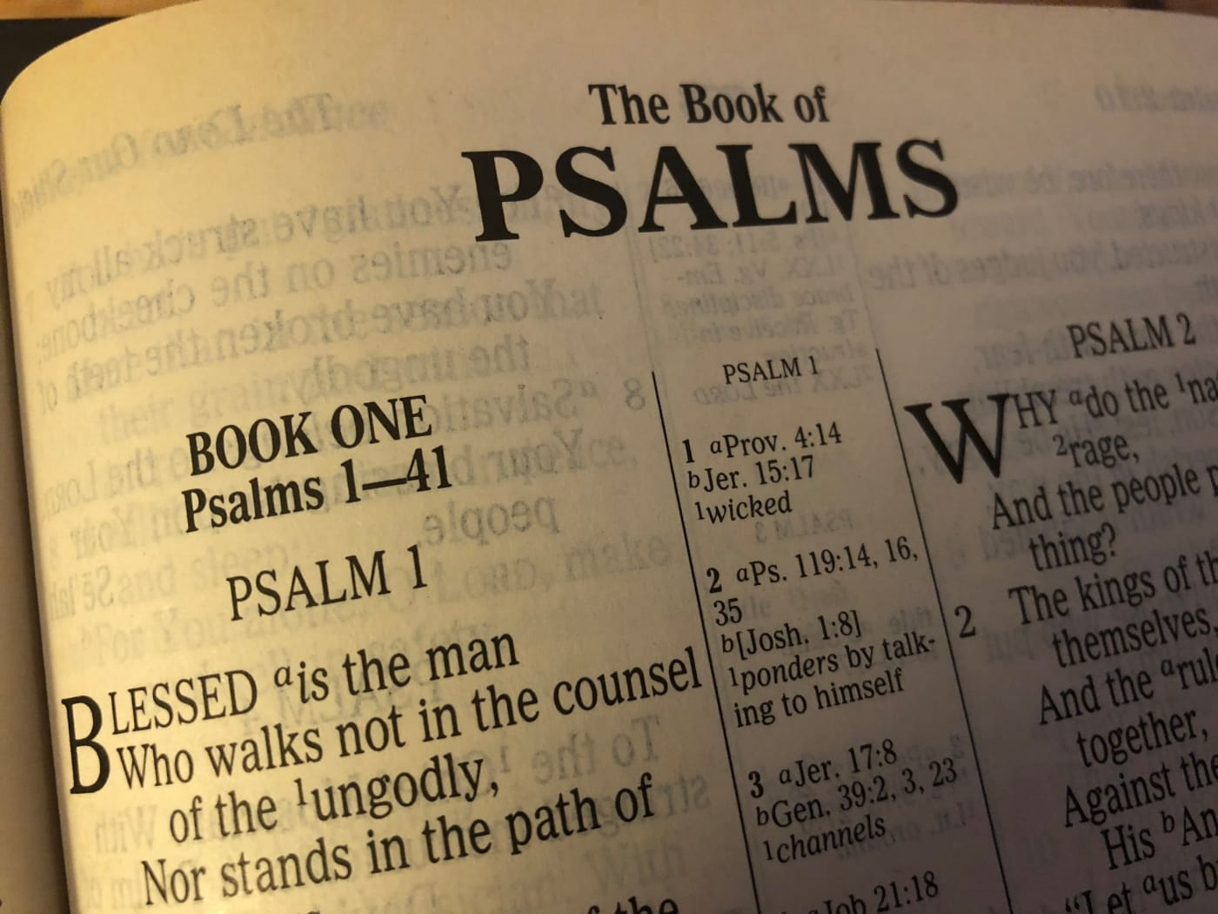
I Must Spend Time With Other Christians
1:1 1 Blessed is the man Who walks not in the counsel of the ungodly, Nor stands in the path of sinners, Nor sits in the seat of the scornful;

Slide 3
I Must Spend Time With Other Christians
12:26 ²⁶ The righteous should choose his friends carefully, For the way of the wicked leads them astray.

Slide 4
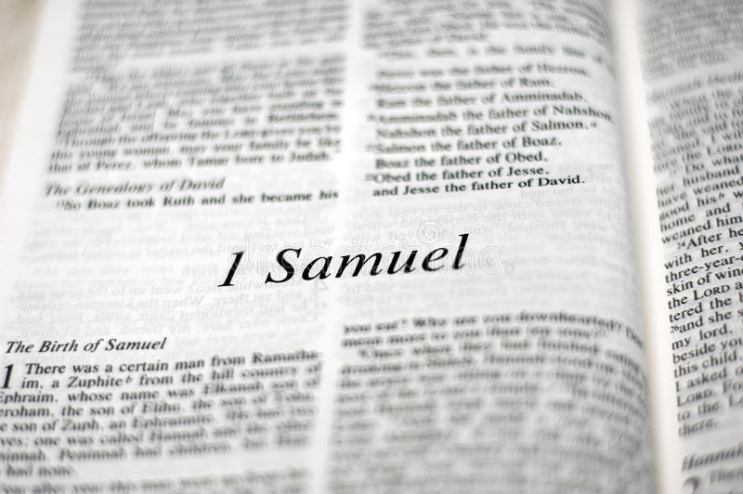
I Must Spend Time With Other Christians
23:16 ¹⁶ Then Jonathan, Saul’s son, arose and went to David in the woods and strengthened his hand in God.

Slide 5
I Must Spend Time With Other Christians
2:42 ⁴² And they continued steadfastly in the apostles’ doctrine and fellowship, in the breaking of bread, and in prayers.

Slide 6
I Must Spend Time With Other Christians
2:46 ⁴⁶ So continuing daily with one accord in the temple, and breaking bread from house to house, they ate their food with gladness and simplicity of heart,

Slide 7
I Must Spend Time With Other Christians
15:33 ³³ Do not be deceived: “Evil company corrupts good habits.”

Slide 8
I Must Spend Time With Other Christians
3:12 ¹² Beware, brethren, lest there be in any of you an evil heart of unbelief in departing from the living God;

Slide 9
I Must Spend Time With Other Christians
3:13 ¹³ but exhort one another daily, while it is called “Today,” lest any of you be hardened through the deceitfulness of sin.

Slide 10
I Must Spend Time With Other Christians
10:24 ²⁴ And let us consider one another in order to stir up love and good works,

Slide 11
I Must Spend Time With Other Christians
10:25 ²⁵ not forsaking the assembling of ourselves together, as is the manner of some, but exhorting one another, and so much the more as you see the Day approaching.

Slide 12
I Must Spend Time in Prayer
59:1 59 Behold, the Lord’s hand is not shortened, That it cannot save; Nor His ear heavy, That it cannot hear.

Slide 13
I Must Spend Time in Prayer
59:2 ² But your iniquities have separated you from your God; And your sins have hidden His face from you, So that He will not hear.

Slide 14
I Must Spend Time in Prayer
15:8 ⁸ The sacrifice of the wicked is an abomination to the Lord, But the prayer of the upright is His delight.

Slide 15
I Must Spend Time in Prayer
Jn 9:31 ³¹ Now we know that God does not hear sinners; but if anyone is a worshiper of God and does His will, He hears him.

Slide 16
I Must Spend Time in Prayer
1 Pet 3:12 For the eyes of the Lord are on the righteous, And His ears are open to their prayers; But the face of the Lord is against those who do evil.

Slide 17
I Must Spend Time in Prayer

Slide 18
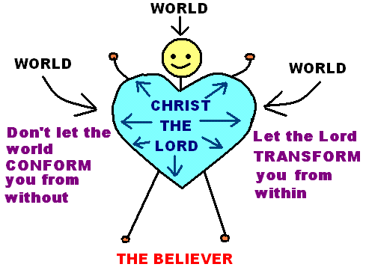
I Must Continue to Live a Moral Life

Slide 19
I Must Seek Forgiveness When I Stumble
1 Jn 1:8-9 ⁸ If we say that we have no sin, we deceive ourselves, and the truth is not in us. ⁹ If we confess our sins, He is faithful and just to forgive us our sins and to cleanse us from all unrighteousness.

Slide 20
I Must Seek Forgiveness When I Stumble
1 Jn 1:10 ¹⁰ If we say that we have not sinned, we make Him a liar, and His word is not in us.

Slide 21
I Must Seek Forgiveness When I Stumble
1 Jn 2:1 2 My little children, these things I write to you, so that you may not sin. And if anyone sins, we have an Advocate with the Father, Jesus Christ the righteous.

Slide 22
I Must Seek Forgiveness When I Stumble
1 Jn 2:2 ² And He Himself is the propitiation for our sins, and not for ours only but also for the whole world.

Slide 23
I Have Work to Do

Slide 24
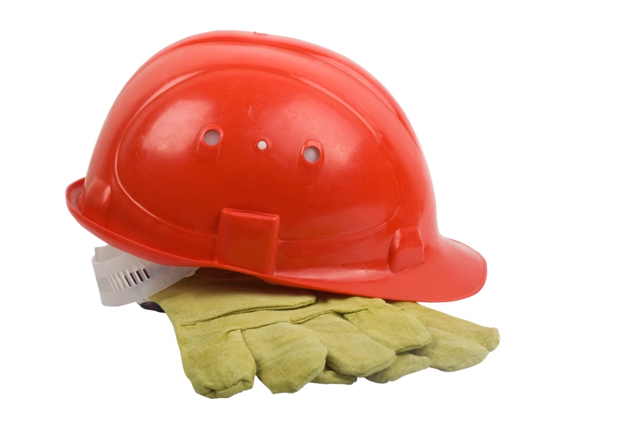
I Have Work to Do
1 Cor 15:58 ⁵⁸ Therefore, my beloved brethren, be steadfast, immovable, always abounding in the work of the Lord, knowing that your labor is not in vain in the Lord.

Slide 25
I’ve been baptized…Now what?
I have been saved and I live for God

